Slide 1
Welcome to today’s workshop
Ensuring support and challenge for all students in mixed attainment classes
Helen Hindle
@helenhindle1
@mixedattainmen1
www.mixedattainmentmaths.com
hhindle@parkview.haringey.sch.uk

Slide 2



Slide 3
The misallocation of students to academic sets in maths
By Becky Taylor, on 21 June 2019
Findings from the BEST PRACTICE IN GROUPING STUDENTS Research ucl
@GroupingStudy @BeckyFrancis7
Black students were 2.43 times more likely than White students to be allocated to a lower maths set.
Asian students were 1.65 times more likely than White students to be allocated to a lower maths set.
Female students were 1.53 times more likely than males to be allocated to a lower maths set.

Slide 4


Slide 5
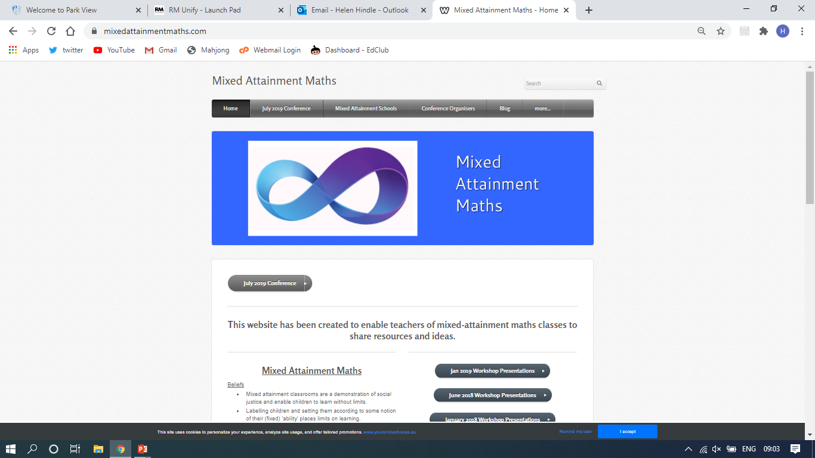

Slide 6
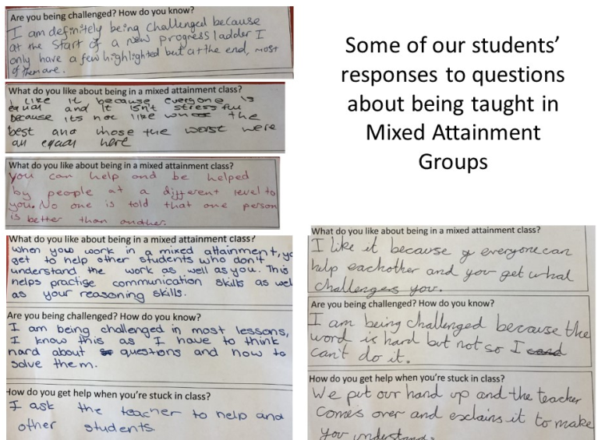

Slide 7
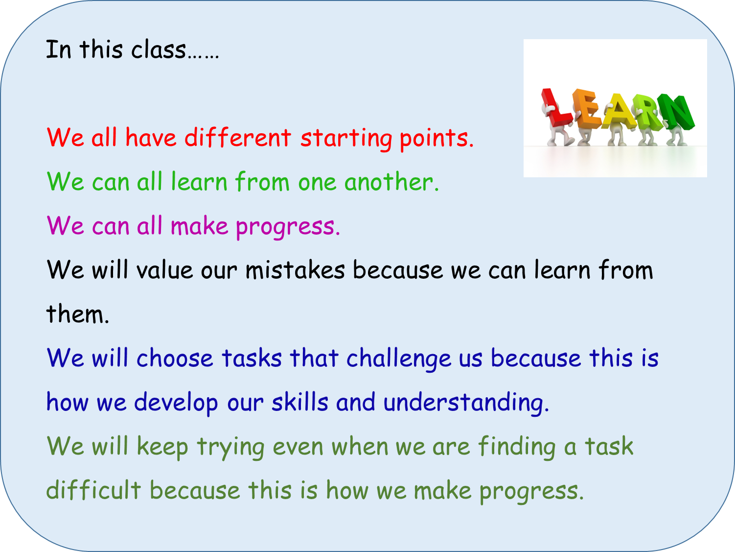
Changing the culture of the classroom…..
Notes:
This is a sticker that goes on the front of our pupils’ exercise books.

Slide 8
GCSE Sequences | a) I can draw the next two patterns in a sequence. HM 196 b) I can find the next two terms in a sequence. HM 197 | c) I can find a term to term rule for a linear sequence. (Describe a sequence in words.) HM 197 d) I can generate terms of a sequence from a term to term rule. HM 197 e) I recognise and I can use sequences of triangular, square and cube numbers, simple arithmetic progressions, and other sequences. HM 261, 262, 263 | f) I can find a position to term rule for a linear sequence and explain how I worked it out. HM 198 g) I can generate terms of a linear sequence from a position-to-term rule and decide whether a number is a term in a sequence. HM 198 h) I understand the difference between a linear sequence and a quadratic sequence. HM 247 | I) I can find the next two terms of a quadratic sequence. HM 249 & 250 j) I can generate terms of a quadratic sequence from a position to term rule and decide whether a number is a term in a sequence. HM 249 & 250 | k) I can find a position to term rule for a quadratic sequence. HM 248 l) I recognise and can use simple geometric progressions (r^{n} where n is an integer, and r is a rational number > 0 or a surd). HM 264
Notes:
Print slides 1-4, four to a page.

Slide 9
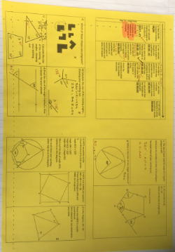
Learning Journey

Slide 10
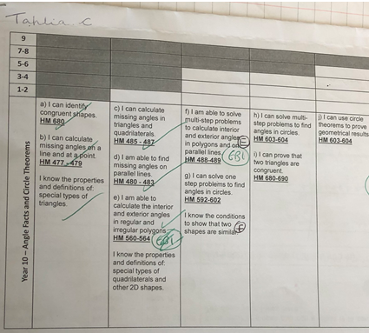

Slide 11
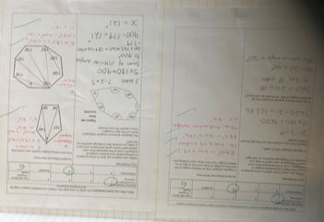
Focus on new skills learnt.

Slide 12
Differentiation is essential to the meet the diverse needs of all the learners in the class.
Differentiation involves a range of techniques, strategies and organisational options.

Slide 13
Differentiation by ………
Task - Pupils work on different tasks / worksheets with the lesson.
Support - Some pupils may work with a teaching assistant
Questioning - Bringing all students in a class into a question and answer exchange.. adjusting the level of questioning to the student in a subtle way.
Explanation - Pupils receive different teacher input at different times throughout the lesson.
Outcome - The same stimulus leads to open ended responses. (‘Multiple Entry Point Tasks’ )
Expectation - There are various learning goals that are shared with pupils. Pupils are taught how to and encouraged to self select the appropriate learning goal, for example through reference to a learning journey.

Slide 14
Discuss
Do you use anything similar?
How do you differentiate?

Slide 15
Open Starters / Do Now
Lead to a class discussion
Explanations come from the pupils
Link to the main activity / task.

Slide 16
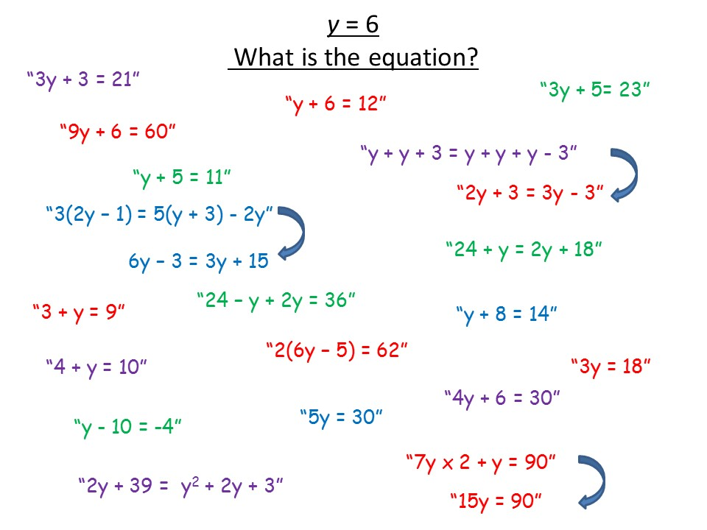
Notes:
Example of an open starter activity, with pupils’ responses.

Slide 17
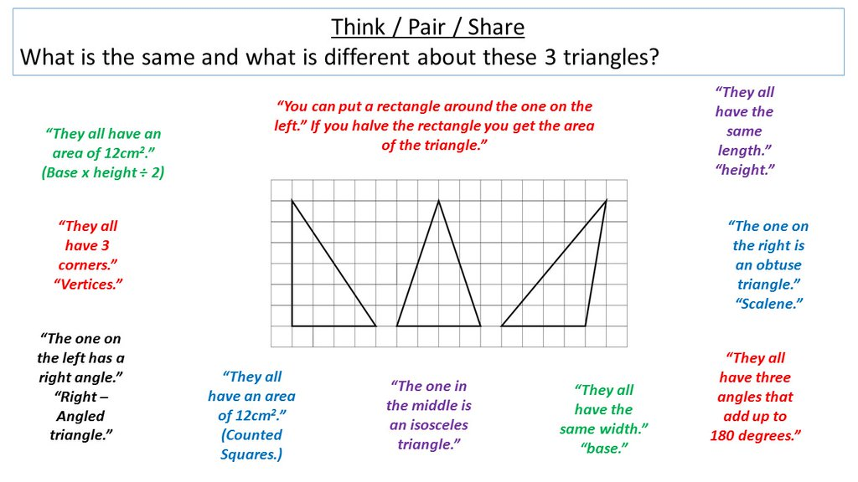
Notes:
Example of an open starter activity, with pupils’ responses.

Slide 18
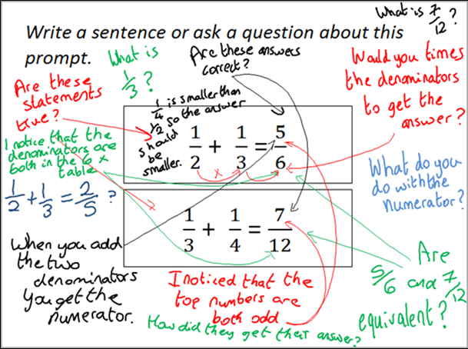
Notes:
Example of an Inquiry Prompt, with pupils’ responses. See www.inquirymaths.org

Slide 19
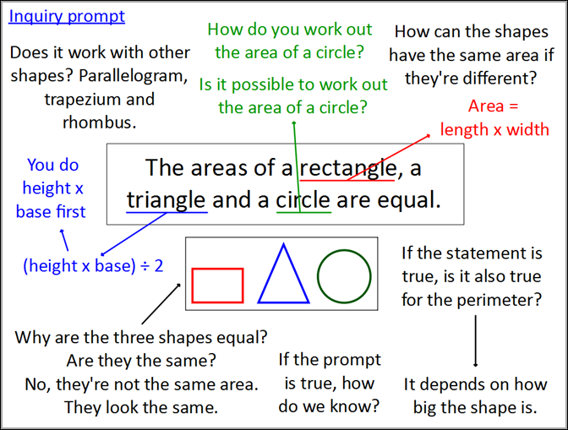
Notes:
Example of an Inquiry Prompt, with pupils’ responses. See www.inquirymaths.org

Slide 20
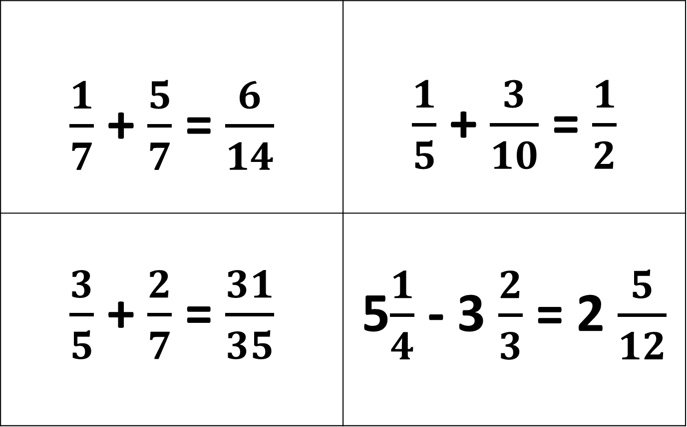
True or False? – Convince Me
$\frac{1}{7}$ + $\frac{5}{7}$ = $\frac{6}{14}$ | $\frac{1}{5}$ + $\frac{3}{10}$ = $\frac{1}{2}$
$\frac{3}{5}$ + $\frac{2}{7}$ = $\frac{31}{35}$ | 5$\frac{1}{4}$ - 3 $\frac{2}{3}$ = 2 $\frac{5}{12}$
Notes:
Example of an open starter activity.

Slide 21
Which is the odd one out?
You must give a reason for your answer.
6
3
2
4
6
3
2
2
14
Notes:
Example of an open starter activity

Slide 22
Ask a question – make a comment starter activities.
What questions might pupils ask?
What conjectures might they make?
What explanations might they offer?
What misconceptions might they reveal?
Notes:
10 minutes

Slide 23
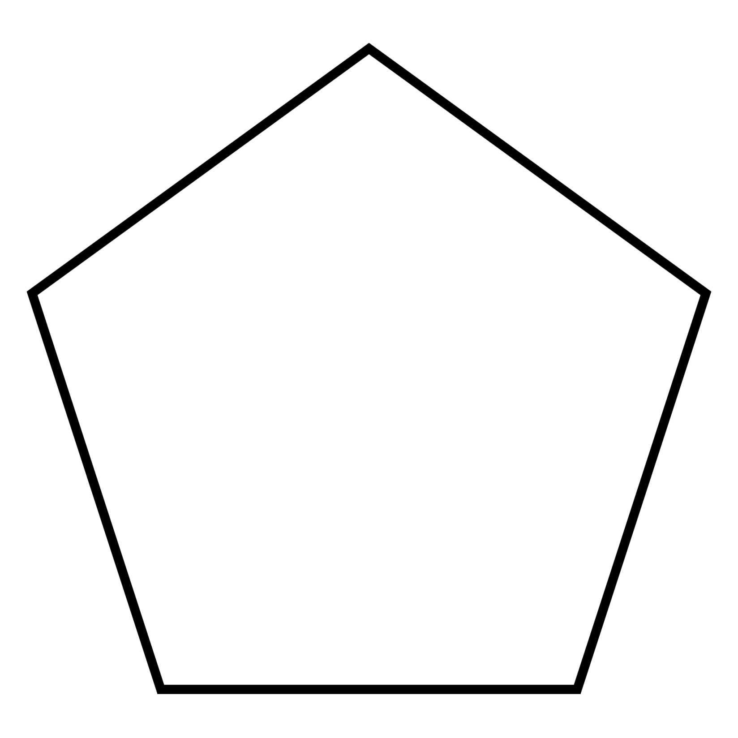
Make a comment or ask a question.

Slide 24
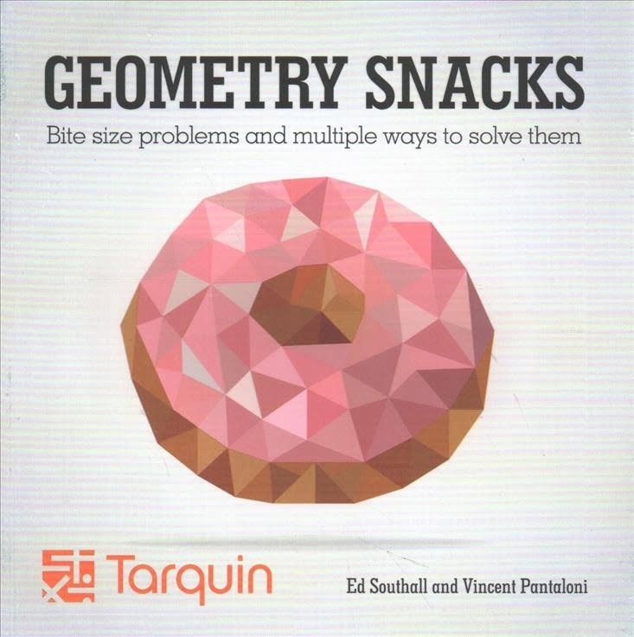
This is a regular pentagon, find the value of the missing angle.

Slide 25
Differentiated Tasks Discussion
Which is the most Effective?
Which has the greatest depth of Maths?
Which is the most Open?
What further adaptions might you make?
What concrete resources might you use?

Slide 26
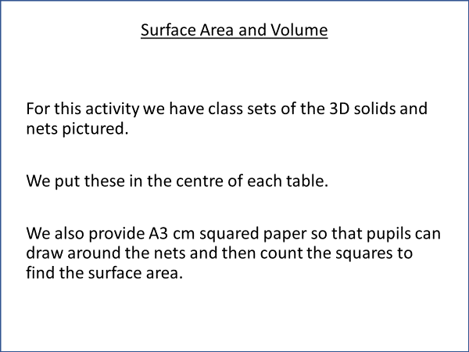
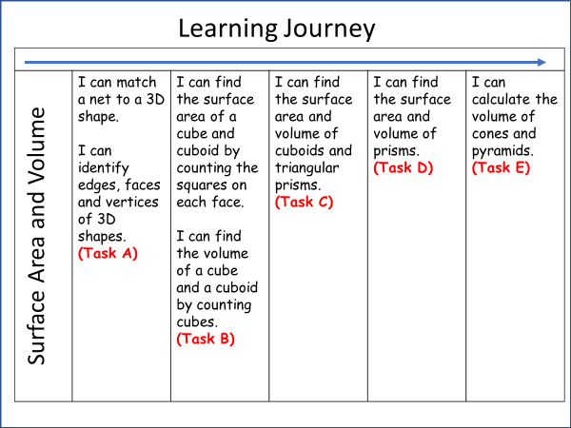
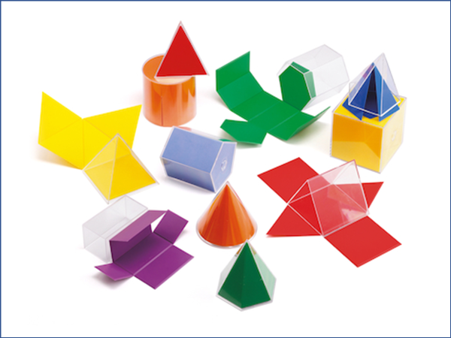
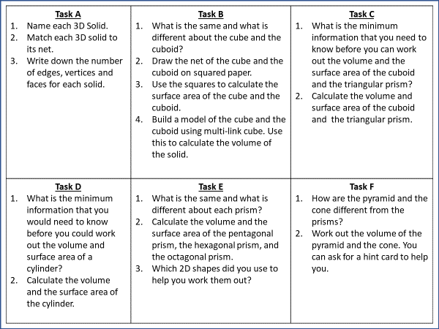
Notes:
Example of a differentiated main activity.

Slide 27


Slide 30
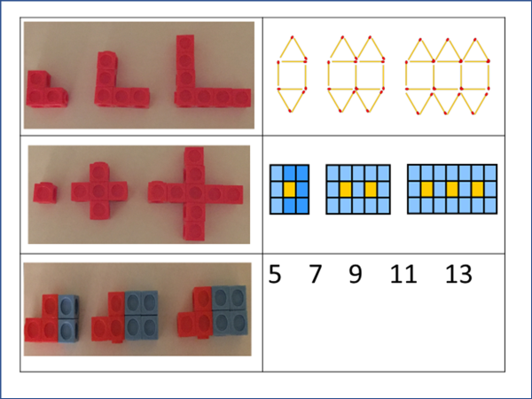
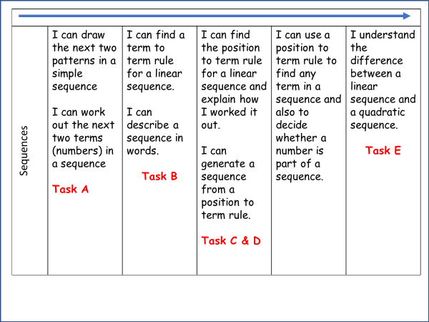
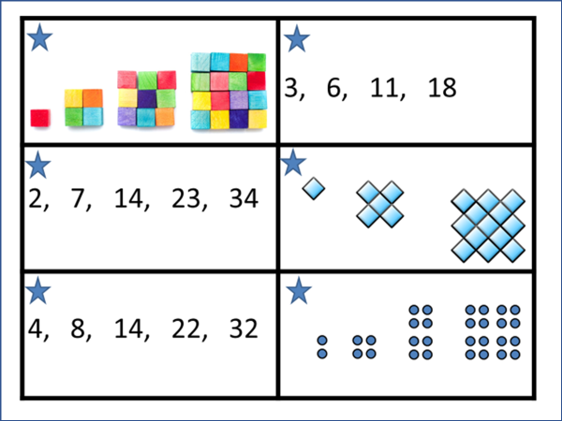
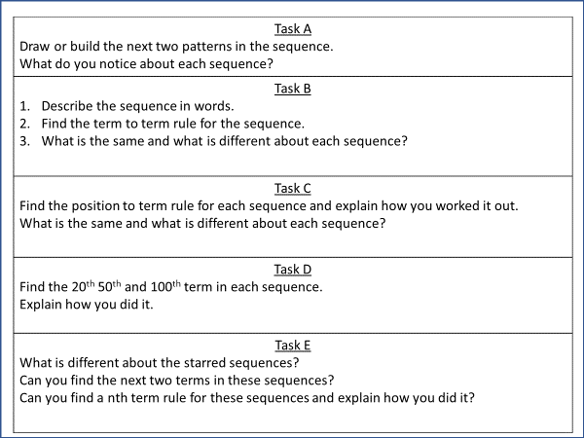
Notes:
Example of a differentiated main activity.

Slide 34
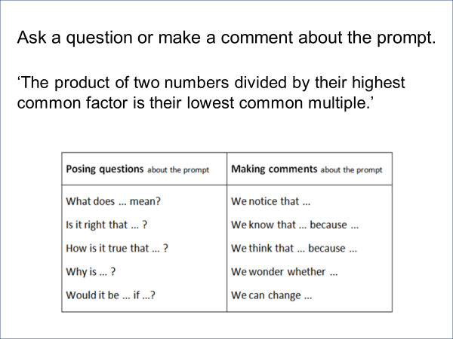
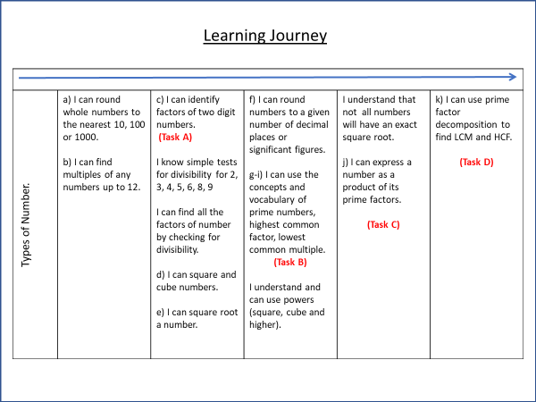
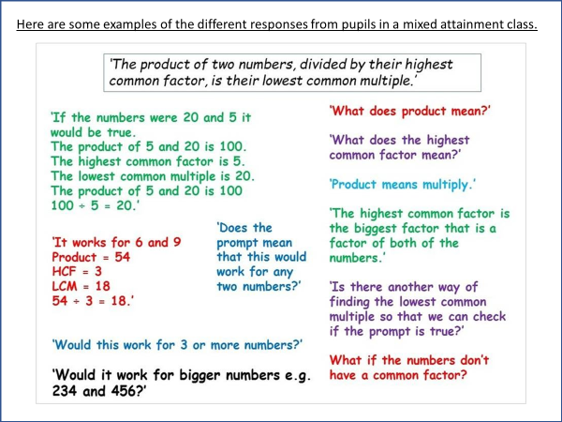
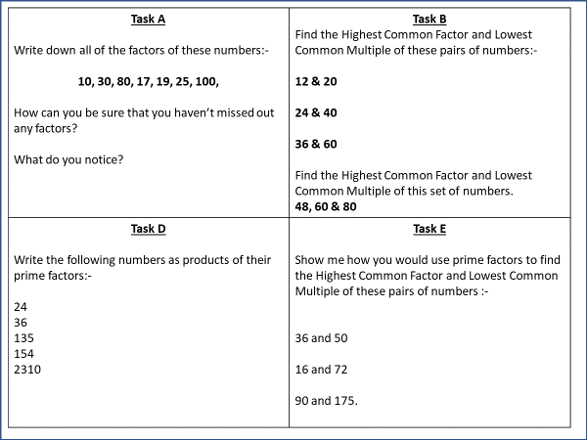
Notes:
Example of a differentiated main activity.

Slide 38
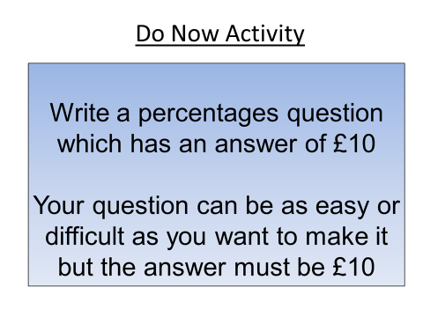
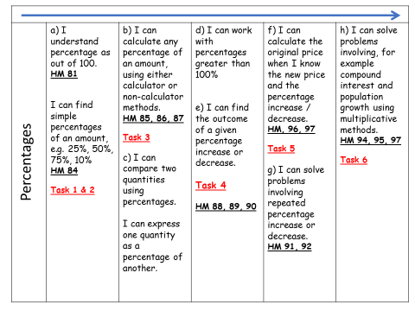

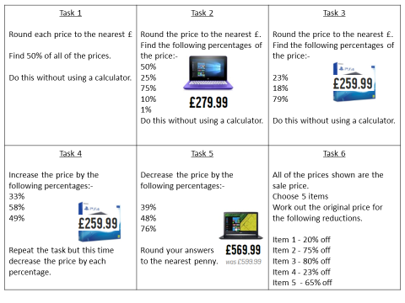

Slide 39
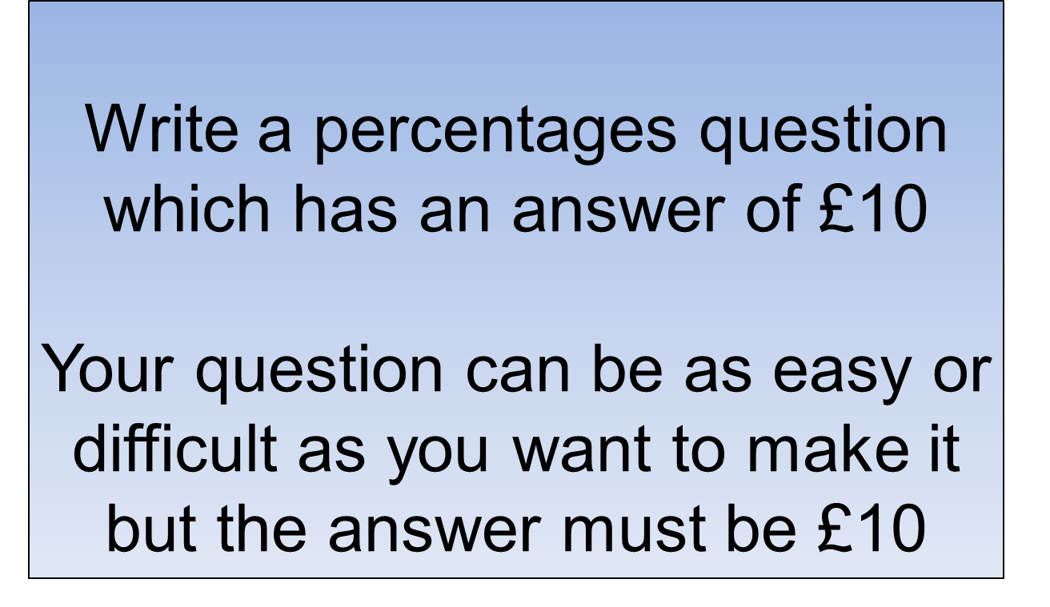
Do Now Activity

Slide 40
Percentages | a) I understand percentage as out of 100. HM 81 I can find simple percentages of an amount, e.g. 25%, 50%, 75%, 10% HM 84 Task 1 & 2 | b) I can calculate any percentage of an amount, using either calculator or non-calculator methods. HM 85, 86, 87 Task 3 c) I can compare two quantities using percentages. I can express one quantity as a percentage of another. | d) I can work with percentages greater than 100% e) I can find the outcome of a given percentage increase or decrease. Task 4 HM 88, 89, 90 | f) I can calculate the original price when I know the new price and the percentage increase / decrease. HM, 96, 97 Task 5 g) I can solve problems involving repeated percentage increase or decrease. HM 91, 92 | h) I can solve problems involving, for example compound interest and population growth using multiplicative methods. HM 94, 95, 97 Task 6
Notes:
Print this slide and the next slide two to a page and give to pupils to glue into their books. These should be printed to colour paper so that pupils can easily find them in their books. Pupils should be referring to these in most lessons.

Slide 41









































These are all real prices from the technology section of the Argos catalogue.

Slide 42





Task 1 Round each price to the nearest £ Find 50% of all of the prices. Do this without using a calculator. | Task 2 Round the price to the nearest £. Find the following percentages of the price:- 50% 25% 75% 10% 1% Do this without using a calculator. | Task 3 Round the price to the nearest £. Find the following percentages of the price:- 23% 18% 79% Do this without using a calculator.
Task 4 Increase the price by the following percentages:- 33% 58% 49% Repeat the task but this time decrease the price by each percentage. | Task 5 Decrease the price by the following percentages:- 39% 48% 76% Round your answers to the nearest penny. | Task 6 All of the prices shown are the sale price. Choose 5 items Work out the original price for the following reductions. Item 1 - 20% off Item 2 - 75% off Item 3 - 80% off Item 4 - 23% off Item 5 - 65% off

Slide 43
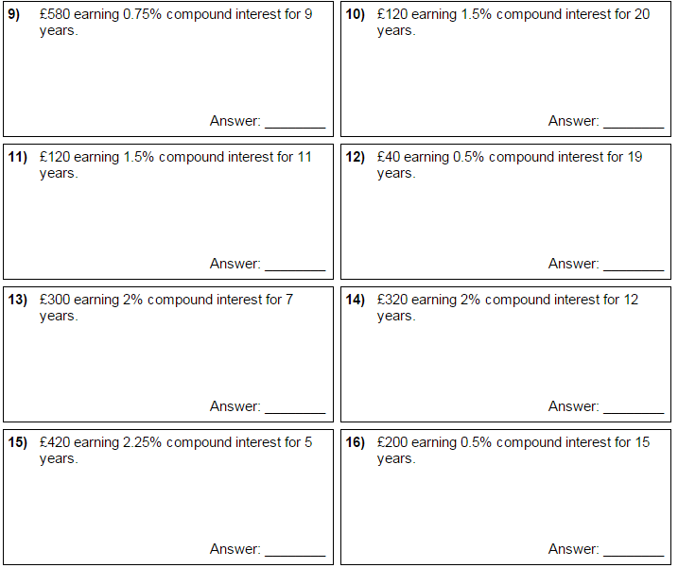
Task 7: Compound interest

Slide 44
All pupils must have access to the full range of differentiated tasks
Pupils must be given the opportunity to select the appropriate task for themselves (the teacher should re-direct when necessary.)
Pupils should be aware that every lesson they should be engaged in a task which challenges them but which is also achievable
Pupils should be given frequent opportunities to reflect on their learning / progress against their learning journey.

Slide 45
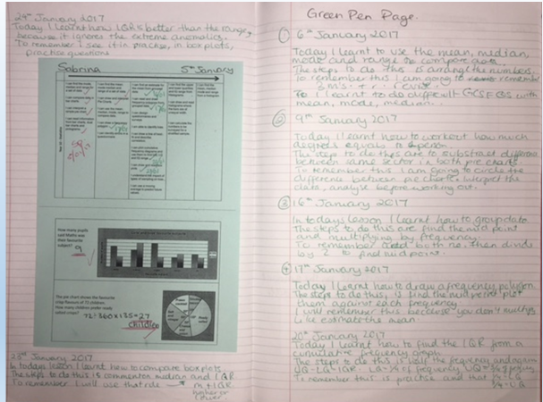
Student Reflection
Notes:
Example of a strategy for student reflection.

Slide 46
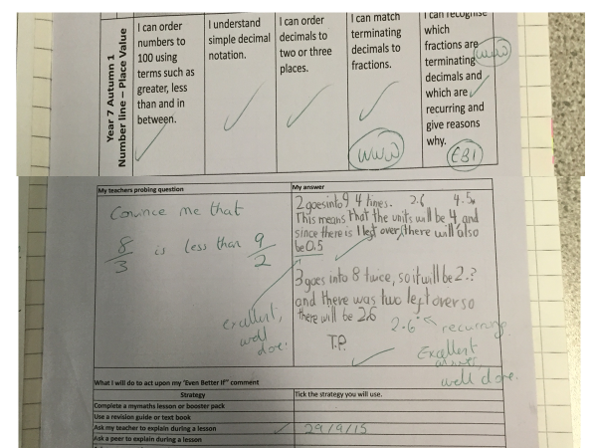
Notes:
Setting a challenge question after marking an assessment.

Slide 47
GREEN PEN REFLECTION
Today I learned…
The steps to do this are…
To remember this I will… or I need to remember to….
Notes:
Example of a strategy for student reflection.

Slide 48
Notes To Myself – Directed Number
Name:
Adding positives | Adding negatives | Subtracting positives
Subtracting negatives | Multiplying negatives | Dividing negatives
Notes:
From Gareth Evans @MrE_Maths . Gareth has an excellent website garethevansmaths.wordpress.com

Slide 49
Notes:
From Gareth Evans @MrE_Maths . Gareth has an excellent website garethevansmaths.wordpress.com

Slide 50
Notes:
From Gareth Evans @MrE_Maths . Gareth has an excellent website garethevansmaths.wordpress.com

Slide 51
Colour in the arrow, up to the statement which best describes your current understanding.
 | I’m so confident - I could explain this to someone else!
 | I can get to the right answer but I don’t understand well enough to explain it yet.
 | I understand some of this but I don’t understand all of it yet.
 | I tried hard and I listened but I am finding this challenging. I will make sure that I get help with this next lesson.
 | I do not understand any of this yet. There are things I could do to be a better learner next lesson.
Notes:
Example of a strategy for student reflection.

Slide 52
My Favourite MISTAKES
Means
I
Start
To
Acquire
Knowledge
Experience
Skills
A mistake that moved my learning on……
Notes:
Example of a strategy for student reflection.

Slide 53
Tips I would give a friend to solve this problem are ......... | I have made a link between this topic and … | To help me move forward, when I got stuck today, I ….
Today I interacted with the teacher by …… | Today I am still unsure about ……………… To fill in this gap I intend to ………… | A barrier to my learning today was……….. I will try to overcome this by …..
Today I explained to ………. how to ………….. | Something I have learnt today about the way I learn is ……… | At home, I need to look at ………………
Notes:
Example of a strategy for student reflection.

Slide 54
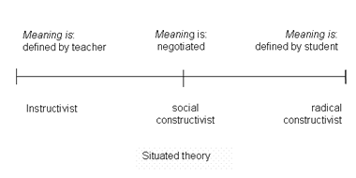
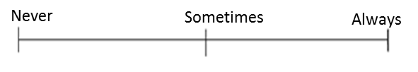
Which mindset did I demonstrate? | Mark each scale with an arrow.
Did I use whole class discussions / explanations as learning opportunities? (Did I listen? Did I ask questions? Did I contribute answers or make suggestions?)
Did I work on tasks that challenged me?
Did I use strategies to ‘un-stick’ myself when I found the tasks difficult?
Did I check my work for mistakes and correct them?
Did I put as much effort as I possibly could into the tasks?
Never
Sometimes
Always
Notes:
Example of a strategy for student reflection.

Slide 55
Progress Pyramid
One question I would like answered…
Two things I am not sure about yet….
Three things I understand well enough to explain to someone else…
Notes:
Example of a strategy for student reflection.

Slide 56
I am really pleased with...
Today I have tried to...
To progress I need to...
Today I have learned that...
In these questions I have learnt that…
I have been able to…
But I got stuck on...
Self Reflection
Before this lesson I could already...
Now I can also...
One thing I need to remember from today’s lesson is...
I was successful when I…
I did not know how to…
But now I can…
The most important thing I learned today is...
I can see the link between...
Notes:
Example of a strategy for student reflection.

Slide 57
Set high expectations and encourage
Challenge
Collaboration
Choice

