Slide 1
Teaching & learning trigonometry with KS4 all-attainment groups: an exploration on a coordinate grid

Slide 2
To begin to make sense of trigonometry students need to have fluency with the following first principles:

Slide 3
A line of length 1 can be divided into decimal parts, 0, 0.1, 0.2, 0.3... 1

Slide 4
Angle is a measure of turn

Slide 5
How to read co-ordinates

Slide 6
Each of these concepts are taught in primary schools from Y3 or Y4

Slide 7
Exploring the co-ordinates of a Rotating Arm of length 1

Slide 8
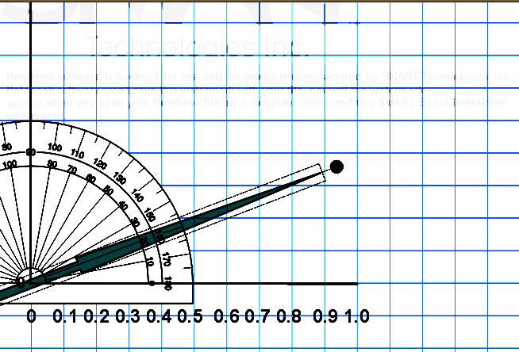
0.8
0.7
0.6
( , )

Slide 9
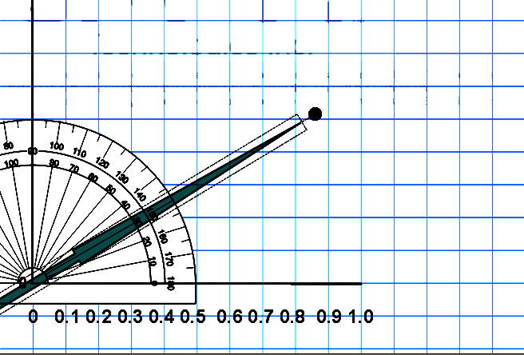
0.8
0.7
0.6
( , )

Slide 10
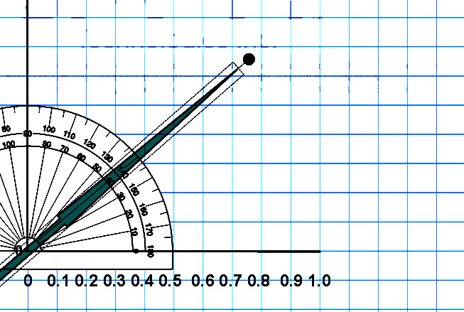
0.8
0.7
( , )
0.6

Slide 11
Estimate x and y ordinates for angles from 0° to 90° to 2-decimal places

Slide 12
Angle | x-ordinate | y-ordinate
0⁰
10⁰
20⁰
30⁰
40⁰
50⁰
60⁰
70⁰
80⁰
90⁰

Slide 13
Students discussing and writing about what they notice – leading to journal writing; creating a record of achievement.

Slide 14
- looking for patterns - making conjectures - seeking generality

Slide 15
Further questions could be...

Slide 17
At what angle are
the x and y
ordinates the same?

Slide 18
From your data make estimates of angles such as 37⁰, 64⁰, etc.

Slide 19
What will the co-ordinates be for 100°? 140°, 230°… 400°?

Slide 20
Using sin and cos keys to check how close, rounded to 2-decimal places, their original estimated measures were for the x and y ordinates...

Slide 21
The last time I used this approach (April 2017) some pairs of students drew graphs of angles (from 0⁰ to 450⁰) against x ordinates followed by angles against y ordinates

