Slide 1
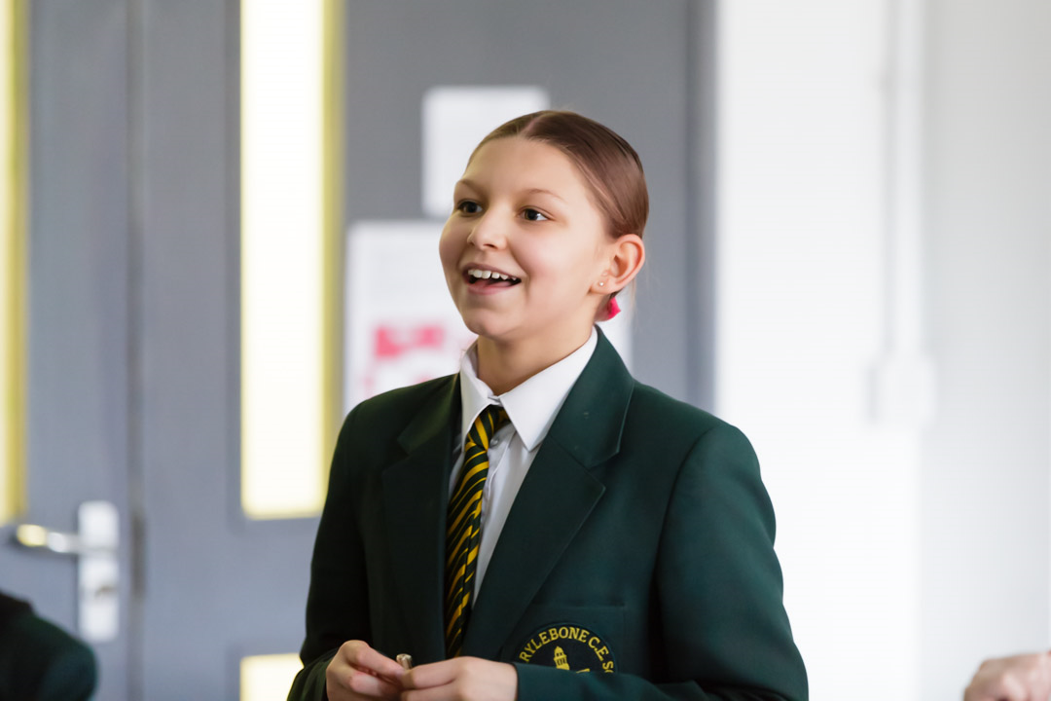
Teaching for Mastery in a mixed attainment setting
Megan Bailey, KS3 Coordinator St. Marylebone CE School
Secondary Mastery Lead: London Central and North West Maths Hub

Slide 2
Starter
 + 17 = 15 + 24
99 –  = 90 – 59
25 x 16 x 125 =
0.62 x 37.5 + 3.75 x 3.8 =
Consider the strategies you use

Slide 3
To a large extent, the set a pupil is placed in determines the mathematics he/she will encounter and potentially caps what he/she might attain.
Moving up a set becomes increasingly difficult as pupils progress through the school due to higher sets’ more extensive mathematical knowledge and skills.
Mathematics: made to measure
22 May 2012, OFSTED
Ref: 110159

Slide 4
What is ‘Mastery’
What it is?
2. What is isn’t?

Slide 5
What is Mastery?
A mastery approach; a set of principles and beliefs.​
A mastery curriculum.​
Teaching for mastery: a set of pedagogic practices.​

Slide 6
Essence of Mastery
All pupils can succeed.​
Whole-class interactive teaching, where the focus is on all pupils working together on the same lesson content at the same time. ​
Lesson design focuses on small steps through a carefully sequenced learning journey. ​
Typical lesson content includes questioning, short tasks, explanation, demonstration, and discussion. ​
Procedural fluency and conceptual understanding are developed in tandem through intelligent practice.​
Significant time is spent developing deep knowledge of the key ideas needed to underpin future learning.
​

Slide 7
Teaching for Mastery
Mastery means that learning is sufficiently:​
Embedded​
Deep​
Connected​
Fluent​
In order for it to be:​
Sustained​
Built upon​
Connected to ​
Just good teaching!

Slide 8
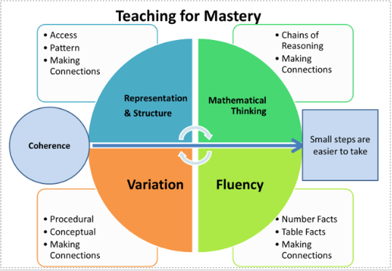

Slide 9
The Challenge of mixed attainment
At any point in time, different learners:
Will proceed at different rates
Will have different prior skills and concepts to call upon

Slide 10
What is differentiation?
What is it? What it is not?

Slide 11
When we present a collection of examples or exercises related to some mathematical idea to our pupils what do we want them to be looking for?
What do we want them to pay attention to?

Slide 12
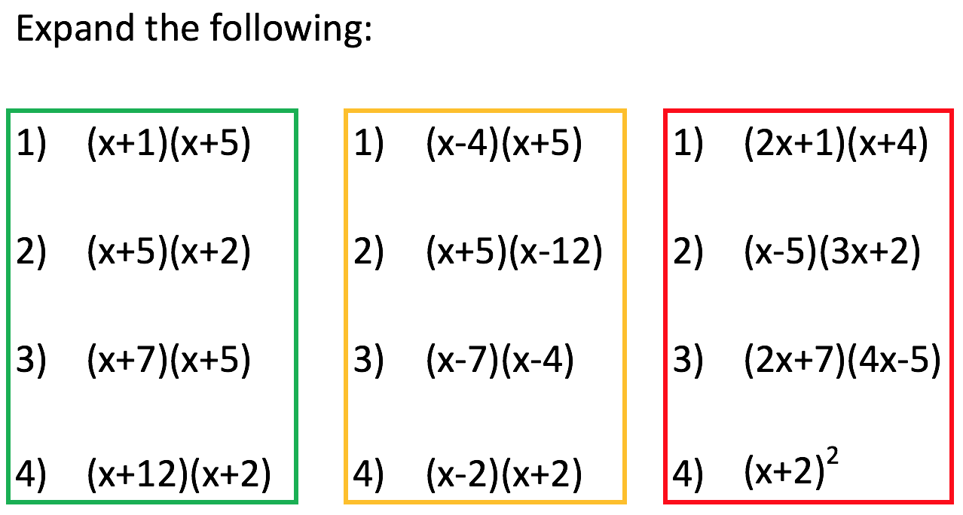
Repetition – “just a process”

Slide 13
Repetition – “just a process”
What is it not?

Slide 14
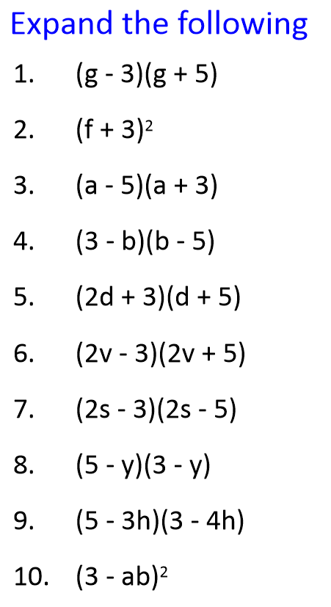
Is this an example of differentiation?

Slide 15
Variation
Variation is not the same as variety – careful attention needs to be paid to what aspects are being varied (and what is not being varied) and for what purpose.

Slide 16
Is this an example of differentiation?

Slide 17
Fluency

Slide 18
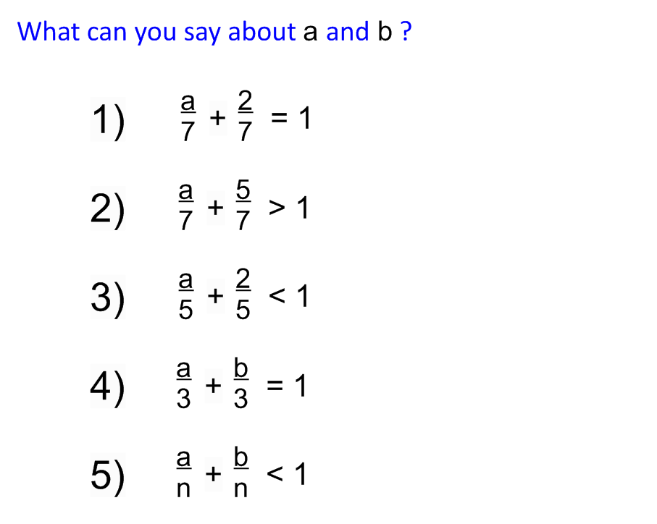
Desirable difficulties
Triggers encoding and retrieval process that supports learning comprehension and remembering.

Slide 19
Variation
Provides the opportunity
for practice (intelligent rather than mechanical);
to focus on relationships, not just the procedure;
to make connections between problems;
to use one problem to work out the next;
to create other examples of their own.

Slide 20
How many ways can you answer this question?
How would you expect your students to answer this question?

Slide 21
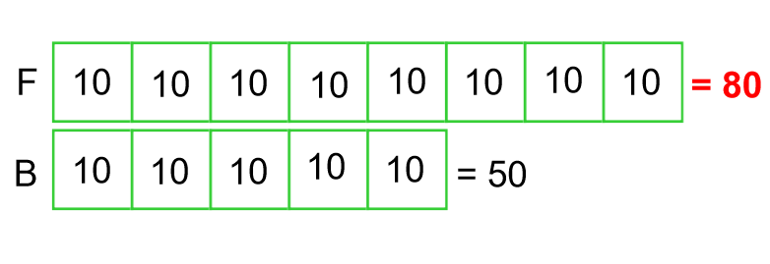

Slide 22
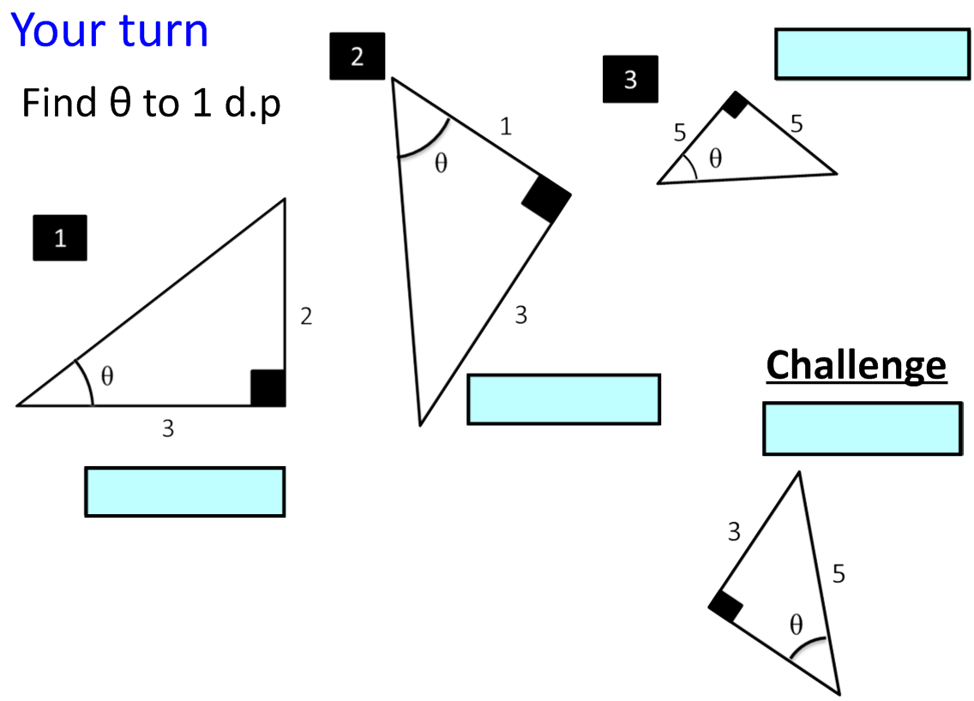
Non- Standard
Standard
Non- Standard
Non- Standard
Finding missing angles using the tan ratio only

Slide 23
What do you want different students to attend to?
1) The yellow area is 16cm²
(a) What’s the perimeter of the yellow section?
(b) What’s the perimeter of the grey section?
Explain your reasoning.
2) Using π as 3.14 gives the grey area as 150.72cm²
(a) What’s the perimeter of the yellow section?
(b) What’s the perimeter of the grey section?
Explain your reasoning.

Slide 25
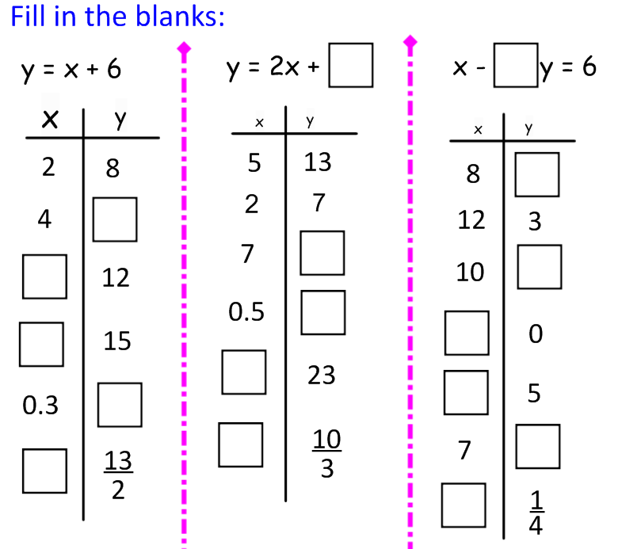

Slide 26
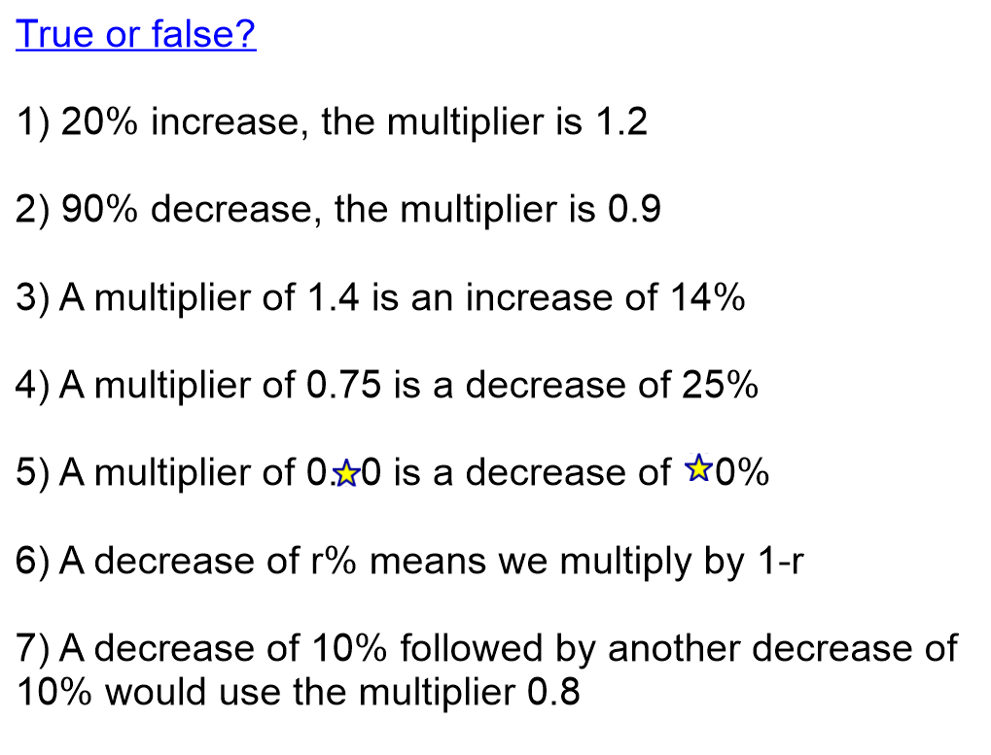

Slide 27
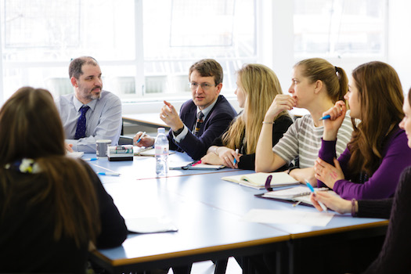
Collaborative Planning
“Discussion of misconceptions”
“Quality of questioning”
“Consistency”
“Planning for depth”
“Drawing on experience”
“Effective CPD”
“Talking about Maths!”

