Slide 1




MAM Conference Summer 2022
Centre for Research in Mathematics Education
Mark.simmons@nottingham.ac.uk
@simmo1363

Slide 2

Poor little Scrumbugs! What can we do?

Slide 3
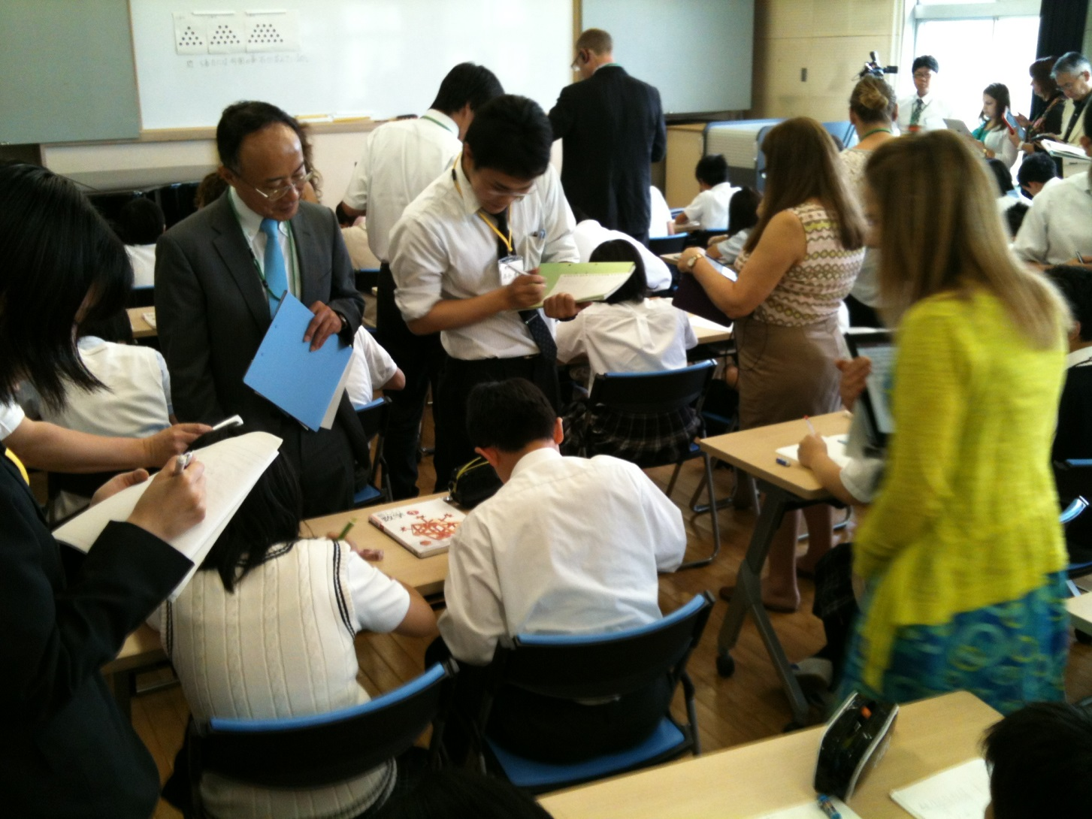
Professional learning:
The potential of lesson study

Slide 4
Overview
Lesson study: why? what? how? Remember L3?
Lesson study in Japan: focussing on concept development
Lesson study in England: focussing on TMMAG and...

Slide 5


International studies:
Lesson Study: why (the interest)?
PISA & TIMSS
The Teaching Gap:
The best ideas from the world’s teachers for improving education in the classroom
Stigler & Hiebert (1999)

Slide 6
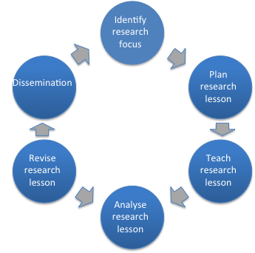
Lesson Study: what? how?
Lesson Study provides for school-based professional learning of both individual teachers and departments.
In Japan it is long-established and has high status with schools drawing on specialist subject expertise often from university-based colleagues

Slide 7
Lesson Study process:
Identify research focus
Research focus often linked to a whole-school focus
Plan research lesson
Dissemination
Revise research lesson
Teach research lesson
Analyse research lesson

Slide 8
Lesson Study process:
Identify research focus
Joint planning with shared ownership
Japan – focus on concept development
England- how can all make progress in TMMAG?
Plan research lesson
Dissemination
Revise research lesson
Teach research lesson
Analyse research lesson

Slide 9
Lesson Study process:
Identify research focus
Class teacher teaches lesson in line with plan
Other teachers observe students’ learning without interfering (make notes, photograph students’ work)
Plan research lesson
Dissemination
Revise research lesson
Teach research lesson
Analyse research lesson

Slide 10
Lesson Study process:
Identify research focus
Post-lesson discussion focussed on research question
Key roles:
Chair
Koshi – knowledgeable other
Plan research lesson
Dissemination
Revise research lesson
Teach research lesson
Analyse research lesson

Slide 11
Lesson Study process:
Identify research focus
Teachers refine their lesson in line with their ‘research findings’ and may disseminate this more widely
Plan research lesson
Dissemination
Revise research lesson
Teach research lesson
Analyse research lesson

Slide 12
#TMMAG Lesson Study Cycle, March 2022
Our Process:
RQ always 'How Can All Learners Make Progress in a #TMMAG classroom
Pre-lesson: Group quiz Tom on his lesson design
Lesson observation: 10 teachers (2 kids each)
Post-Lesson Discussion: What we saw/heard/thought
Have you ever tried CPD through Lesson Study? Could it work?

Slide 13
TMMAG Video resources (Pre-edit)
Ade filmmaker has produced three rough-cut films so far.
What are the BIG Qs people want answered?
What four films should we make? Which must-see moments?
How could you use these films for dept. CPD?

Slide 14
TMMAG 2-side guide
As a group we tried to compress our understandings onto 2 sides of A4
What might we alter?
How could the guide be used?

Slide 15
TMMAG Video resources (Pre-edit)
Videos from Aldw Wh March 22
Password: Maths4All
Nottm TMMAG 2-side guide.docx

Slide 16

HAPPY SUMMER!!

Slide 17
Teach Algebra like.....
https://gridalgebra.com/welcome
Have a play – I really rate this!

Slide 18
Key Findings (some are only guesses): Meaning of Lg & AfL
Being mathematical ≠ Being fast, being correct....
It is NOT about Answers (often given by T early) but..
It IS about processes: There are lots of WAYS to be right
Collaborative, problem-solving, reasoning, checking. Struggle and mistakes
Progress and self-comparison NOT levels and other-comparison
Pupil needs to U own starting point (AfL) and take resp. for task choices.
We can check with each other (Brain, book <-> buddy, boss)

Slide 19
Key Findings (some are only guesses) Learning via Dialogue
Dialogue – exploratory talk (rules and training essential)
I will explain/ask, ABCJ
I can explain=> I Understand
T records many Kids' words as they work/answer - gives all starting pts for talk & validates each one's thinking.
Incorrect As open up discussions – we can spot wrongness as we reason/talk/think :. value these
Concept-building via verbal reasoning

Slide 20
Key Findings (some are only guesses): Dialogue & Language
Language: Use, define, reason with, learn it (T contingently stops explaining terms, Kids critique lang use)
Vary visual examples (not only prototypical...example/non-example)
Rich Tasks – low threshold, high ceiling..
Diffn via kids' responses and communication
..and by the choices of task they make – we can educate these choices
Fluent, insightful role-models are heard from by all (Pairs/small groups may NOT contain extremes of Att. => enter ZPDs)

Slide 21
Key Findings contd (some are only guesses) Pedagogy contd
Collaborative exploration (esp of key (Anchor) tasks) slow, deep, reflective plenarising -> Framing Learning, Complex instruction, summarise, clarify, predict…compare Repns, U other P's methods
Uses mwbs a lot – less closedly, good routine necessary..
(good Q: why did I choose X's mwb?)

Slide 22
Key Findings contd (some are only guesses)
Teach to the TOP, scaffold at the bottom, Extn always available.
There will be floundering (but less despair –see CM’s data)
Teacher skill/agency/autonomy/prof Self Esteem enhanced?
Outliers benefit least academically (but socially...) Pros>Cons JH
Other ways are possible: Hindle (learning journeys) Blair (IBL)…

Slide 23
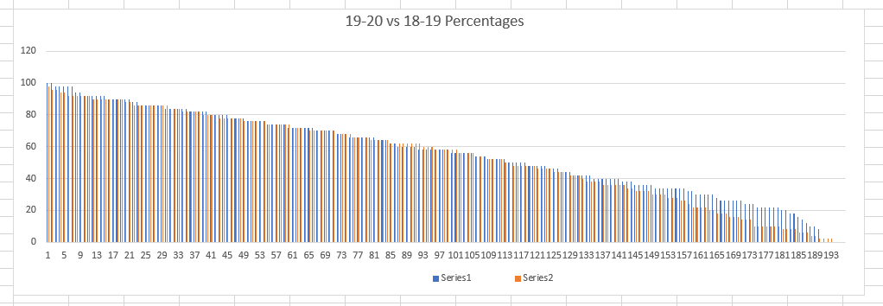
Caution: Small sample (n=190 ?)
Wot, no tail?

Slide 24
Key Findings contd (some are only guesses): Changing carefully
Parents – messaging is important, esp for ‘top set’ who believe their kid’s membership part of ‘natural order’ (Francis, 2017)
:. Have SLT backing….
One year group at a time
Start with keenies...CPD is a MUST...SKT and contingent skills IMPROVE
Plan collaboratively, discuss maths SKT, find/agree exp P resp – share year groups
Sets are created on tested performance, influenced by SES, birth date, test style, language, culture,...and cause self fulfg proph by various mechs

Slide 25
Questions for the future
Discussion Qs:
Do we NEED to set to prepare for tiered GCSE exams? When?
Teacher Qing: Challenging kids with high prior attainment
HOW do 2ary Ts learn how 1ary Ts teach? LAPs think they're starting over
How best to engage reluctant colleagues? Parents? SLT?
SoL: Share? (Evolution, Kyozai Kenkyu, Predicted Pupil responses)
Collaboration – Nottingham City/County, EME, EMW Hubs?
How to continue our collaboration 2020-21? (Video? Teachmeets? HoDs network?)

Slide 26




Keep in touch
mark.simmons@nottingham.ac.uk
@simmo1363
UoNSoE
@UoNSoE

