Slide 1
Mixed Attainment Maths
Mark Horley, St. Marylebone CE School, Westminster
@mhorley
mark.horley@gmail.com

Slide 2
51891840

Slide 3
Bus stop Division, with an integer quotient
How many different Divisors can you find? How do you know you’ve got them all?
Can you find other Dividends where this works?
What is the smallest number which can be divided by:
1 -> 9?
1 -> 8?
1-> 7?
Etc.

Slide 4
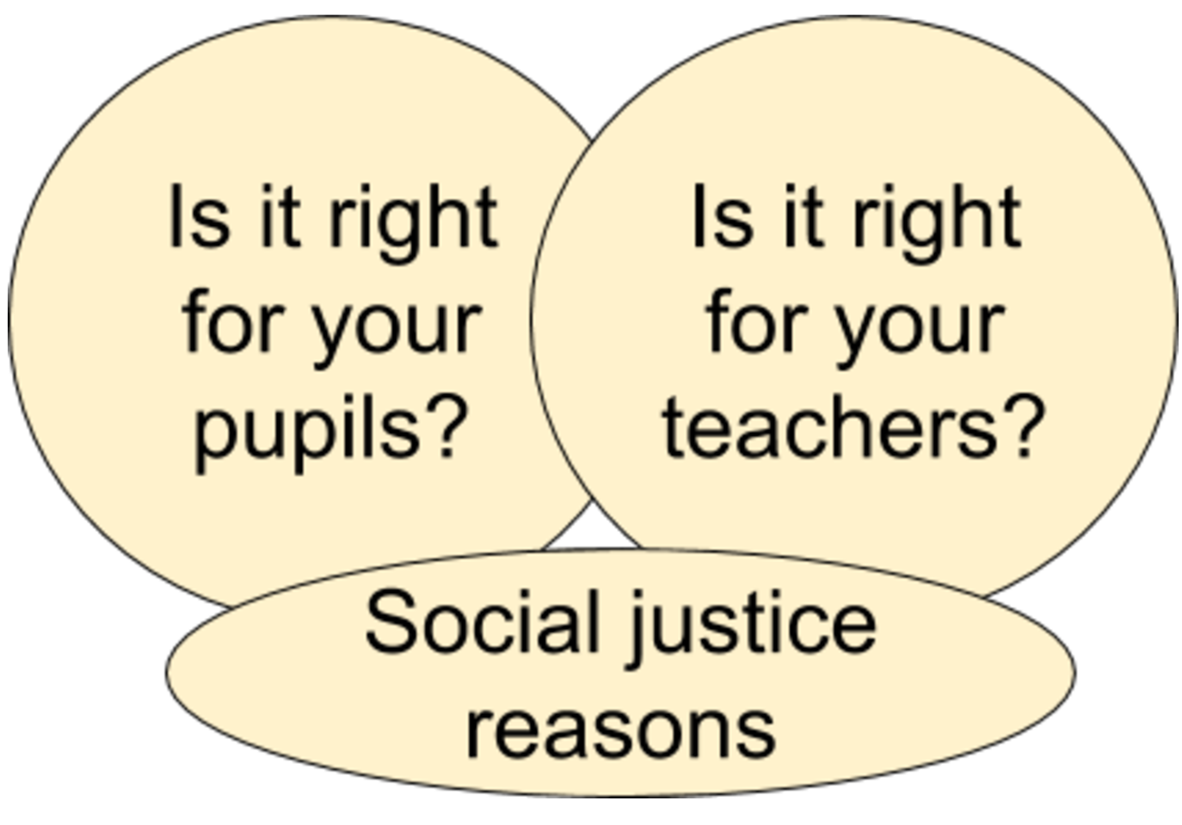

Slide 5
http://www.bristol.ac.uk/media-library/sites/cmpo/documents/taylor2016.pdf

Slide 6
The Challenge of differentiation
Two key principles:
At any point in time, different learners will proceed at different rates AND have different foundational knowledge
Every minute is valuable

Slide 7
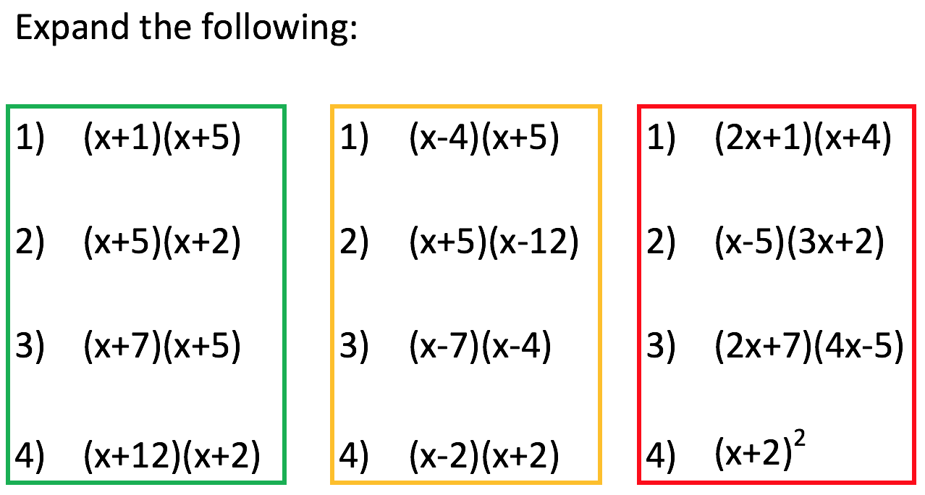

Slide 8
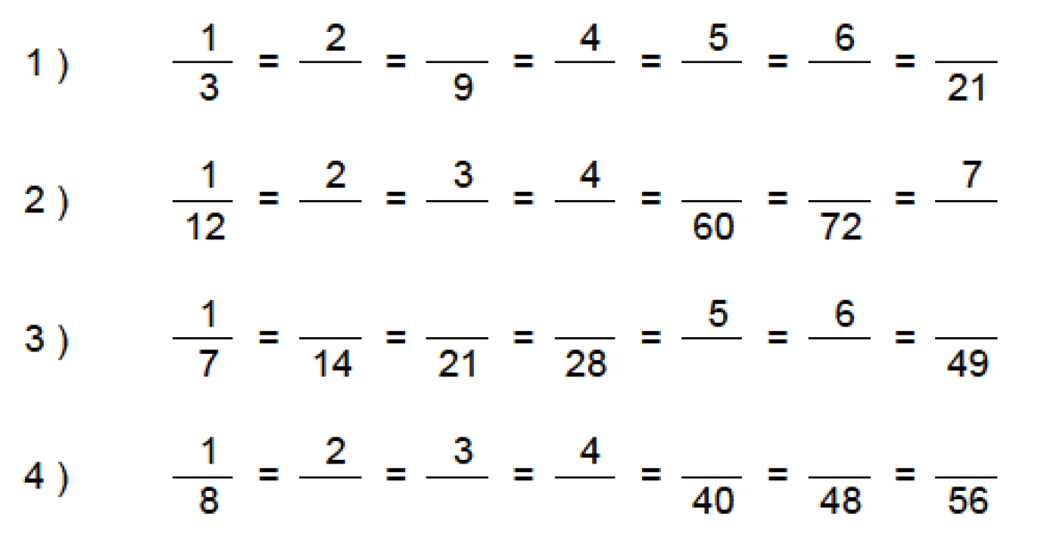
Equivalent fractions

Slide 9
Equivalent fractions
$$\frac{21}{28}$$
$\frac{21}{28} −\frac{3}{4}$ = $\frac{18}{24}$

Slide 14
Introduce Algebra early in Year 7
The basics
Collecting like terms
Substitution
Distributive and Associative Laws applied to arithmetic and algebra
Carefully avoiding negatives
E.g. 5(a + 3b) – 2a
But not 5(a + 3b) – 8a

Slide 15
Present a need for algebra
Using these three lengths of line, how many different triangles can you make?
Find the perimeter of each triangle.
a
c
b

Slide 16
A
B
C
D
E
F
G
H

Slide 17
E
D
B
A
G
H
F
C
4a+2b
2c+2a
2c+b
2b+a+c
2a+2b
3a+c
a+b+c
2a+b

Slide 18
What can you say about a and b?
1) $\frac{a}{7}+\frac{2}{7}=1$
2) $\frac{a}{7}+\frac{5}{7}>1$
3) $\frac{a}{5}+\frac{2}{5}<1$
4) $\frac{a}{3}+\frac{b}{3}=1$
5) $\frac{a}{3}+\frac{b}{3}<1$
6) $\frac{a}{n}+\frac{b }{n}<1$

Slide 20
TRUE of FALSE
To multiply by 10, you add zero to a number
3.4 $×$ 100 = 3.400
4.56 ÷ 100 = 0.456
340 ÷ 10 = 34.0
0.83 $×$ 1000 = 83
Dividing by 100 is the same as dividing by 10 twice
To multiply by 100, you move the decimal point two places to the right

Slide 21
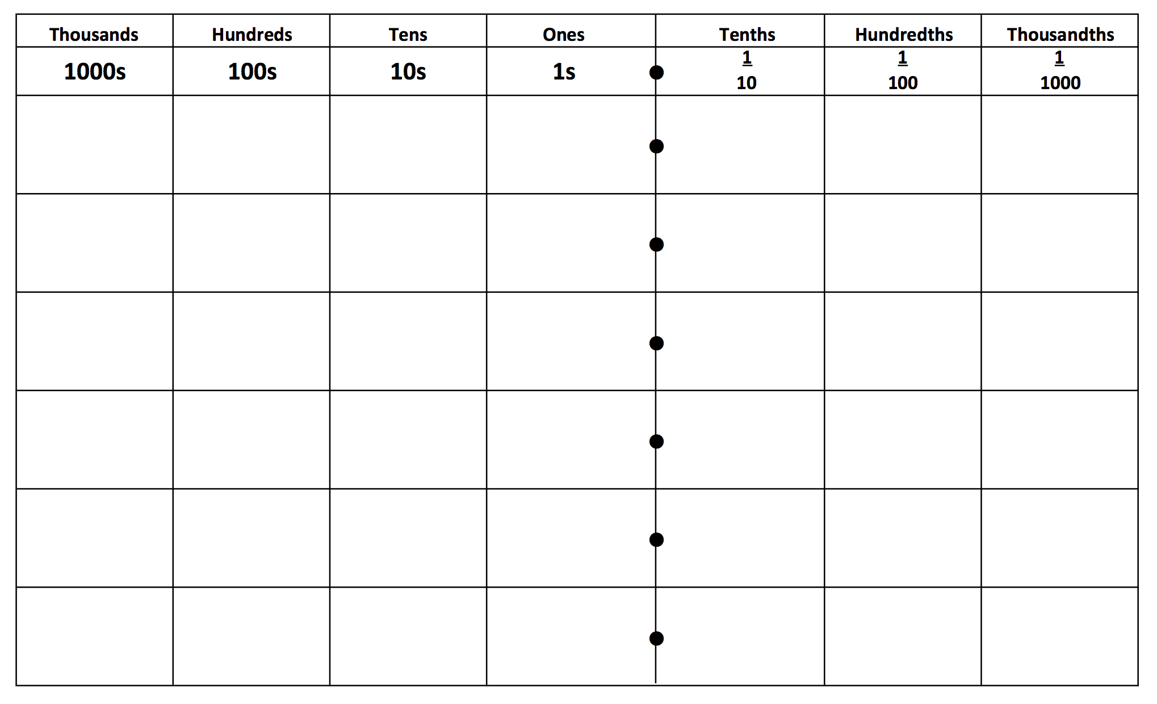

Slide 22
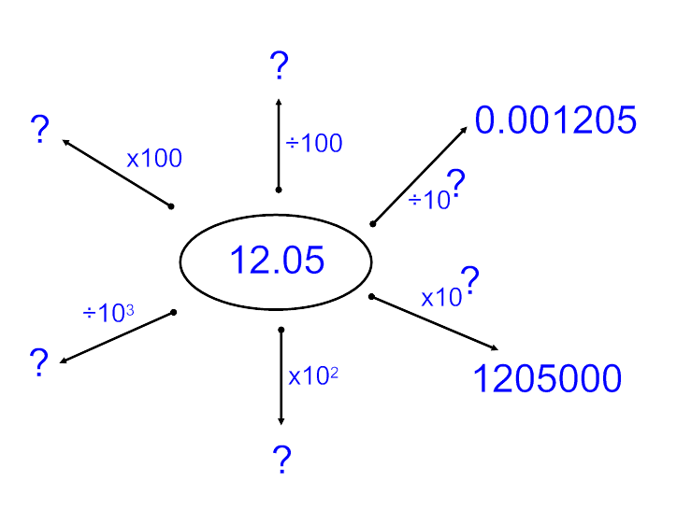

Slide 23
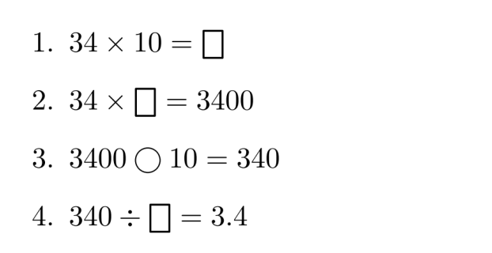
Fill the boxes and continue the pattern
34 ◯ ☐ = 3.4
34 ◯ ☐ = 3.4
34 ◯ ☐ = 0.34
34 ◯ ☐ = 0.34
34 ◯ ☐ = 0.034
34 ◯ ☐ = 0.034

Slide 24
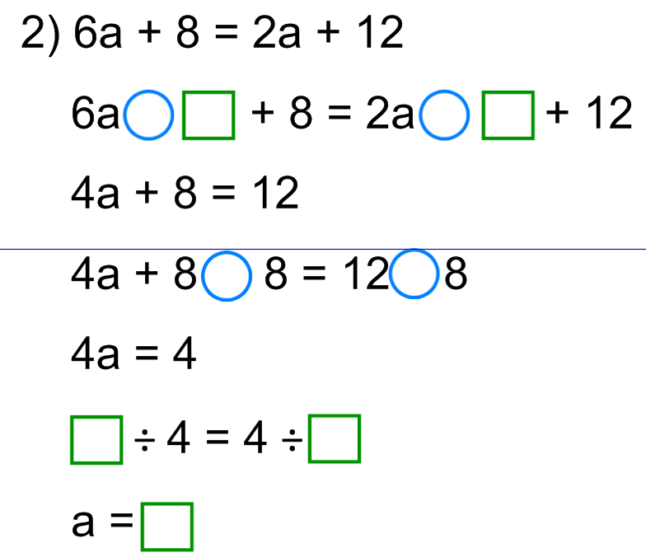

Slide 25
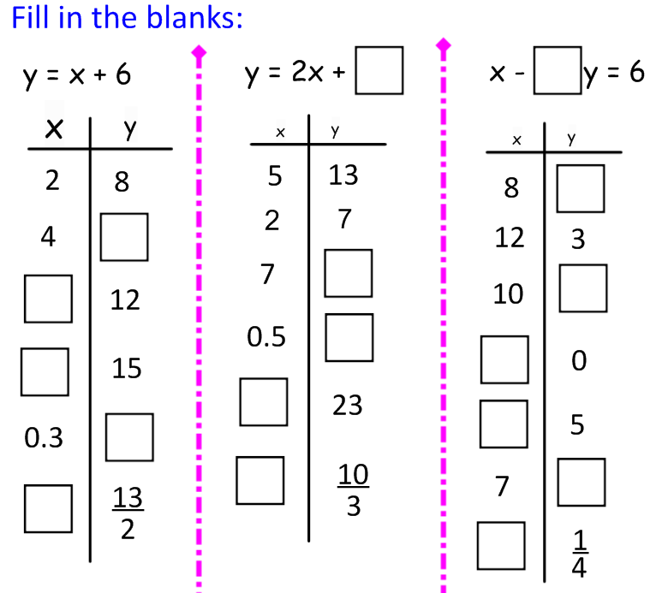

Slide 26
All 4 digit palindrome numbers are divisible by 11

