Slide 1
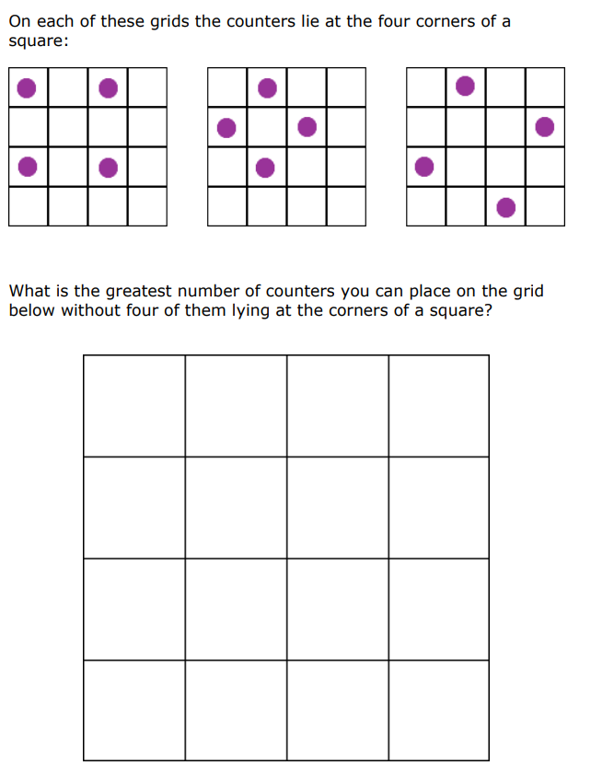
Do Now
Use the large grids and the counters on your tables.
Challenge: Investigate larger grids and see whether there is a pattern to the number of counters by looking at smaller grids too.
Is it possible to predict the largest number of counters in any size grid?

Slide 2
“Engagement comes from people seeing the creativity in math and the different ways people see mathematical ideas. This is intrinsically interesting, numbers can be so open and number problems can be solved in so many ways. When this realisation is combined with visual insights into the mathematical ways of working, engagement is intensified”.
– Jo Boaler, 2016 in Mathematical Mindsets
Notes:
Boaler (2009) discusses the creation of positive identities, suggesting it is not compatible with placing children in ‘ability groups’, but requires a pedagogical approach aimed at creating equity.
This involves teachers having expectations that all children are capable of mathematical learning, and consciously using strategies such as ‘assigning competence’, or publicly highlighting contributions of children who might otherwise have low status, as part of the ‘complex instruction’ approach (Boaler, 2010).

Slide 3
Socio-cultural implications:
The creation of positive identities.
Creating equity in the classroom.
”Manipulatives may be the focus or vehicle for learning through interaction.
Manipulatives therefore may become the subject of dialogue and reasoning, rather than images to be internalized.
Manipulatives have a role in the co-construction of meaning through modelling and argumentation. They are a focus for interaction, which mediates learning cognitively and socially.”
- Nuffield Foundation, 2014

Slide 4
Differentiated by…
Task-specific use
Easy access use
“Manipulatives may provide support in helping children to explain why strategies work, helping high attaining students to explain concepts, helping low attaining students to understand concepts.”
- Nuffield Foundation (2014)

Slide 5
Try out the differentiated tasks on the table, suited to KS2/KS3 students.
Write down any tasks you know of, or any new ideas you have.
Challenge:
How can we incorporate the manipulatives into topics which are notoriously harder to teach using physical objects?

Slide 6
Which tasks stood out for you?
How do the manipulatives aid high, middle and low achievers learning?
How can we incorporate the manipulatives into topics which are notoriously harder to teach using physical objects?

Slide 7
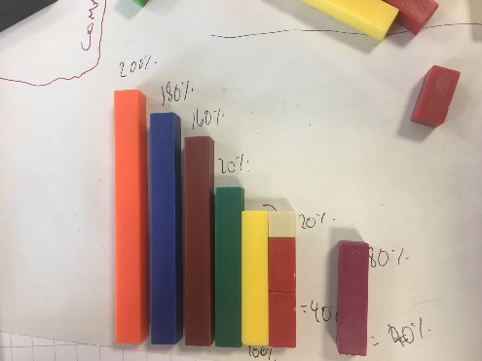
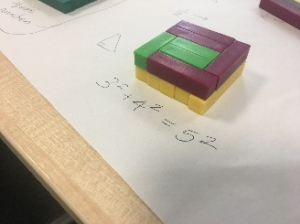
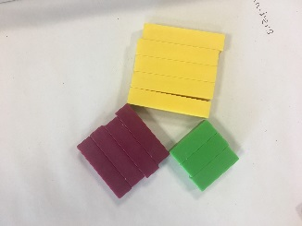
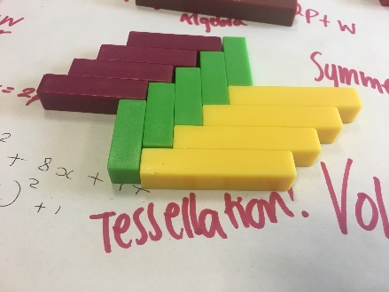
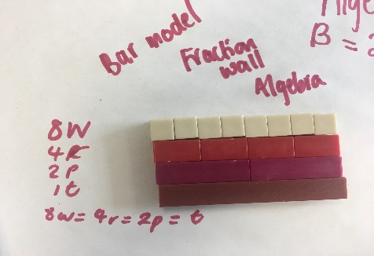
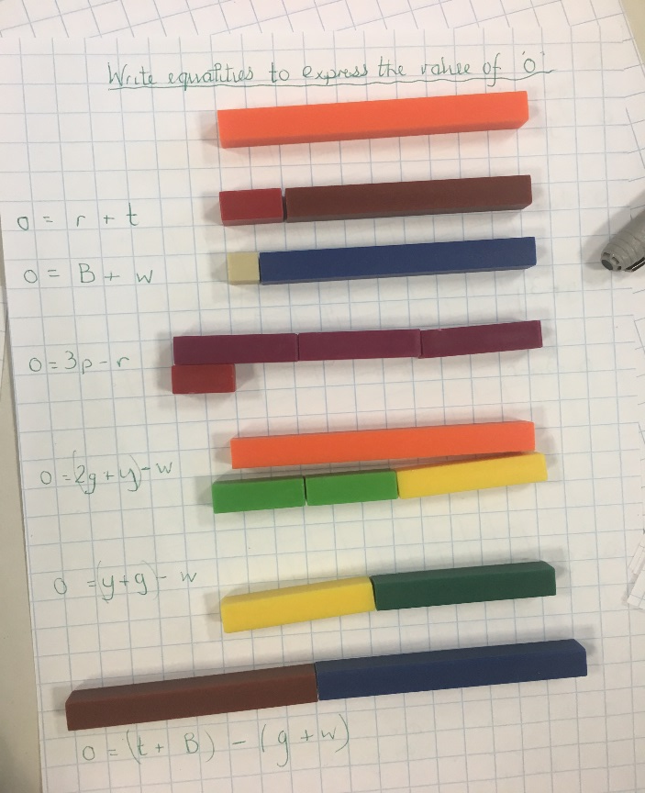
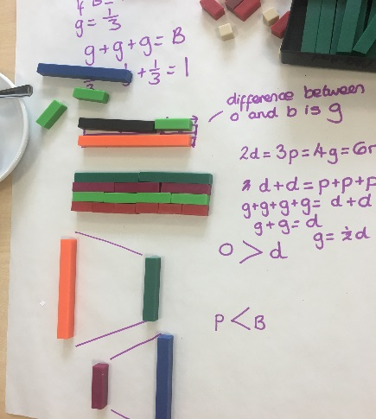
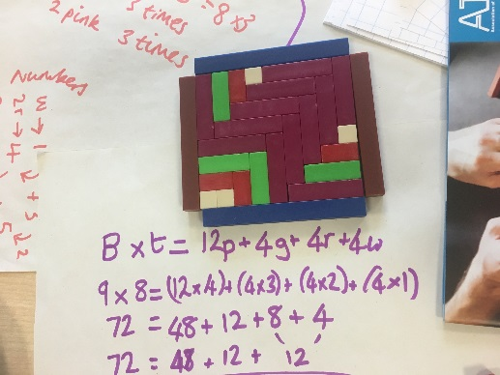
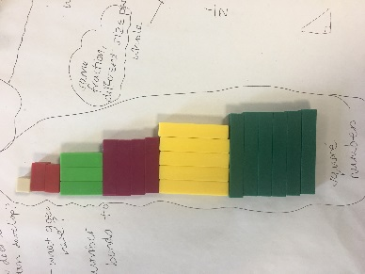
Pythagoras
Percentages
Tessellation
Algebraic equalities and equations
Bar modelling
Perimeter and Area
Equalities and comparisons
Square Numbers

Slide 11
Deeper Thinking/Problem Solving
If the yellow rod = 100%, what is the red rod worth? Percentages/fractions/comparing quantities/greater than 100%
Mike said: 'Choose any 5 rods. There will always be at least one case where three of these add together to make a multiple of green’. Is this always, sometimes or never true? Possible outcomes/ trial and error/ logic/ factors/multiples
The yellow + black + purple rod make a hollow triangle when put together. Which other rods of the same length can also make a hollow triangle? Properties of triangles/ possible outcomes/ trial and error/ logic
Courtesy of ATM Cuisenaire Early Years to KS3 - CPD Day Course

Slide 12
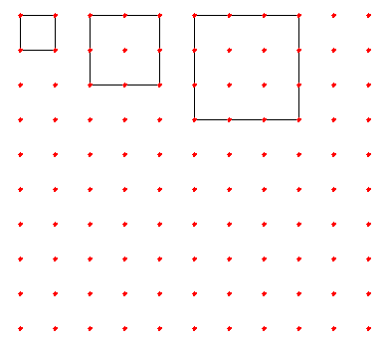
Here is a pattern of squares
The first square has 4 nails; the length of its sides is 1.
The second square has 8 nails on the edges and 1 nail inside; the length of its side is 2.
The third square has 12 edge nails and 4 inside nails
You can continue this pattern and count the nails on the edges and inside each square.

Slide 13
How many edge nails and how many inside nails does a square with side 12 have?
Explain whether or not there is a square with 2025 inner nails.
Is there a square with the same number of edge nails as inner nails

Slide 14
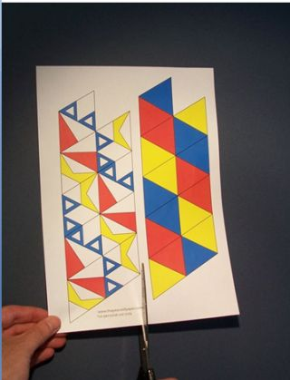
First you need to decide which of the templates you would like to use. The template on the left will result in a flexagon with six unique patterns while the right will give only three. The model I am demonstrating is made from the template on the left.

Slide 15
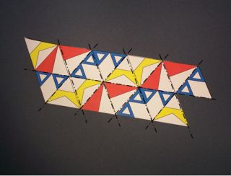
Once the template has been cut out, crease along all the diagonals and along the centre.

Slide 16
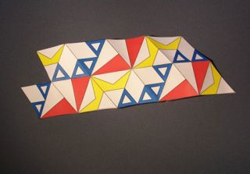
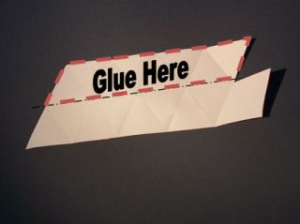
Once the template has been creased this should be the result. Turn the template over to the non coloured side for the next step.
Add glue along the small side and fold in half along the centre line.

Slide 17
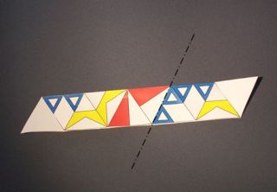
Fold the left side under to create a mountain fold between the blue and red triangles.

Slide 18
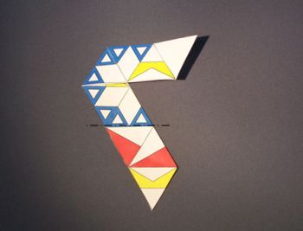
Fold under again between the blue and red triangles. This creates another mountain fold. Let the single layer flap sit on top of the existing paper.

Slide 19
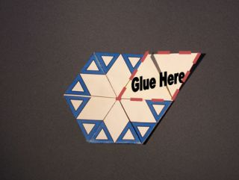
Now glue the two single layer flaps together to enclose all the uncoloured paper.

Slide 20
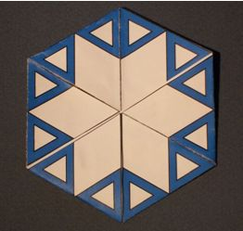
Congratulations you’ve just made your very first flexagon.

