Slide 1
Problem Solving in a Mixed Ability Classroom
Leann de Belder
@LMPeters16
Give the problems a go…

Slide 2
What does reasoning and problem solving look like in my classroom?
In groups, discuss what reasoning and problem solving means to you.
Can you define each term?
What are your pupils’ views?
What does it look like in your classroom?
How often do you teach the skills of problem solving?
Notes:
Table groups- large paper.
Compare and share ideas

Slide 3
Fluency, Reasoning and Problem Solving
In your tables sort through the phrases in the envelopes and determine if they describe fluency, reasoning or problem solving.

Slide 4
Fluency | Reasoning | Problem Solving
Varied and frequent practice Developing conceptual understanding Recall and apply Rapidly and accurately | Follow lines of enquiry Conjecture relationships (form an opinion on the basis of incomplete information) Develop argument, justification or proof Using mathematical language | Applying mathematics Routine and non-routine problems Breaking down into smaller steps Persevering in seeking all solutions
Notes:
Sorting activity- which questions are F, R, PS? In table groups- how do you know? From the White Rose planning- Ben to share with you today.
Just because questions are in a word problem format doesn’t make them problem solving.

Slide 5
Reasoning type questions
Odd one out
Always, sometimes, never,
True or false?
Spot the error
Non- examples
If this is true then I also know……

Slide 6
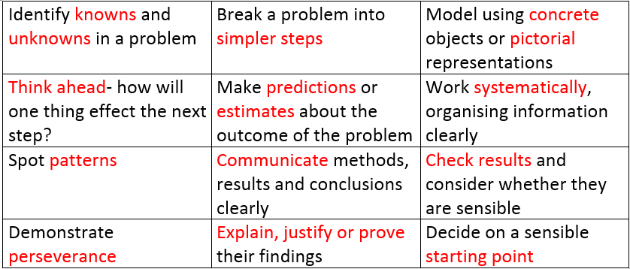
Order these based on importance when problem solving.
Notes:
Task- Order by importance
We need to think about how we can teach these skills so that pupils are able to use them. Quite often forget how we are going to do this.

Slide 7
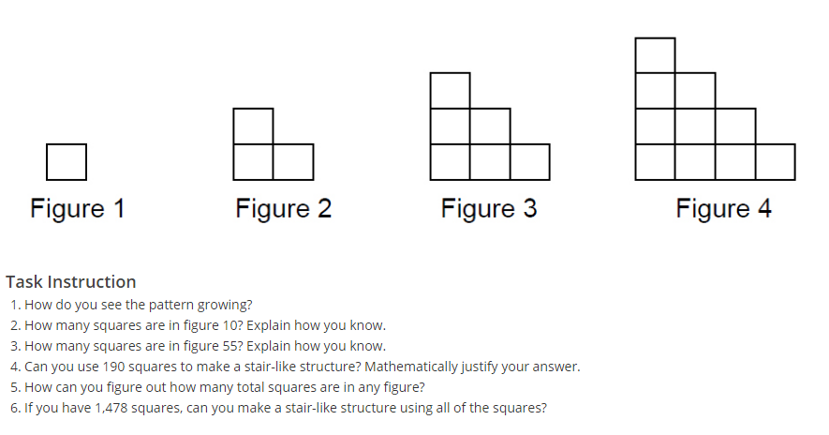
What was your starting point?
Which mathematical and problem solving skills did you use?
Which problem solving skills do you think are the most important to? Why?
Notes:
n(n+1)/2

Slide 8
Reaching the whole class
Low floor, high ceiling problems
Support questions, tips or alterations for lower ability pupils to get them started
Groupings/partners when working out problems
Stretching higher abilities pupils

Slide 9
How many squares
How many squares are in an 8 by 8 chessboard?
Hint: It’s not 64
How would you differentiate this problems?
How I’ve done this problem in my classroom
Working on their own
Tips: use a table to record, start with a smaller chessboard, use colours or scrap paper to aid, look for patterns, work systematically
Working in pairs/tables
Stretch - n x n chessboard

Slide 10
Plan an activity
Look at Amy’s Dominos and Number Properties
Give them a go
Work with your table to design how you would present this to one of your groups
Consider what Problem Solving skills you’d focus on, teachable mathematic skills and differentiation

Slide 11
Problem Solving in Mixed Ability
Focus on the mathematics the pupils need, teachable points during the problem and the problem solving skills they will develop
Select low floor, high ceiling tasks that all pupils can access, but have questions available to stretch pupils who solve the problem
Consider where in the set of lessons you will do this style of problem.

Slide 12
Thank you!
l.debelder@srrcc.org.uk
@lmpeters16

