Slide 1
Managing challenging behaviour in mixed attainment Maths classes

Slide 2
What this is...
A reflective exploration into the nature of challenging behaviours.
A collaborative opportunity to share insights and best practice.
A recognition of the need to cater for all of our students.
What this is not...
A revolutionary quick fix to challenging behaviours!

Slide 3
Agree or disagree?
Badly behaved children are often bad at Maths.
If a child displays rude, aggressive or offensive behaviour in my classroom they have to leave.
It is part of my job to follow up instances of challenging behaviour after lesson time.
I feel able to cope with the challenging behaviours that arise in my classroom.
I have adequate space and time to reflect and digest instances of challenging behaviour that take place in the classroom.

Slide 4
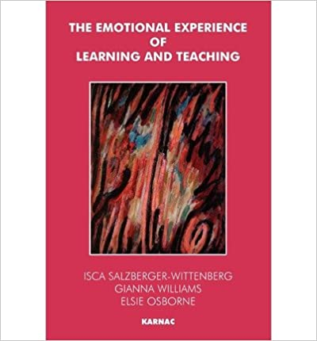
Understanding behaviours
Read through the extract.
“…Learning arises in a situation in which we do not as yet know or are as yet unable to achieve what we aim to do. It thus invariably involves uncertainty, some degree of frustration and disappointment. This experience is a painful one and if it is more than can be tolerated then it may be evaded, as in the case of Robert, or else dealt with omnipotently and angrily as in the case of Michael.”
(p.53, The Emotional Experience of Learning and Teaching, Osborne, Salzberger-Wittenberg, Williams, 1999).

Slide 5
For discussion…
What behaviours might we see from students, which stem from the fear of not succeeding when learning to acquire a new skill? Maths specific examples?
How does the ethos of teaching mixed attainment maths link with the need to understand students’ (conscious or unconscious) fears surrounding the learning experience?
Poorly behaved students end up in lower sets – not because of their level of attainment, but because of the vicious cycle of behaviour and setting.

Slide 6
Sharing best practice: Maths
Think of a student who displays challenging behaviours.
Consider the Maths activity in front of you.
How might they feel approaching this learning situation?
How might you manage this?
How could you further tailor the activity to suit their learning needs?

Slide 7
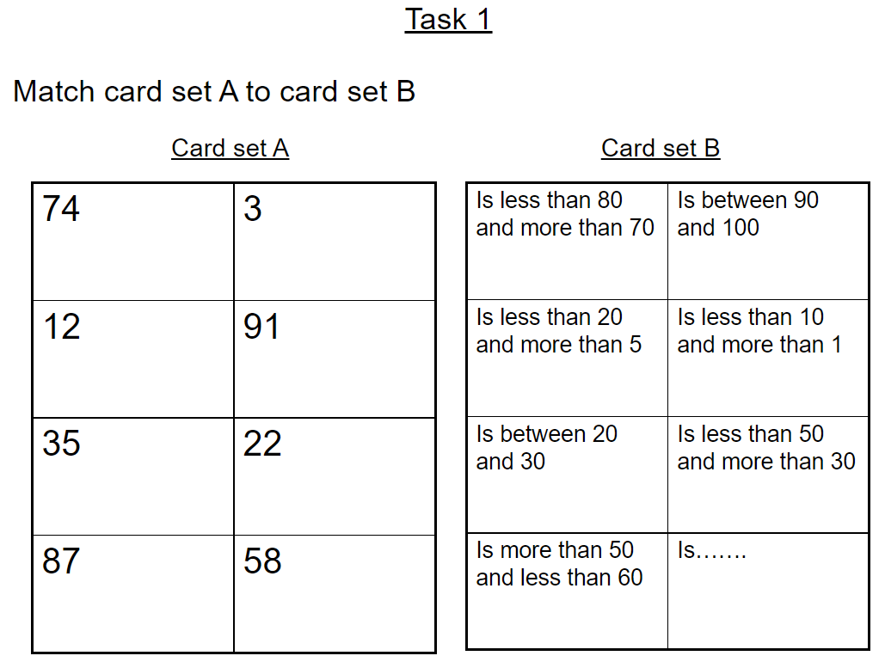

Slide 9
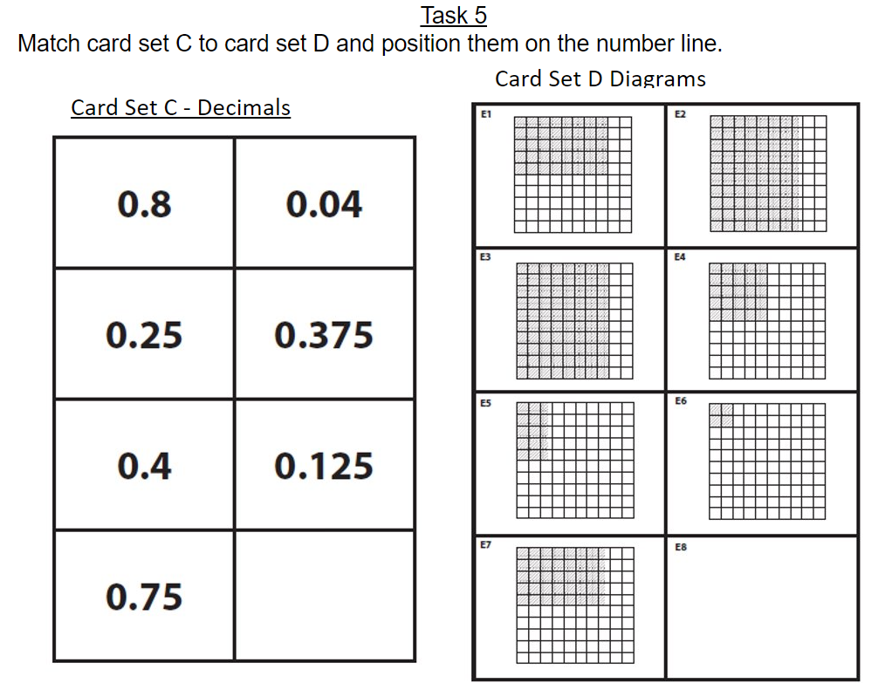

Slide 12
Sharing best practice: Maths
Collaborative work between groups enables students to get help from each other while all producing their own piece of work.
This can resolve some of the issues of difficult behaviour in groups.
Autonomy of task choice is central to the highly aspirational environment you want all learners to become accustomed to.

Slide 13
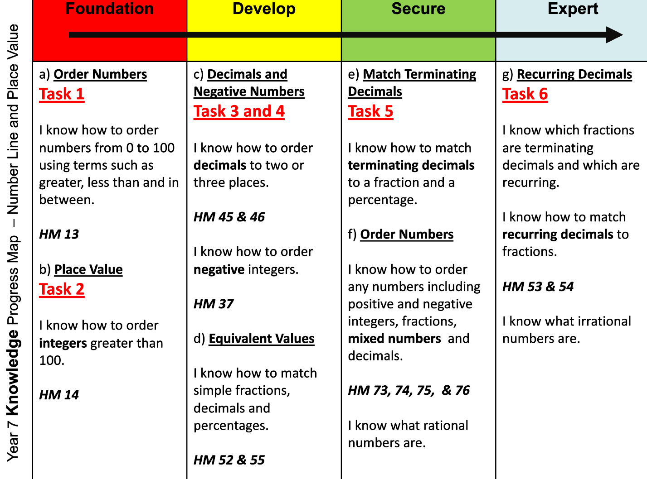

Slide 14
Organisation is key!
Seating plans: organise your classroom by spreading out the attainment levels of students.
Class lists: teachers highlight the students in their classes who display the most challenging behaviours. These students are spread evenly across the cohort and put with teachers who have pre-existing good relationships with them, wherever possible.
Planning a diverse and inclusive curriculum: students should see themselves and their culture represented in the global history of Maths, this should be incorporated into lessons. Motivates and makes Maths relevant/ personal.

Slide 15
Transference of emotional states
We know from our everyday experience that we can be affected by other people's moods. We may feel weighed down and enveloped by the depression of another person, or be infected by the gaiety and laughter of a group. The very words we choose suggest that we think of emotional states as being concretely transferable, getting right into us and taking us over. To some extent such feelings pass unseen like an electric current and we only know about them by the effect they have upon us.
Awareness that we may be used as containers for excessive mental pain may make us more open and receptive to the communication of emotions. We may, on the other hand, be quite frightened to lay ourselves open to being filled up with feeling states that others find too intolerable to bear on their own… What makes the painful experience bearable is an interest and ability to think about the feelings evoked in us. We may need space and time to consider the nature of the pain and appreciate what it is about. This thinking about feelings enables us both to have the experience and to apprehend its meaning, and may thus result in a better understanding of ourselves and others. It may lead to personal growth as well as a greater ability to tolerate the emotional pain of others.
(p.61-63, The Emotional Experience of Learning and Teaching, Osborne, Salzberger-Wittenberg, Williams, 1999).

Slide 16
Sharing best practice: Emotional regulation and restorative practice.
Consider the role play scenario with the people around you.
What emotions were evoked in the teacher?
What emotions were communicated from the child?
What would a helpful next step be?

Slide 17
Takeaway Tips and Discussion
Learning can be a painful experience for some of our students. Build a relationship which is based on positive recognition, contains their difficult emotions, and is constantly encouraging the child to return to the task at hand.
Observe your own emotional reactions to the child’s behaviour; what are they evoking in you, where might this come from?
Track progress and celebrate success.

