Slide 1
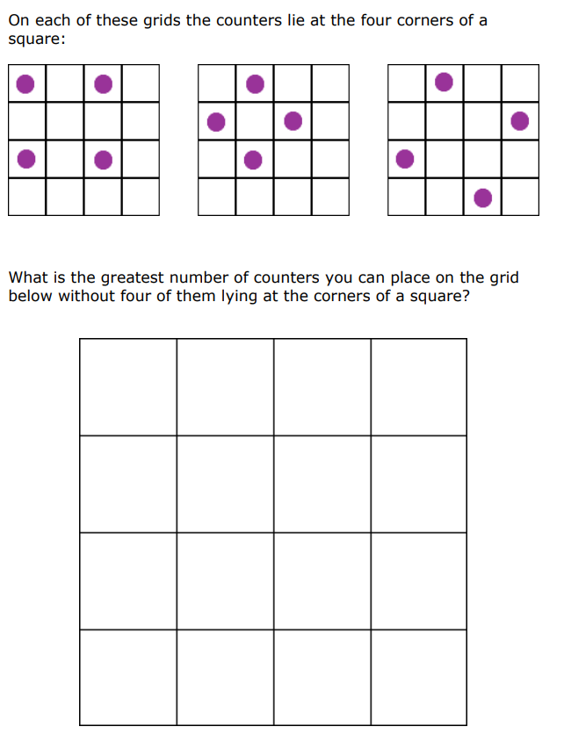
Do Now
Use the large grids and the counters on your tables.
Challenge: Investigate larger grids and see whether there is a pattern to the number of counters by looking at smaller grids too.
Is it possible to predict the largest number of counters in any size grid?
Notes:
https://nrich.maths.org/1142

Slide 2
“Engagement comes from people seeing the creativity in math and the different ways people see mathematical ideas. This is intrinsically interesting, numbers can be so open and number problems can be solved in so many ways. When this realisation is combined with visual insights into the mathematical ways of working, engagement is intensified”.
– Jo Boaler, 2016 in Mathematical Mindsets
Notes:
Boaler (2009) discusses the creation of positive identities, suggesting it is not compatible with placing children in ‘ability groups’, but requires a pedagogical approach aimed at creating equity.
This involves teachers having expectations that all children are capable of mathematical learning, and consciously using strategies such as ‘assigning competence’, or publicly highlighting contributions of children who might otherwise have low status, as part of the ‘complex instruction’ approach (Boaler, 2010).

Slide 3
Socio-cultural implications:
The creation of positive identities.
Creating equity in the classroom.
”Manipulatives may be the focus or vehicle for learning through interaction.
Manipulatives therefore may become the subject of dialogue and reasoning, rather than images to be internalized.
Manipulatives have a role in the co-construction of meaning through modelling and argumentation. They are a focus for interaction, which mediates learning cognitively and socially.”
- Nuffield Foundation, 2014

Slide 4
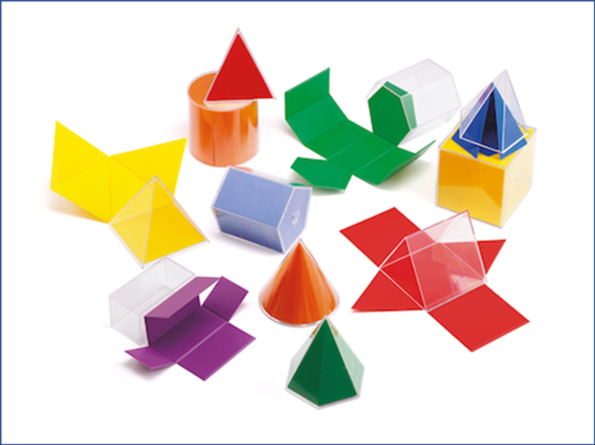
Think / Pair / Share – How might you use this resource with a mixed attainment class?

Slide 5
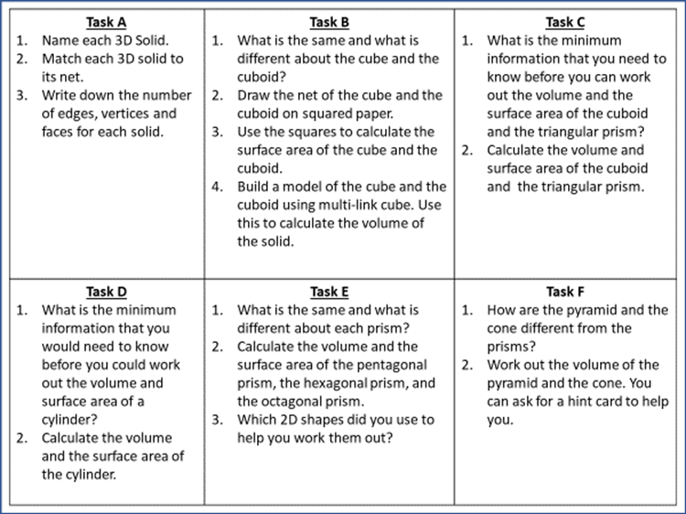

Slide 6
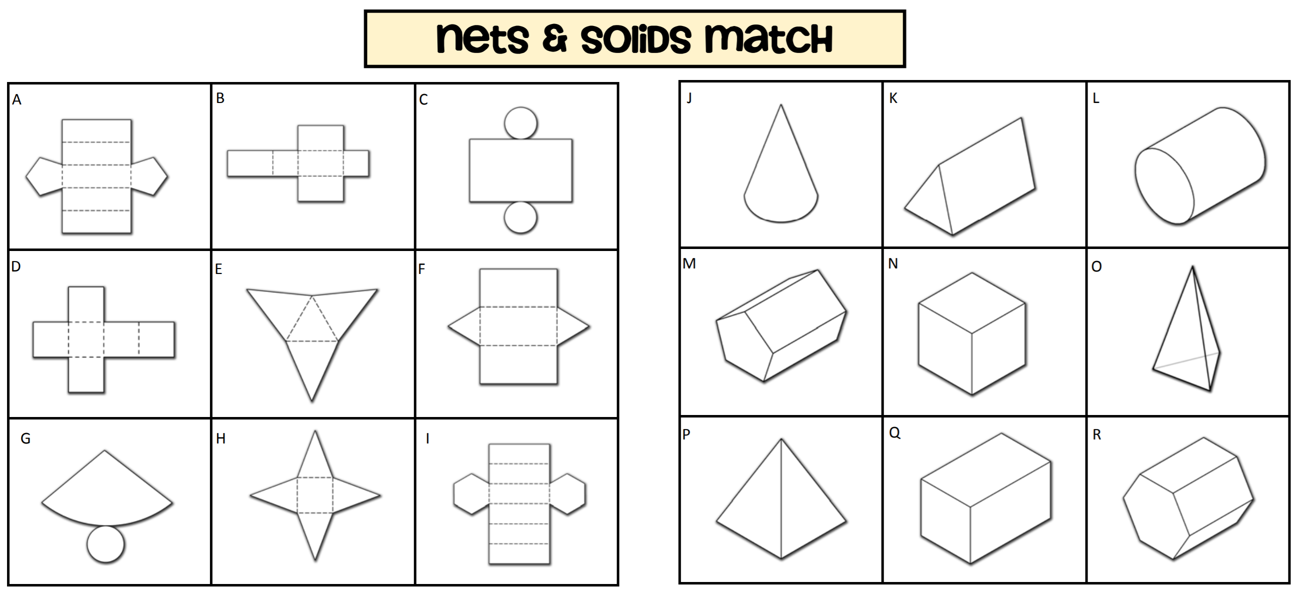
Task A – Use the 3D Shapes to help you

Slide 7
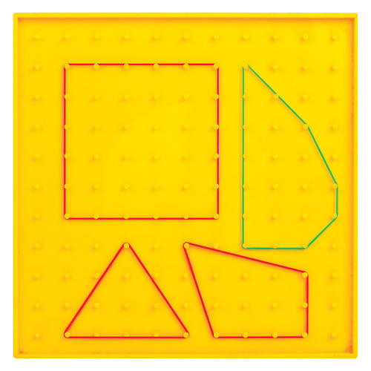
Think / Pair / Share – How might you use this resource with a mixed attainment class?

Slide 8
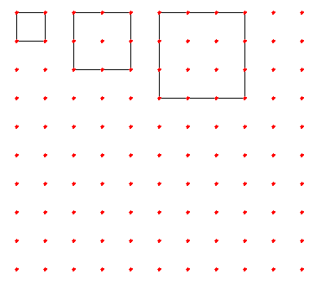
Here is a pattern of squares
The first square has 4 nails; the length of its sides is 1.
The second square has 8 nails on the edges and 1 nail inside; the length of its side is 2.
The third square has 12 edge nails and 4 inside nails
You can continue this pattern and count the nails on the edges and inside each square.

Slide 9
How many edge nails and how many inside nails does a square with side 12 have?
Explain whether or not there is a square with 2025 inner nails.
Is there a square with the same number of edge nails as inner nails

Slide 10
Geoboard activity to find circle theorems:
Teachers use Hovercam to demonstrate the 4 main circle theorems, one by one.
Use a protractor to measure the angles and write down what you notice.

Slide 11
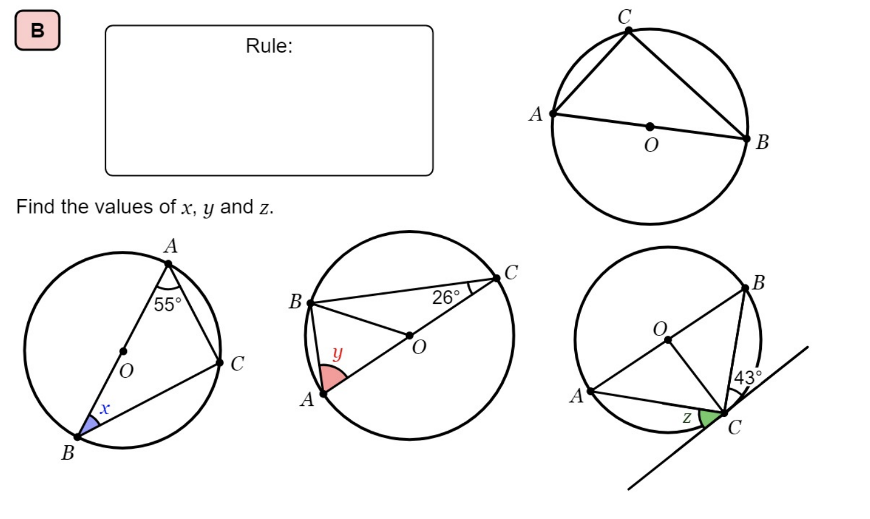
What do you notice?
https://www.geogebra.org/m/aRREmZBg#material/mXM8a8Xs
1
Measure this angle. What do you notice?

Slide 12
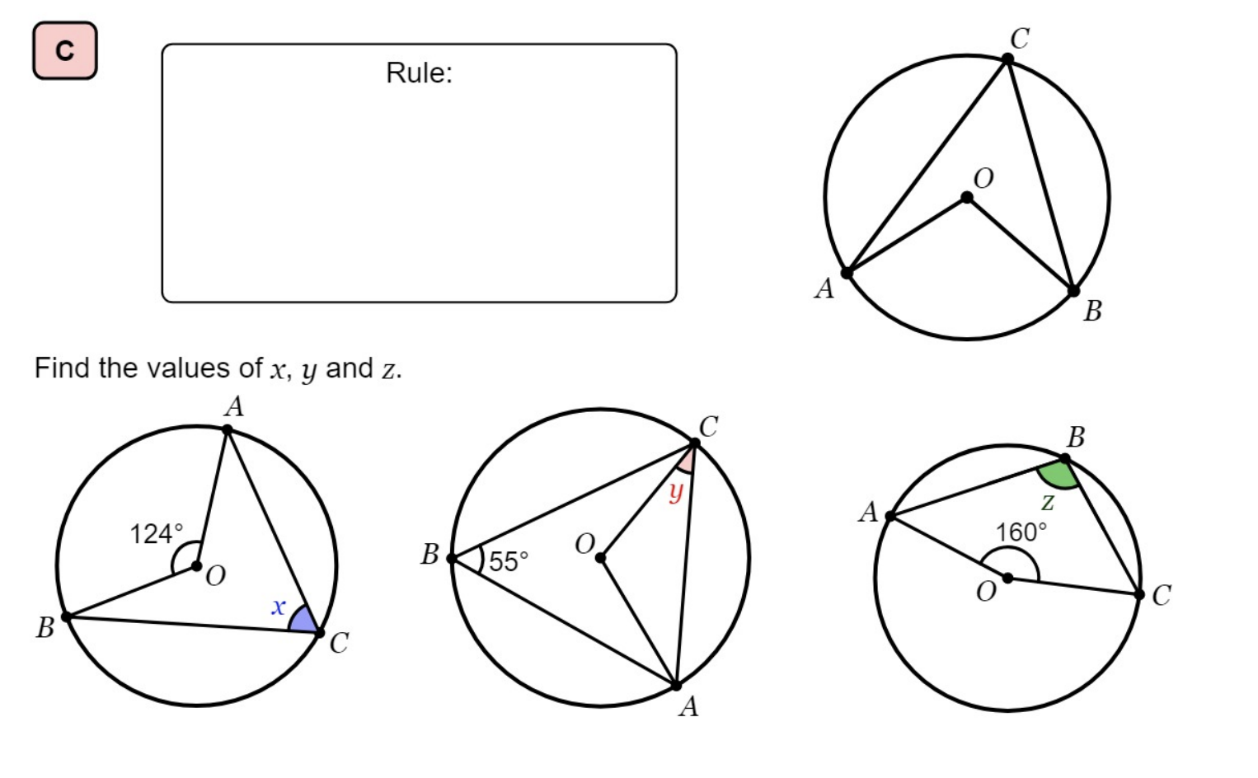
What do you notice?
https://www.geogebra.org/m/aRREmZBg#material/VGNfTTEu
2
Measure these angles. What do you notice?

Slide 13
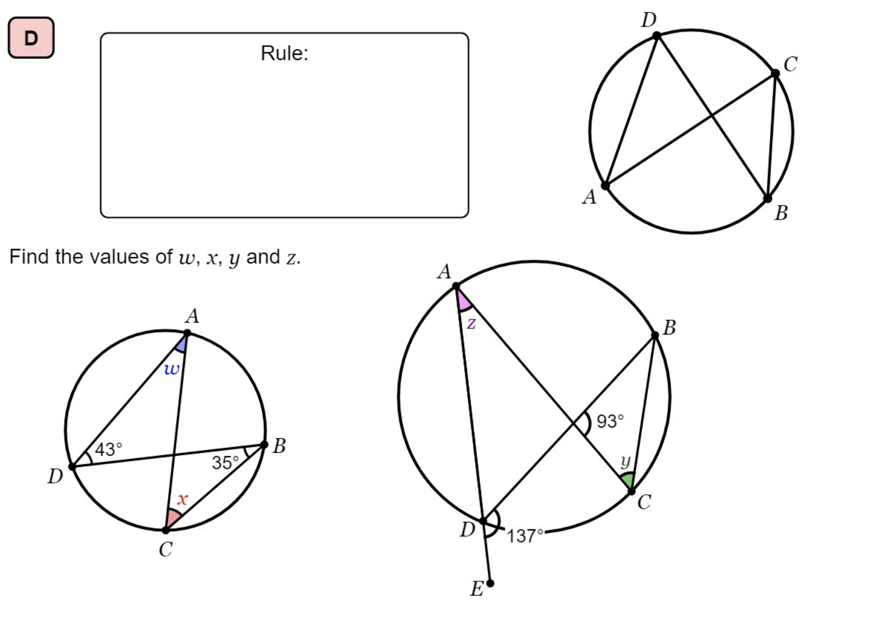
What do you notice? https://www.geogebra.org/m/aRREmZBg#material/UT4sXfYW
3
Measure these angles. What do you notice?
Measure these angles. What do you notice?

Slide 14
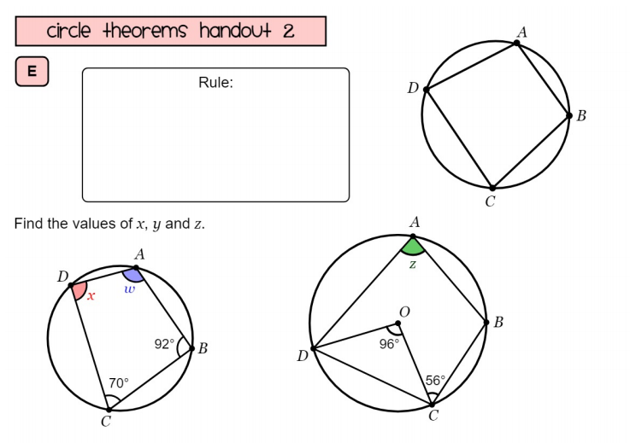
What do you notice?
4
Measure these angles. What do you notice?
Measure these angles. What do you notice?

Slide 15
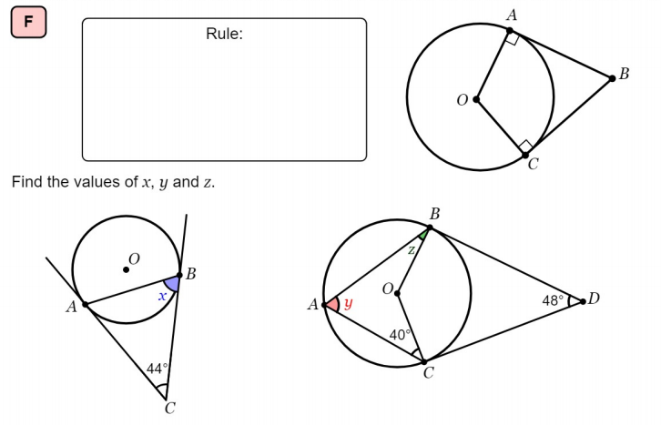
What do you notice?
https://www.geogebra.org/m/xbAwK5Pd
5

Slide 16
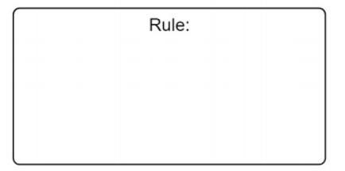
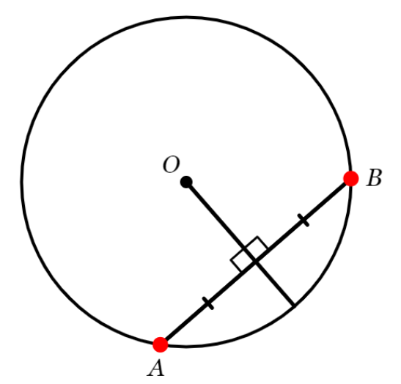
What do you notice?
https://www.geogebra.org/m/EzaeAWNH#material/VADYfPdq
6

Slide 17
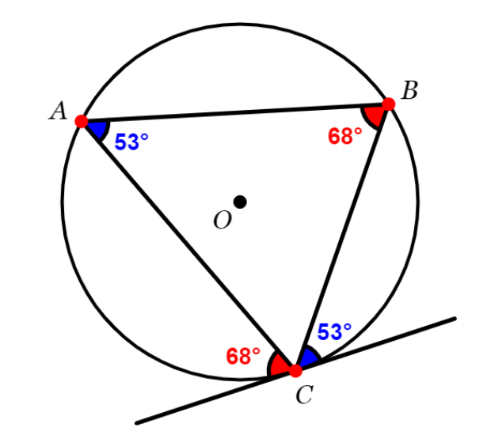
What do you notice?
7
https://www.geogebra.org/m/NGa2ZyFv

Slide 18
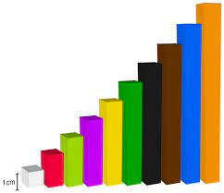
Think / Pair / Share – How might you use the cuisenaire rods resource with a mixed attainment class?

Slide 19
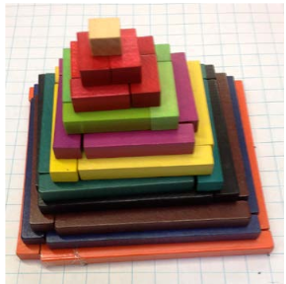
Task 1
Look at the picture.
How would you describe this shape? Try to use mathematical language.
Make the top 3 layers with your rods. You will need one white cube and 6 red sticks. What shape would fill the gap in the bottom layer?
Copy and complete this table:
Level | Number of white blocks needed to make it
Top (1) | 1
Second (2) | …
Third | …
Fourth | …

Slide 20
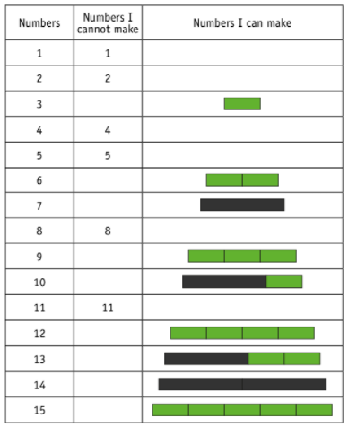
Task 2 Numbers I cannot make
This problem is about exploring which number cannot be made when using just two colours of rods and addition only.
For example, if I choose green and black rods:
I cannot make the number 1 or the number 2.
I can make the number 3 with one green rod.
I cannot make the numbers 4 or 5, but I can
make 6 and 7
Choose two colours of rod, show which numbers can be made, using a table like the one shown:
Then, convert some of the ones you can make to algebra. For example,
Two green is 6, so we can say 2G = 6
Extension: In the example, it looks like we can make any number bigger than 11.
Is there a link between the rod colours and the biggest number which can't be made with them?

Slide 21
Task 3
I can solve 2 step equations with unknowns on one side.
Using cuisinaire rods, make these equations:
2 Red = 4
3 Green + 2 = 11
The two reds make something of equal length to the 4 single cubes
The three green and two singles are the same as one orange (ten) and a single
However, now, we will not tell you the colour of the rod! You must find what colour rod makes the right length.
2 rods + 3 = 7
4 rods + 9 = 13
5 rods + 1 = 16
3 rods – 6 = 21
Now, there will be more than one answer.
Try to find them all.
5) 2 rods + 1 different rod = 12
6) 3 rods + 1 different rod = 10
7) 5 rods + 2 different rods = 17

Slide 22
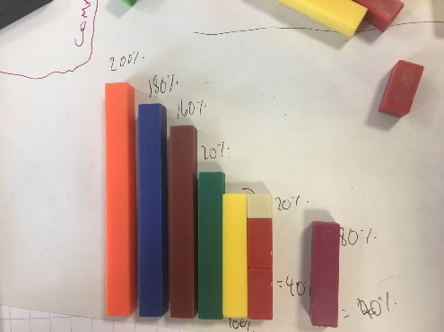
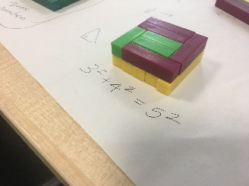
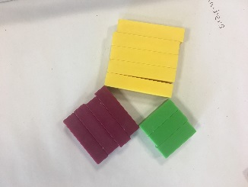
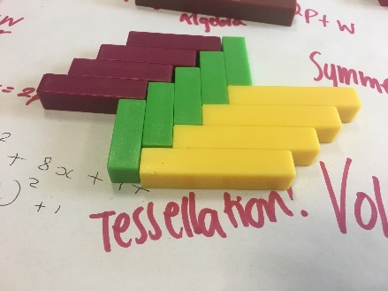
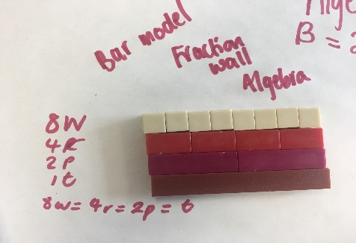
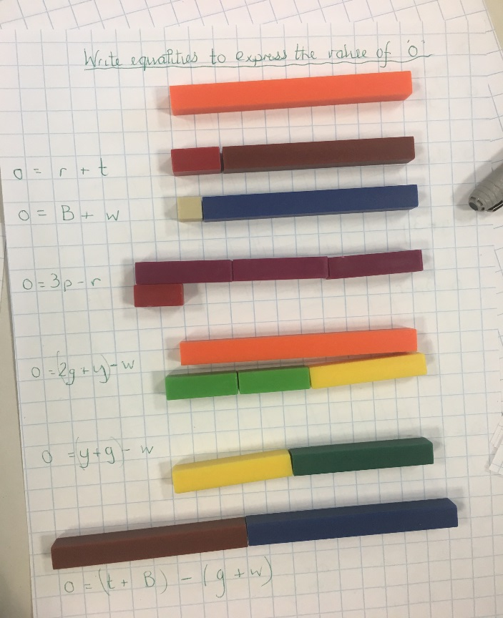
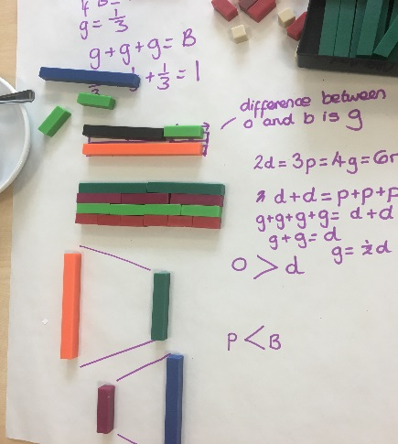
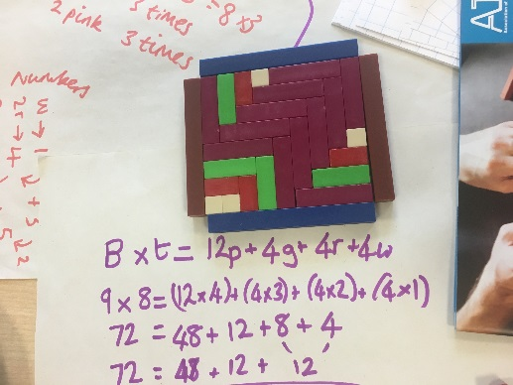
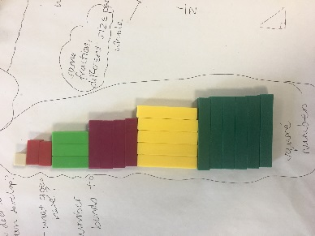
Pythagoras
Percentages
Tessellation
Algebraic equalities and equations
Bar modelling
Perimeter and Area
Equalities and comparisons
Square Numbers

Slide 26
Deeper Thinking/Problem Solving
If the yellow rod = 100%, what is the red rod worth? Percentages/fractions/comparing quantities/greater than 100%
Mike said: 'Choose any 5 rods. There will always be at least one case where three of these add together to make a multiple of green’. Is this always, sometimes or never true? Possible outcomes/ trial and error/ logic/ factors/multiples
The yellow + black + purple rod make a hollow triangle when put together. Which other rods of the same length can also make a hollow triangle? Properties of triangles/ possible outcomes/ trial and error/ logic
Courtesy of ATM Cuisenaire Early Years to KS3 - CPD Day Course

Slide 27
Differentiated by…
Task-specific use
Easy access use
“Manipulatives may provide support in helping children to explain why strategies work, helping high attaining students to explain concepts, helping low attaining students to understand concepts.”
- Nuffield Foundation (2014)

Slide 28
Discuss
Which tasks stood out for you?
How do the manipulatives aid high, middle and low achievers learning?
How can we incorporate the manipulatives into topics which are notoriously harder to teach using physical objects?

