Slide 1
Ensuring support and challenge for all students in mixed attainment classes.
Helen Hindle and Nora Gaoua
@helenhindle1
www.mixedattainmentmaths.com

Slide 2



Slide 3
What are mixed attainment classes?
Classes that have a range of:-
Prior attainment,
SEN,
Pupil Premium
Attitude to Learning
EAL

Slide 4
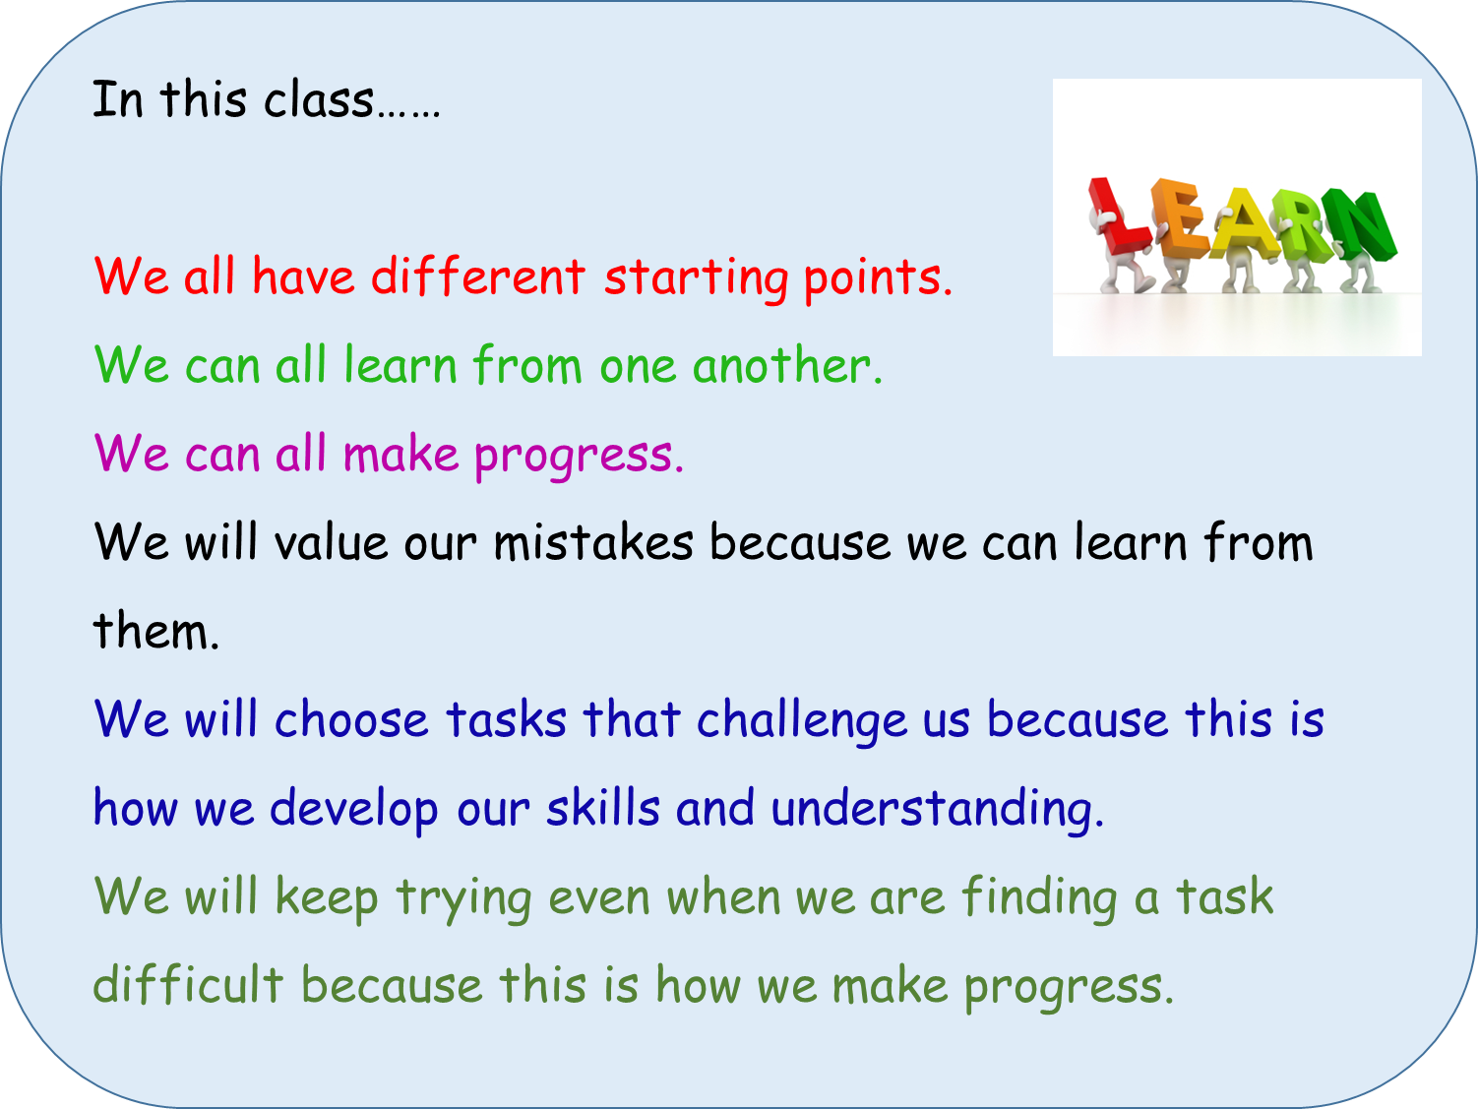
Changing the culture of the classroom…..
Notes:
This is a sticker that goes on the front of our pupils’ exercise books.

Slide 5
 | Foundation | Developing | Secure | Expert
Year 9 Knowledge Progress Map – Simplifying, Expanding and Factorising | a) Simplify I know how to simplify expressions by collecting like terms. HM 156 157 158 159 b) Expressions I know the difference between an equation and an expression. HM 154 c) Expand I know how to expand a single bracket. HM 160 | d) Factorise I know how to factorise linear expressions. HM 168 169 170 171 e) Equation I know the difference between an identity and an equation. HM 154 f) Expand and Simplify I know how to expand two single brackets and simplify. HM 161 | g) Expand Double Brackets I know how to expand double brackets to get a quadratic expression. HM 162 - 164 h) Factorise Quadratics I know how to factorise quadratics of the form x² + bx + c. HM 223 & 224, | i) Factorise Expressions I know how to factorise quadratics of the form ax² + bx + c. HM 225 – 228 j) Expand Triple Brackets I know how to expand triple brackets. HM 166 k) Proofs I know what it means to prove algebraically.

Slide 6
Year 9 Knowledge Progress Map – Simplifying, Expanding and Factorising | Problem Solving - Translate | Foundation | Develop | Secure | Expert
 |  | a1) I can translate geometric problems into simple linear expressions. | b1) I can translate geometric problems into linear expressions containing a single bracket. | c1) I can translate geometric problems into quadratic expressions. | d1) I can translate 3D geometric problems into cubic expressions.
 | Reasoning - Prove | a2) I can multiply two terms together to prove a simple statement about numbers, for example, an even number multiplied by an even number = an even number. | b2) I can use expansion to prove a statement about numbers, for example, an odd number multiplied by an odd number = an odd number. | c2) I can use expansion to prove a complex statement about numbers, for example, for any three consecutive numbers the difference between the square of the middle number and the product of the smallest and largest numbers is always 1. | d2) I can prove a geometric statement, for example, Pythagoras’ Theorem, by expanding brackets.

Slide 7
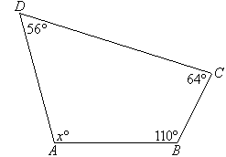
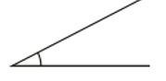
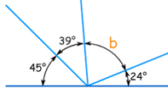
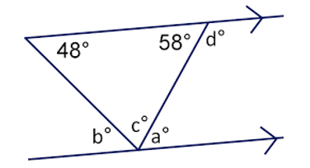
Year 7 Knowledge Progress Map – Angles | Foundation | Develop | Secure | Expert
Year 7 Knowledge Progress Map – Number Line and Place Value | a) Identify Angles I know the definitions of acute, obtuse, reflex and right angles. HM 458, 459 b) Measure Angles I know how to use a protractor to measure acute and obtuse angles. HM 458, 459 | c) Identify Triangles I know the properties of equilateral, isosceles and scalene triangles. HM 823 d) Angle Rules I know the sum of the angles on a line and the sum of the angles at a point. HM 477, 478, 812, 813, 814, 815, 479 | e) Interior Angles I know the sum of the interior angles of a triangle and a quadrilateral. I know how to calculate missing angles in triangles and quadrilaterals. HM 484, 485, 486, 487, 485, 560 | f) Interior and Exterior Angles I know the sum of the exterior angles of any polygon. I know the formula to find the sum of the interior angles of any polygons. I can calculate missing interior and exterior angles of regular and irregular polygons. HM 561, 562, 563, 564, 565 g) Angles on Parallel Lines I know the properties of alternate, corresponding, vertically opposite and co-interior angles on parallel lines. I can calculate missing angles on parallel lines. HM 480, 481, 482, 483, 488, 489, 490, 491,
Example
How can you tell if a triangle is an isosceles triangle.
Example
Calculate the size of angle A.
Example
Using a protractor, measure this angle. What type of angle is this?
Example
Calculate the size of angle b
Example
Calculate the size of the missing angles.

Slide 8
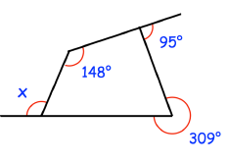
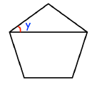
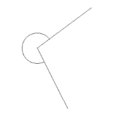
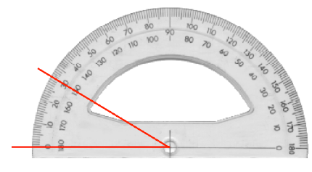
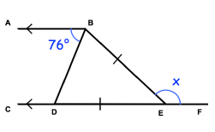
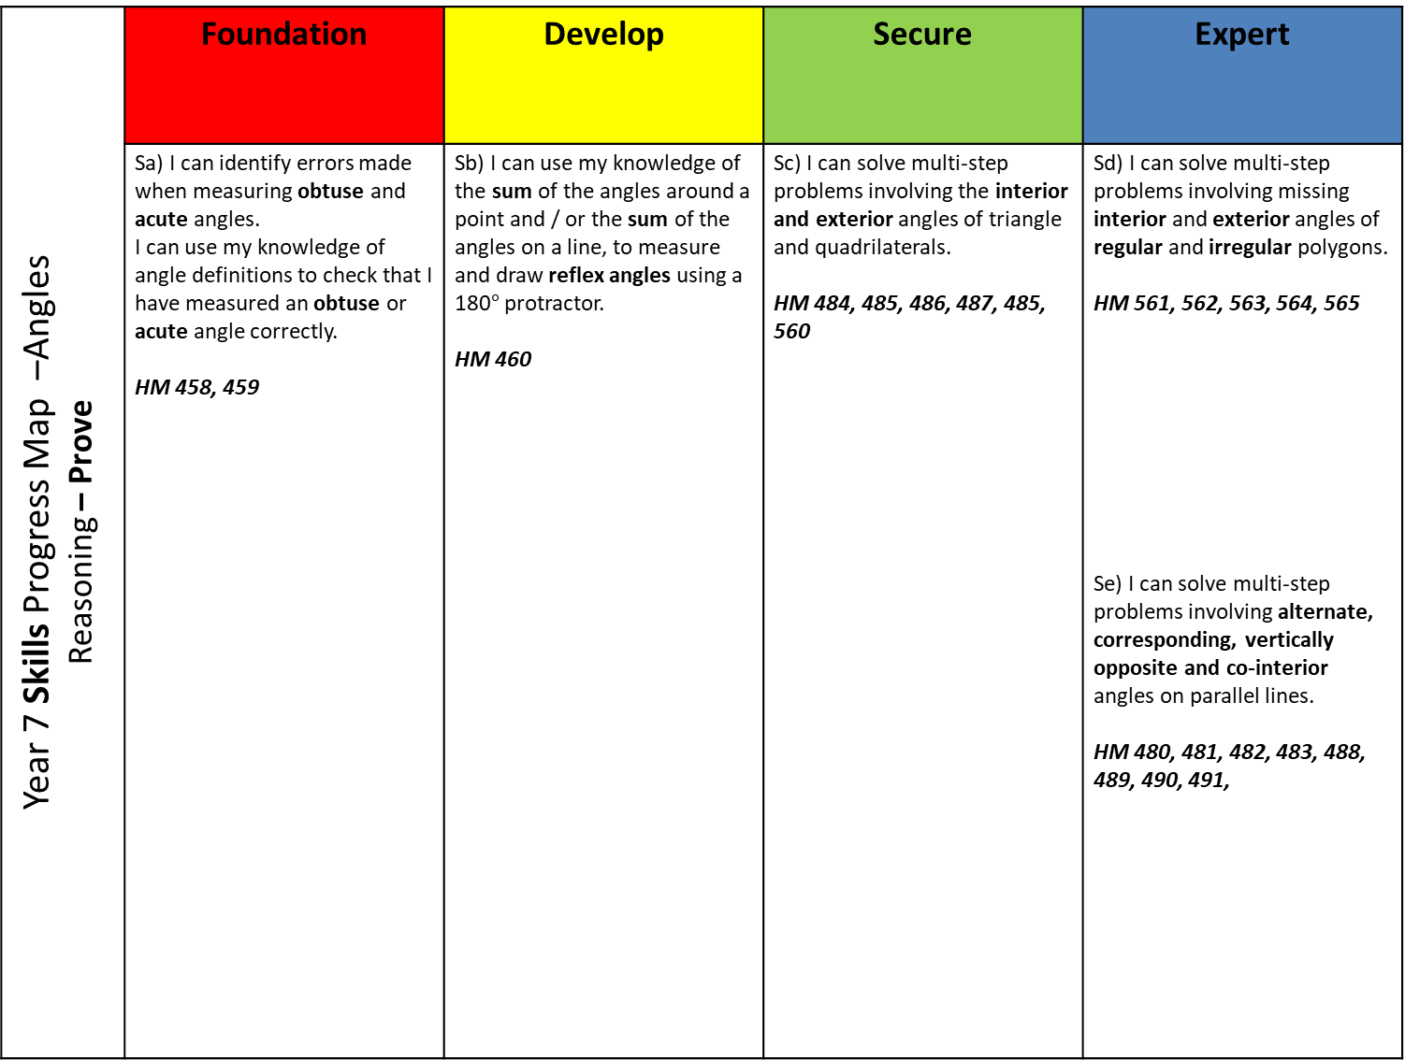
Year 7 Skills Progress Map –Angles Reasoning – Prove | Foundation | Develop | Secure | Expert
Year 7 Knowledge Progress Map – Number Line and Place Value Reasoning - Explore; Find examples and counter-examples | Sa) I can identify errors made when measuring obtuse and acute angles. I can use my knowledge of angle definitions to check that I have measured an obtuse or acute angle correctly. HM 458, 459 | Sb) I can use my knowledge of the sum of the angles around a point and / or the sum of the angles on a line, to measure and draw reflex angles using a 180$°$ protractor. HM 460 | Sc) I can solve multi-step problems involving the interior and exterior angles of triangle and quadrilaterals. HM 484, 485, 486, 487, 485, 560 | Sd) I can solve multi-step problems involving missing interior and exterior angles of regular and irregular polygons. HM 561, 562, 563, 564, 565 Se) I can solve multi-step problems involving alternate, corresponding, vertically opposite and co-interior angles on parallel lines. HM 480, 481, 482, 483, 488, 489, 490, 491,
Example
Shown is a regular pentagon. Calculate angle y.
Example
Calculate angle x.
Example
Using a protractor measure this angle.
What type of angle is this?
Example
Ms Hindle has been asked to draw a 150° angle.
She has made a mistake. Explain what she has done wrong.
Example
Calculate the size of angle x.

Slide 9
When choosing their activity pupils should be encouraged to think about the following questions……
Q What are you learning about today?
Q Where are you on your Learning Journey?
Q Where are you trying to get to on your Learning Journey?
Q How will you get there?

Slide 10
Open Starters / Do Now
Lead to a class discussion
Explanations come from the pupils
Link to the main activity / task.

Slide 11
Ask a question – make a comment starter activities.
What questions might pupils ask?
What conjectures might they make?
What explanations might they offer?
What misconceptions might they reveal?
Notes:
10 minutes

Slide 12

Make a comment or ask a question.

Slide 13

This is a regular pentagon, find the value of the missing angle.

Slide 14
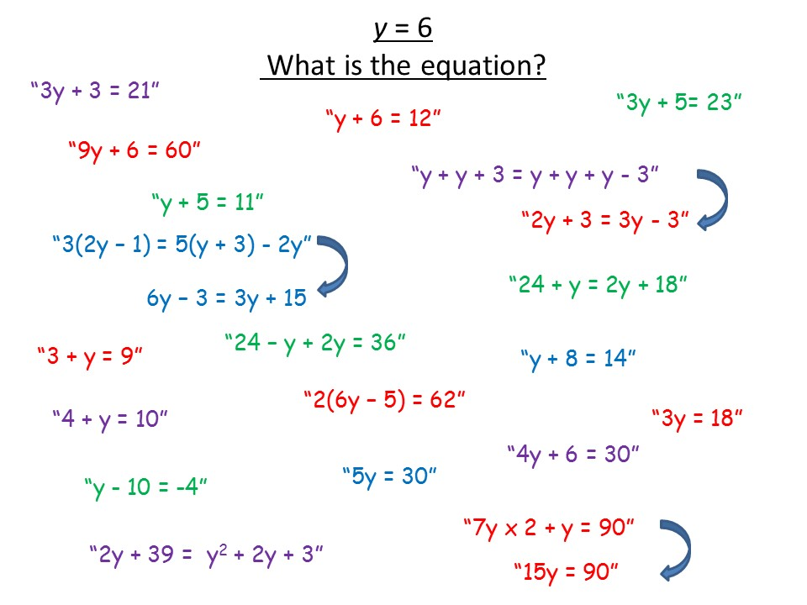
Notes:
Example of an open starter activity, with pupils’ responses.

Slide 15
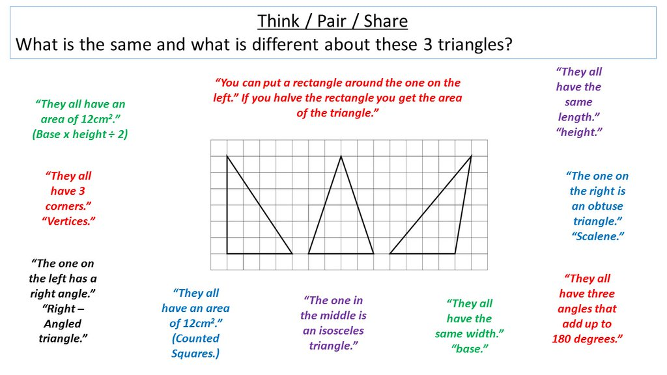
Notes:
Example of an open starter activity, with pupils’ responses.

Slide 16
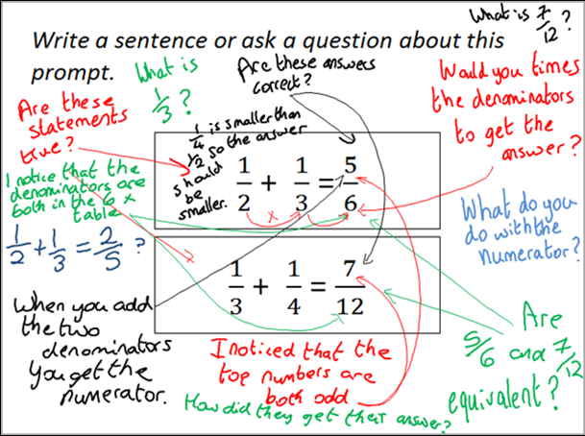
Notes:
Example of an Inquiry Prompt, with pupils’ responses. See www.inquirymaths.org

Slide 17
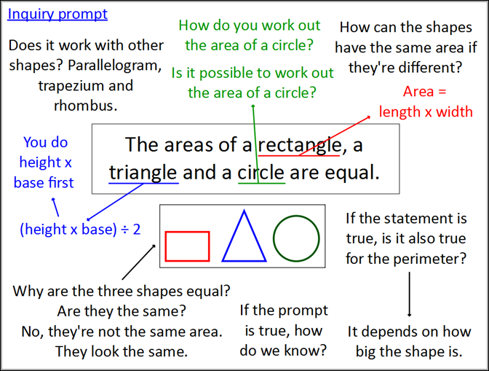
Notes:
Example of an Inquiry Prompt, with pupils’ responses. See www.inquirymaths.org

Slide 18
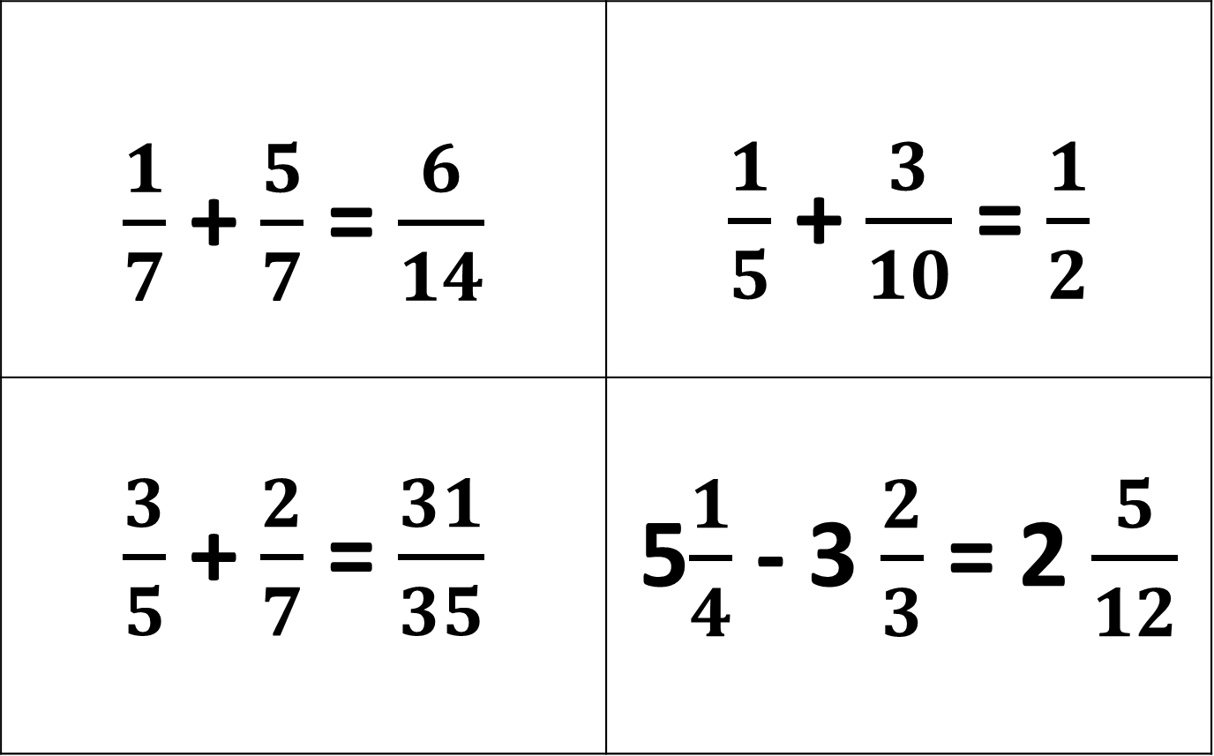
True or False? – Convince Me
$\frac{1}{7}$ + $\frac{5}{7}$ = $\frac{6}{14}$ | $\frac{1}{5}$ + $\frac{3}{10}$ = $\frac{1}{2}$
$\frac{3}{5}$ + $\frac{2}{7}$ = $\frac{31}{35}$ | 5$\frac{1}{4}$ - 3 $\frac{2}{3}$ = 2 $\frac{5}{12}$
Notes:
Example of an open starter activity.

Slide 19
Which is the odd one out?
You must give a reason for your answer.
6
3
2
4
6
3
2
2
14
Notes:
Example of an open starter activity

Slide 20
Which are familiar?
Which do you find effective?
How could you change these for a different topic?

Slide 21
Differentiation is essential to the meet the diverse needs of all the learners in the class.
Differentiation involves a range of techniques, strategies and organisational options.

Slide 22
Differentiation by ………
Task - Pupils work on different tasks / worksheets with the lesson.
Support - Some pupils may work with a teaching assistant
Questioning - Bringing all students in a class into a question and answer exchange.. adjusting the level of questioning to the student in a subtle way.
Explanation - Pupils receive different teacher input at different times throughout the lesson.
Outcome - The same stimulus leads to open ended responses. (‘Multiple Entry Point Tasks’ )
Expectation - There are various learning goals that are shared with pupils. Pupils are taught how to and encouraged to self select the appropriate learning goal, for example through reference to a learning journey.

Slide 23
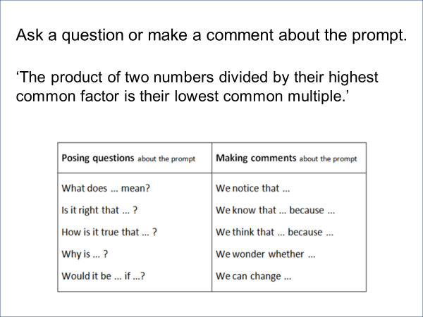
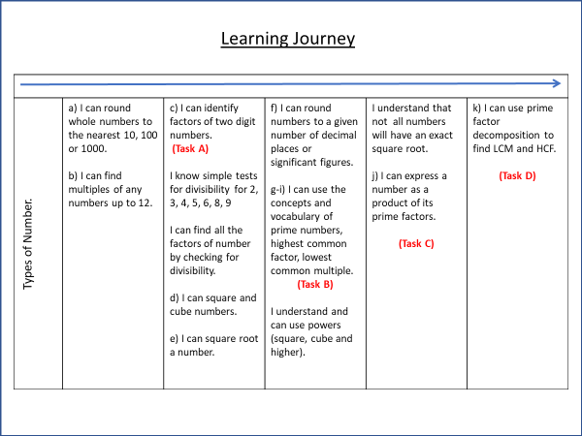
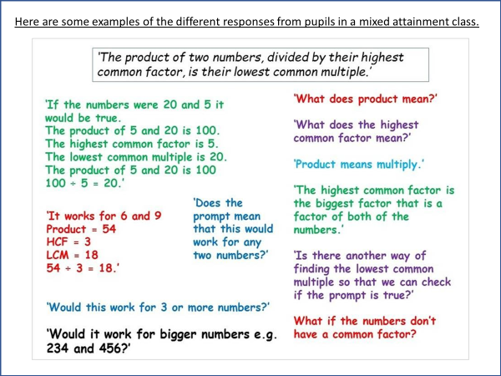
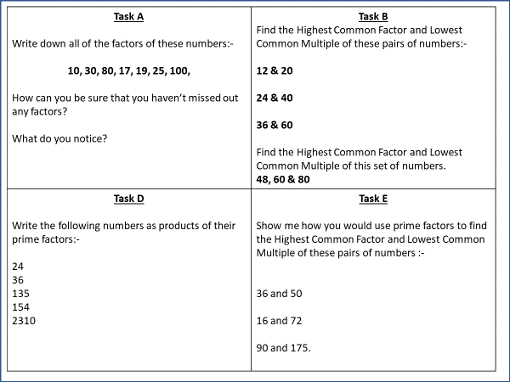
Notes:
Example of a differentiated main activity.

Slide 24
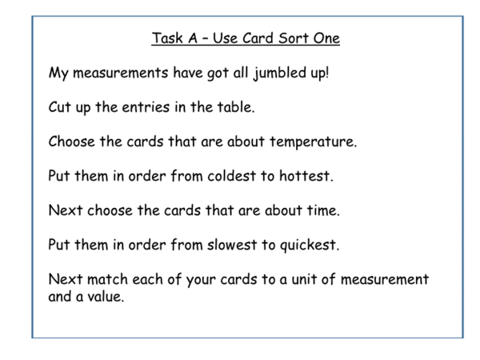
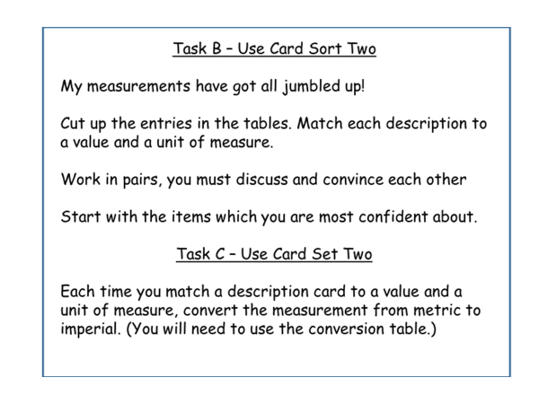
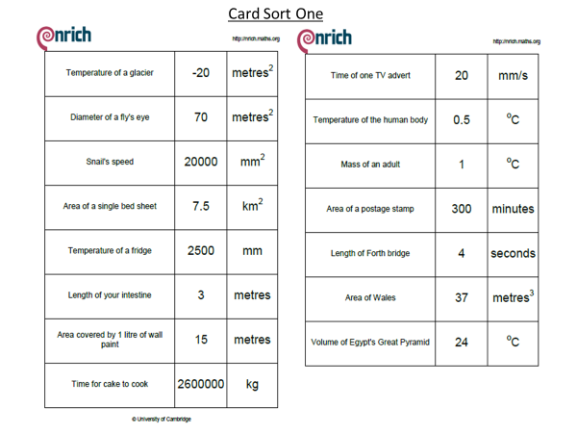
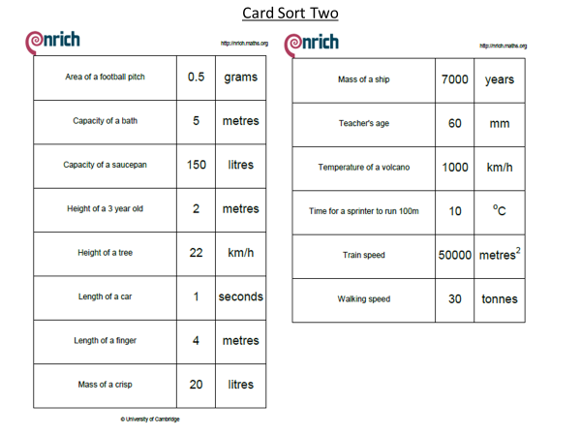
Notes:
Example of a differentiated main activity.

Slide 25
B
I
D M
A S
Four 4s investigation
Use the symbols at the top of each column to make the
numbers up to 20 with four 4s.
Example: 4 + 4 + 4 – 4 = 8
+ - | + - x ( ) | + - x ÷ ( ) | + - x ÷ ( ) !
1. 2. 3. 4. 5. 6. 7. 8. 9. 10. 11. 12. 13. 14. 15. 16. 17. 18. 19. 20
Notes:
Example of a differentiated main activity.

Slide 26
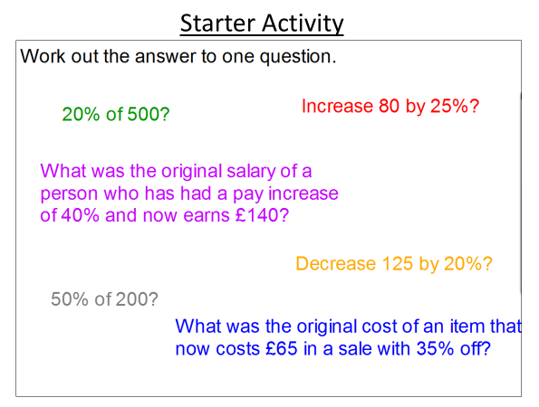
Main Activity –
The answer is…….
Make up six questions that have the same answer.
Put your questions in order from the least to the most challenging.
Notes:
Example of a differentiated main activity.

Slide 27
Differentiated Tasks Discussion
Which is the most Effective?
Which has the greatest depth of Maths?
Which is the most Open?
What further adaptions might you make?
What concrete resources might you use?

Slide 28
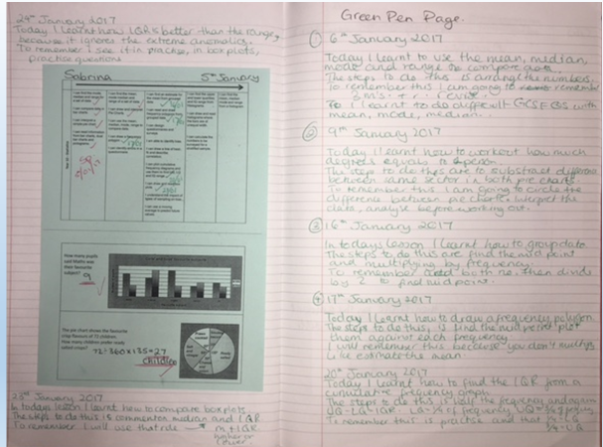
Student Reflection
Notes:
Example of a strategy for student reflection.

Slide 29
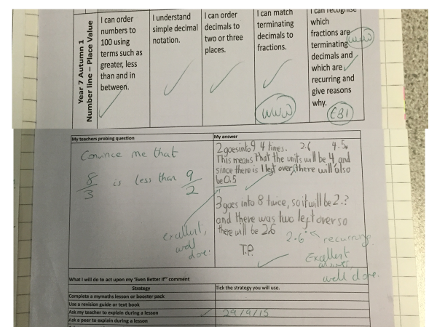
Notes:
Setting a challenge question after marking an assessment.

Slide 30
GREEN PEN PAGE
Today I learned…
The steps to do this are…
To remember this I will… or I need to remember to….
Notes:
Example of a strategy for student reflection.

Slide 31
Colour in the arrow, up to the statement which best describes your current understanding.
 | I’m so confident - I could explain this to someone else!
 | I can get to the right answer but I don’t understand well enough to explain it yet.
 | I understand some of this but I don’t understand all of it yet.
 | I tried hard and I listened but I am finding this challenging. I will make sure that I get help with this next lesson.
 | I do not understand any of this yet. There are things I could do to be a better learner next lesson.
Notes:
Example of a strategy for student reflection.

Slide 32
My Favourite MISTAKES
Means
I
Start
To
Acquire
Knowledge
Experience
Skills
A mistake that moved my learning on……
Notes:
Example of a strategy for student reflection.

Slide 33
Tips I would give a friend to solve this problem are ......... | I have made a link between this topic and … | To help me move forward, when I got stuck today, I ….
Today I interacted with the teacher by …… | Today I am still unsure about ……………… To fill in this gap I intend to ………… | A barrier to my learning today was……….. I will try to overcome this by …..
Today I explained to ………. how to ………….. | Something I have learnt today about the way I learn is ……… | At home, I need to look at ………………
Notes:
Example of a strategy for student reflection.

Slide 34
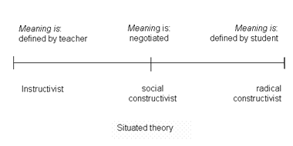
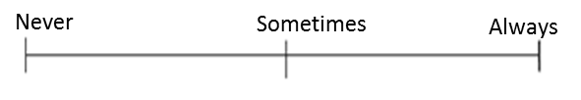
Which mindset did I demonstrate? | Mark each scale with an arrow.
Did I use whole class discussions / explanations as learning opportunities? (Did I listen? Did I ask questions? Did I contribute answers or make suggestions?)
Did I work on tasks that challenged me?
Did I use strategies to ‘un-stick’ myself when I found the tasks difficult?
Did I check my work for mistakes and correct them?
Did I put as much effort as I possibly could into the tasks?
Never
Sometimes
Always
Notes:
Example of a strategy for student reflection.

Slide 35
Progress Pyramid
One question I would like answered…
Two things I am not sure about yet….
Three things I understand well enough to explain to someone else…
Notes:
Example of a strategy for student reflection.

Slide 36
I am really pleased with...
Today I have tried to...
To progress I need to...
Today I have learned that...
In these questions I have learnt that…
I have been able to…
But I got stuck on...
Self Reflection
Before this lesson I could already...
Now I can also...
One thing I need to remember from today’s lesson is...
I was successful when I…
I did not know how to…
But now I can…
The most important thing I learned today is...
I can see the link between...
Notes:
Example of a strategy for student reflection.

Slide 37
The structure of mixed attainment maths lessons in my department.
Do Now Activity –
‘Open’.
All pupils must be able to contribute.
Should lead to a class discussion in which pupils share their ideas and methods.
Should provide the explanation for the main task.
Main Activity –
Differentiated by task or Multiple Entry Point.
Pupils choose their activity by referring to their Learning Journey.
Pupils must be given the opportunity to self select their activity but this must be monitored by the teacher so that pupils that select inappropriately can be redirected.
Plenary
Brings the class back together – what have we learnt?
Plenary should be followed by pupil reflection on their learning.

Slide 38
Set high expectations and encourage
Challenge
Collaboration
Choice

