Slide 1
Practical Approaches for Teaching
Mixed Attainment Mathematics Groups
Helen Hindle
@helenhindle1
www.growthmindsetmaths.com
www.mixedattainmentmaths.com

Slide 2

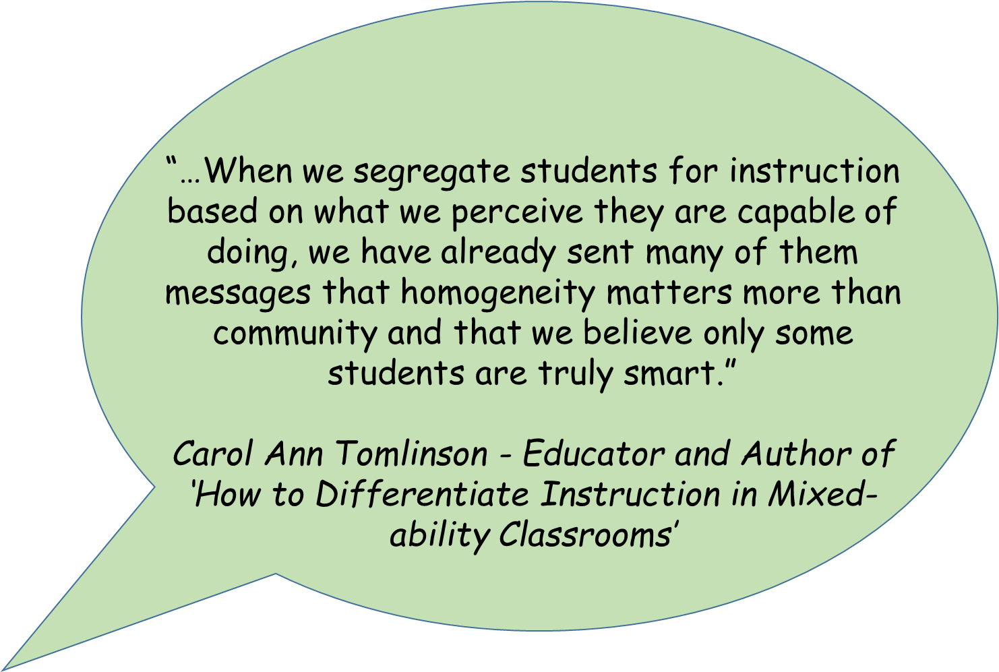

Slide 3
What is mixed attainment teaching?
Classes that have a range of:-
Prior attainment,
SEN,
Pupil Premium
Attitude to Learning

Slide 4
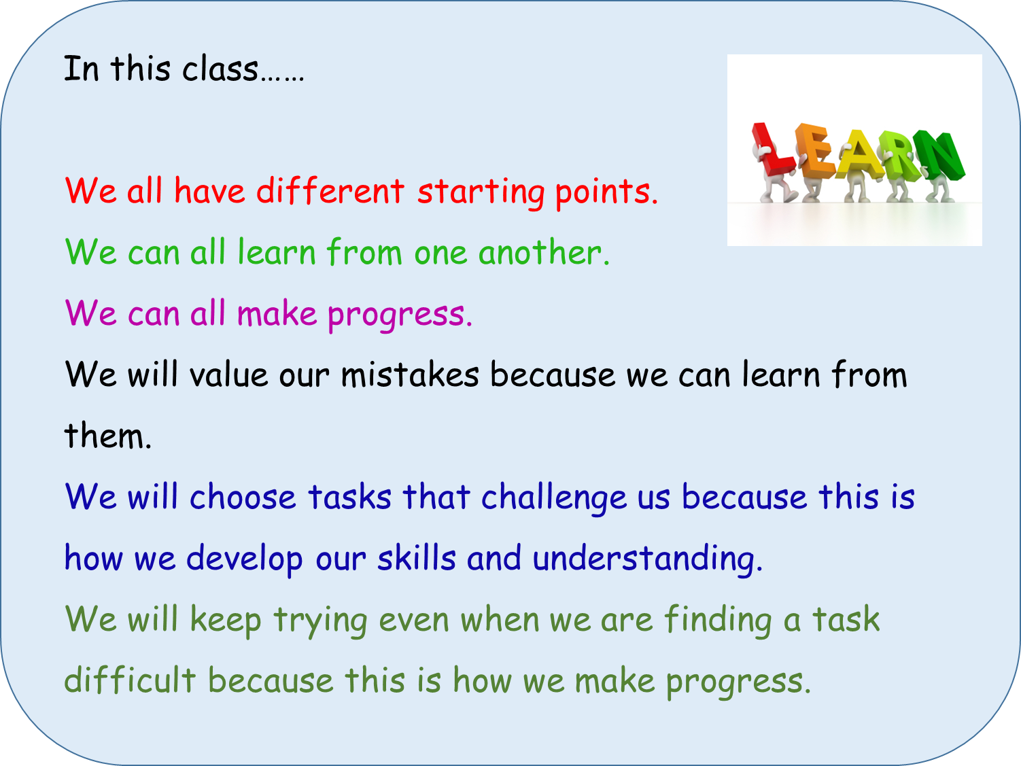

Slide 5
Differentiation – The Big Debate
All pupils should work collaboratively on the same task.
All pupils should work on the same mathematical skill, higher attaining pupils can be stretched with problem solving and reasoning tasks.
No one should move on until everyone understands.
Offer all pupils accessible tasks which can be extended at different rates and depths.
Notes:
5 minutes

Slide 6
Differentiation is essential to the meet the diverse needs of all the learners in the class.
Differentiation involves a range of techniques, strategies and organisational options.

Slide 7
Differentiation by ………
Task
Support
Questioning
Explanation
Outcome
Expectation

Slide 8
Differentiation by ………
Task – Pupils work on different tasks / worksheets with the lesson.
Notes:
Differentiation by task should never be the assigning of different tasks to different children at the outset.
Differentiation by task should involve students self selecting a level of task which will enable them to make progress.

Slide 9
Differentiation by ………
Support – Some pupils may work with a teaching assistant
Notes:
Encourage the teaching assistant to support through questioning
Avoid ‘learned helplessness.’

Slide 10
Differentiation by ………
Explanation – Pupils receive different teacher input at different times throughout the lesson.
Notes:
Encourage pupils to support one another
Avoid explaining the full range of tasks / learning outcomes from the front.

Slide 11
Differentiation by ………
Questioning
Bringing all students in a class into a question and answer exchange.. adjusting the level of questioning to the student in a subtle way.

Slide 12
Differentiation by ………
Outcome – The same stimulus leads to open ended responses. (‘Multiple Entry and Exit Point Tasks’ or ‘High Ceiling Low Threshold Tasks’.)
Notes:
The low threshold should be low enough to enable all students to access the task and the High Threshold should be beyond the reach of any child to achieve independently.

Slide 13
Differentiation by ………
Expectation –There are various learning goals that are shared with pupils. Pupils are taught how to and encouraged to self select the appropriate learning goal, for example through reference to a learning journey.
Notes:
All learning goals should involve elements of reasoning and problem solving.

Slide 14
Open Starters y = 6 What is the equation?

Slide 15
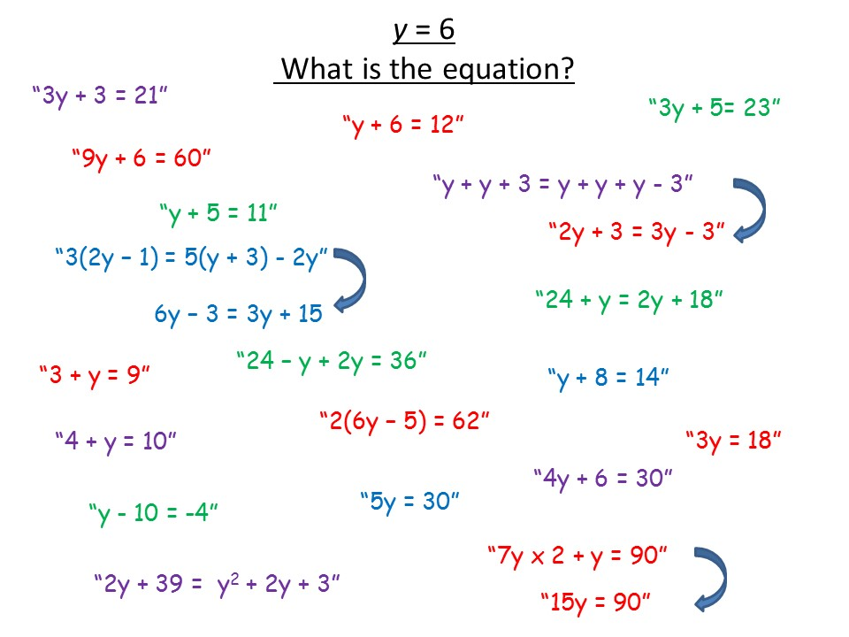

Slide 16
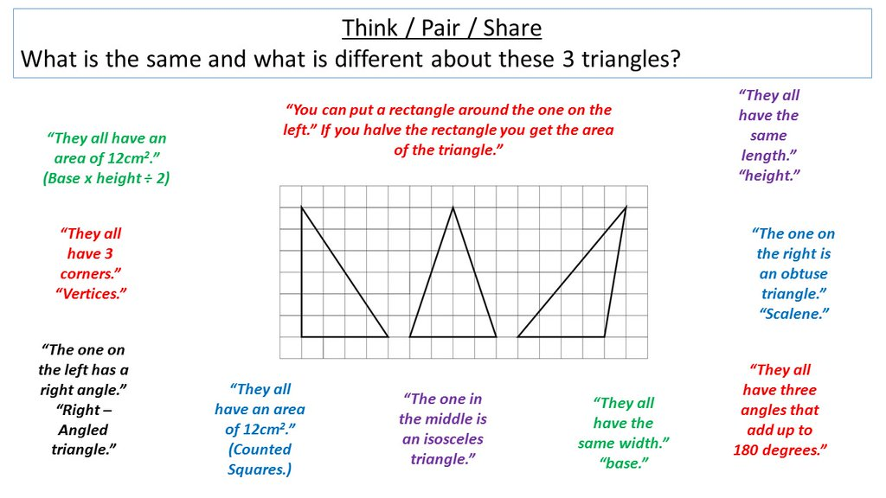

Slide 17
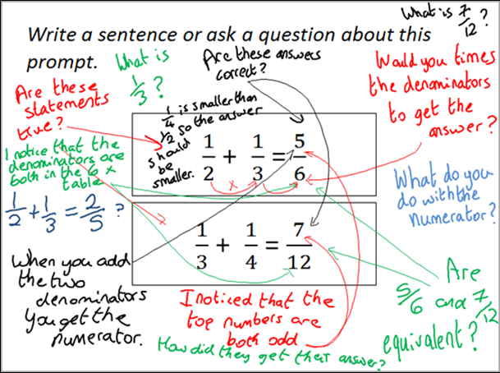

Slide 18
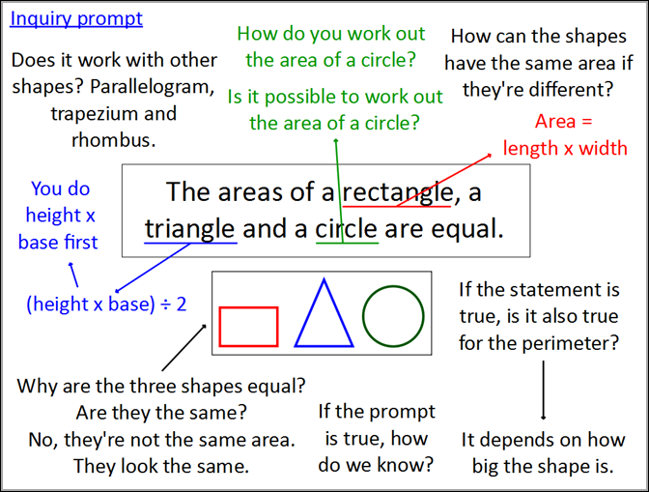
www.inquirymaths.com @inquirymaths #inquirymaths

Slide 19
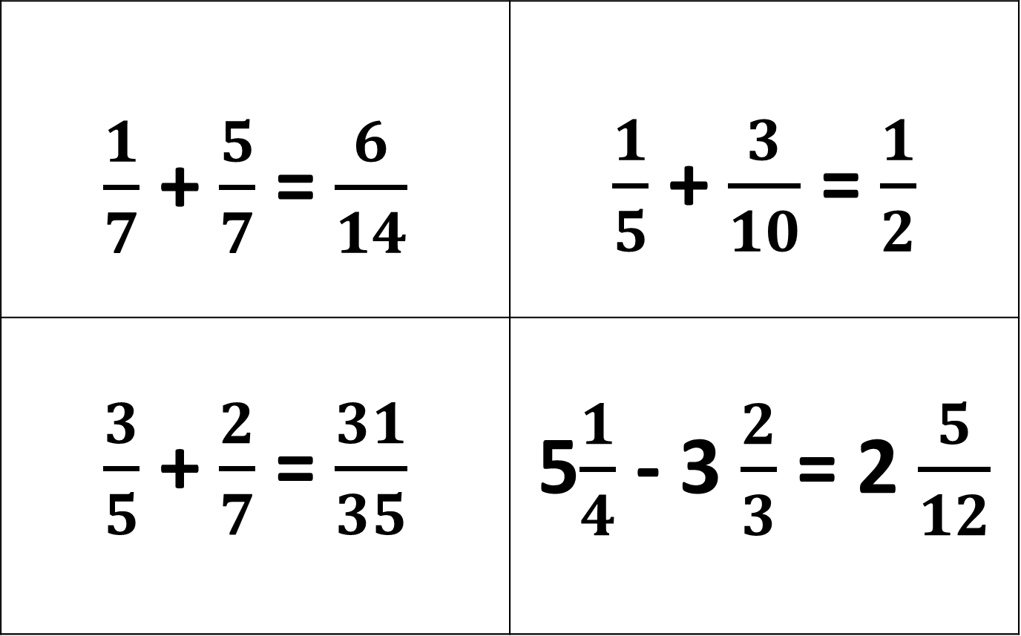
True or False? – Convince Me
$\frac{1}{7}$ + $\frac{5}{7}$ = $\frac{6}{14}$ | $\frac{1}{5}$ + $\frac{3}{10}$ = $\frac{1}{2}$
$\frac{3}{5}$ + $\frac{2}{7}$ = $\frac{31}{35}$ | 5$\frac{1}{4}$ - 3 $\frac{2}{3}$ = 2 $\frac{5}{12}$

Slide 20
Create an open starter or prompt
What questions might pupils ask?
What conjectures might they make?
What explanations might they offer?
What misconceptions might they reveal?
Notes:
10 minutes

Slide 21
Area and Perimeter of Triangles & Quadrilaterals | I understand and can explain the difference between area and perimeter. | I can find the area and perimeter of shapes by counting squares. | I can find the area of rectangles and squares using a formula. | I can find the area of compound shapes, triangles, parallelograms, trapeziums and kites. | I can solve area and perimeter problems by forming and solving equations.

Slide 22
Differentiated Tasks Discussion
Which is the most Effective?
Which has the greatest depth of Maths?
Which is the most Open?
What further adaptions might you make?
What concrete resources might you use?

Slide 23
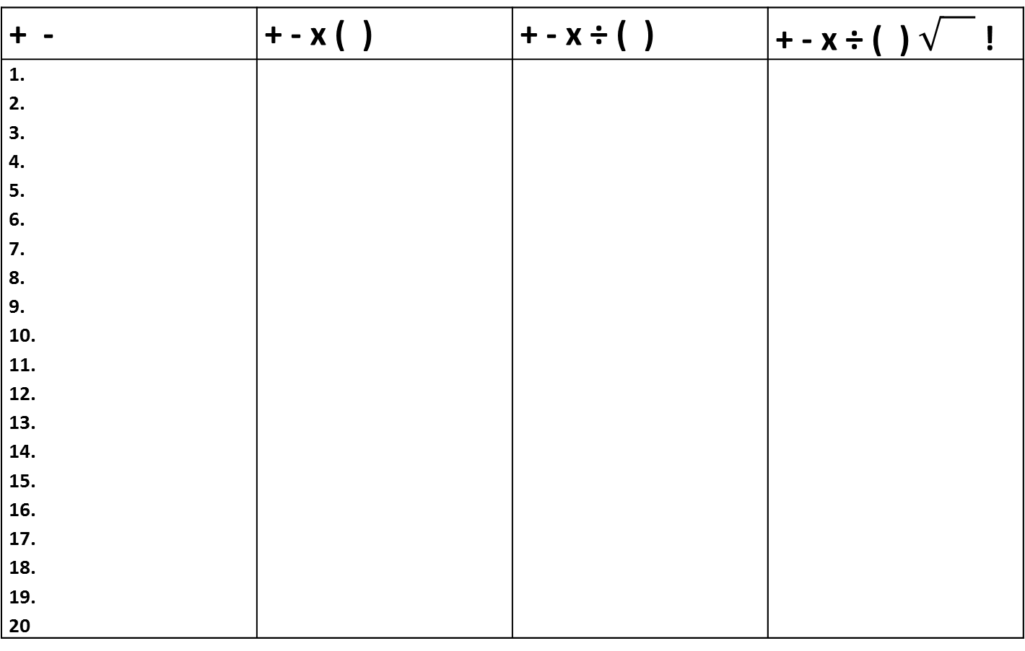
B
I
D M
A S
Four 4s investigation
Use the symbols at the top of each column to make the
numbers up to 20 with four 4s.
Example: 4 + 4 + 4 – 4 = 8
+ - | + - x ( ) | + - x ÷ ( ) | + - x ÷ ( ) !
1. 2. 3. 4. 5. 6. 7. 8. 9. 10. 11. 12. 13. 14. 15. 16. 17. 18. 19. 20
Notes:
Example One.

Slide 24
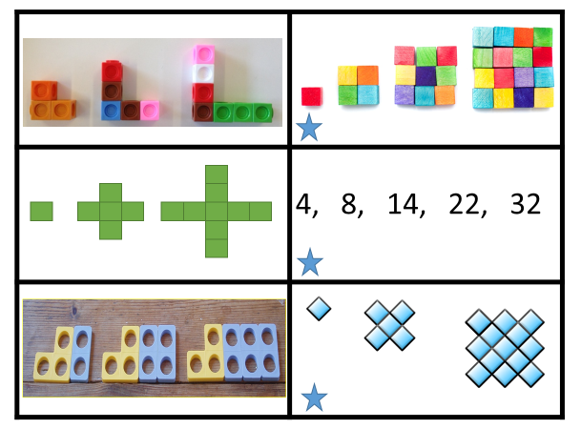
For each sequence decide which of these tasks will challenge you:-
Draw the next two patterns and describe how the pattern grows in words
Copy and complete the table of results.
Find a rule that will help you to predict patterns number 7 and 8. Describe your rule.
Try to find the 15th pattern using your rule?
Find a rule that will help you to predict the 100th pattern. Explain fully how you would use your rule to work out the 100th pattern.
Notes:
Example 2

Slide 25
Create an equivalent expressions spider diagram
Use substitution to check that your expressions are equivalent.
Task A Using the symbols for addition and subtraction write as many different expressions as you can for your chosen expression. | Task B Using the symbols for addition, subtraction, multiplication and division write as many different expressions as you can for your chosen expression. | Task C Using the symbols for addition, subtraction, multiplication and division and using brackets and indices write as many different expressions as you can for your chosen expression.
15n + 9
36n - 30
6n² + 9
Notes:
Example 3

Slide 26
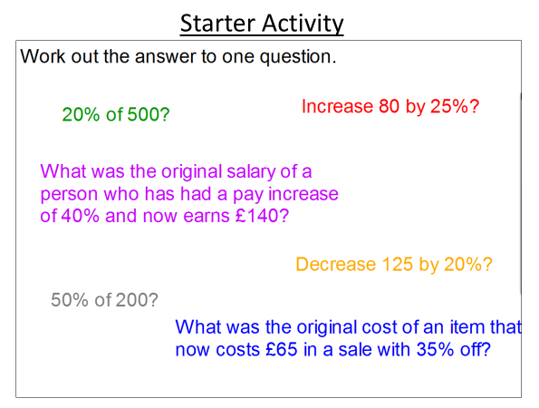
Main Activity –
The answer is…….
Make up six questions that have the same answer.
Put your questions in order from the least to the most challenging.
Notes:
Example 4

Slide 27
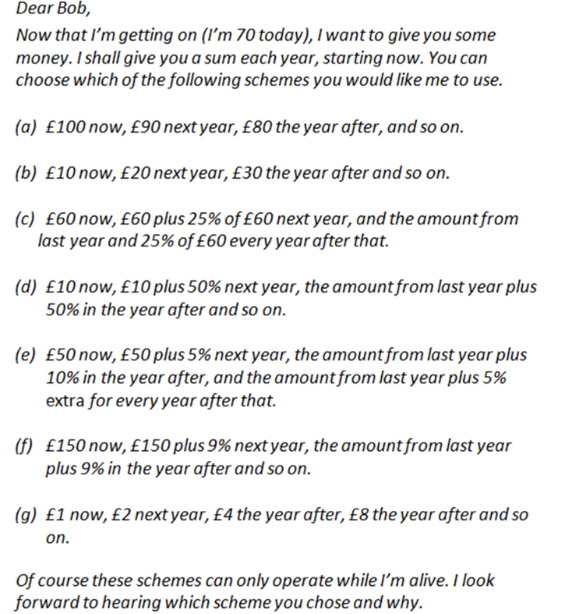
Decide which schemes you want to investigate.
You must compare at least 3 schemes.
Complete the table for your chosen schemes.
Make sure that you show all of your working out.
Notes:
Example 5

Slide 28
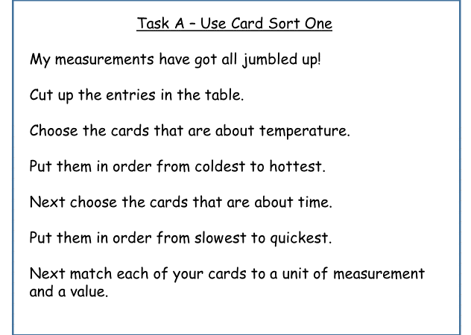
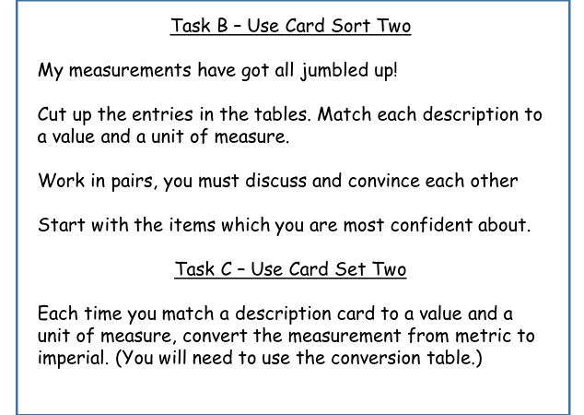
Notes:
Example 6

Slide 29
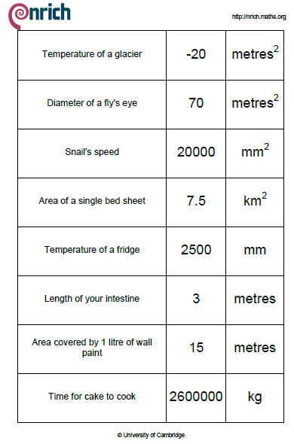
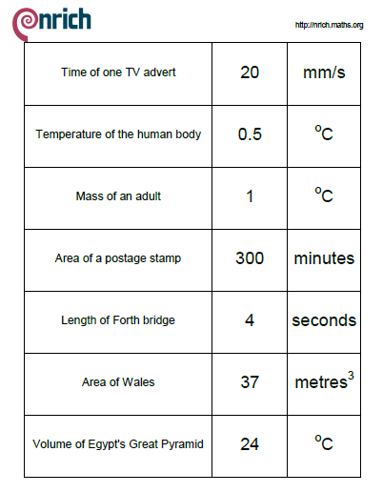
Card Sort One
Notes:
Print this slide and the next slide onto a double sided sheet as pupils will be choosing one of these card sets to use.

Slide 30
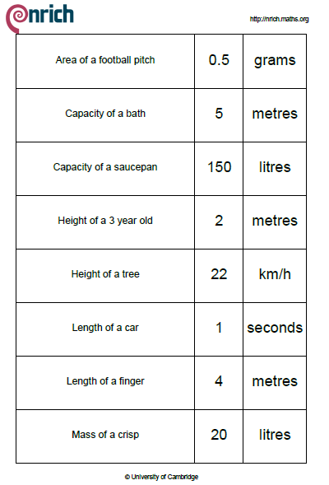
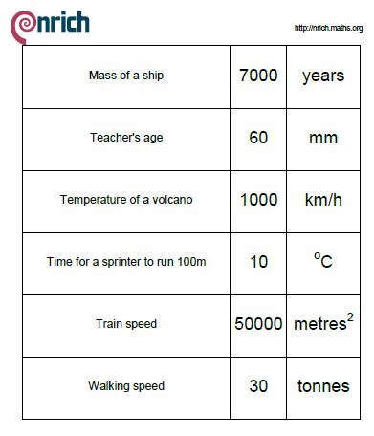
Card Sort Two
Notes:
Print this slide and the previous slide onto a double sided sheet as pupils will be choosing one of these card sets to use.

Slide 31
What is your favourite mixed attainment task?

Slide 32
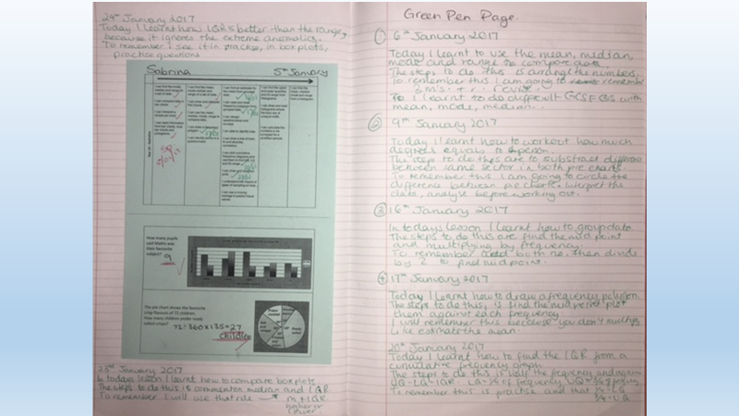
Student Reflection

Slide 33
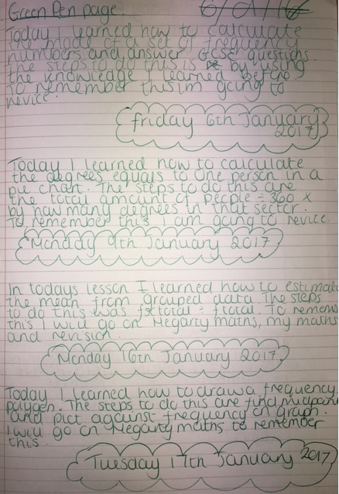
Same year 10 class – Middle achiever Student

Slide 34
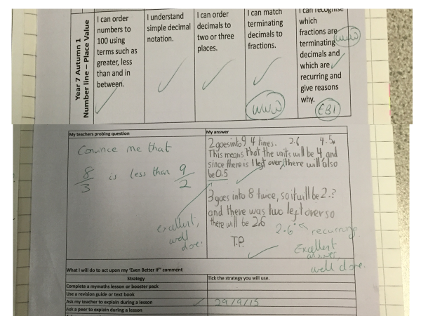
Notes:
Setting a challenge question after marking an assessment.

Slide 35
2nd version
GREEN PEN PAGE
Today I learned…
The steps to do this are…
To remember this I will… or I need to remember to….

Slide 36
Turn to your Green Pen Page
Today I learnt how to…….
The steps to do this are …….
To remember this I am going to…… or I need to remember to ………..

Slide 37
Colour in the arrow, up to the statement which best describes your current understanding.
 | I’m so confident - I could explain this to someone else!
 | I can get to the right answer but I don’t understand well enough to explain it yet.
 | I understand some of this but I don’t understand all of it yet.
 | I tried hard and I listened but I am finding this challenging. I will make sure that I get help with this next lesson.
 | I do not understand any of this yet. There are things I could do to be a better learner next lesson.

Slide 38
My Favourite MISTAKES
Means
I
Start
To
Acquire
Knowledge
Experience
Skills
A mistake that moved my learning on……

Slide 39
Tips I would give a friend to solve this problem are ......... | I have made a link between this topic and … | To help me move forward, when I got stuck today, I ….
Today I interacted with the teacher by …… | Today I am still unsure about ……………… To fill in this gap I intend to ………… | A barrier to my learning today was……….. I will try to overcome this by …..
Today I explained to ………. how to ………….. | Something I have learnt today about the way I learn is ……… | At home, I need to look at ………………

Slide 40
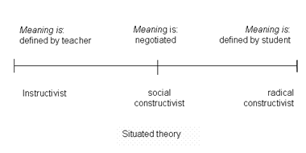
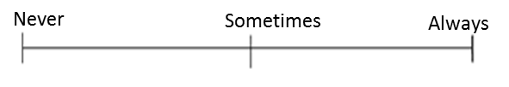
Which mindset did I demonstrate? | Mark each scale with an arrow.
Did I use whole class discussions / explanations as learning opportunities? (Did I listen? Did I ask questions? Did I contribute answers or make suggestions?)
Did I work on tasks that challenged me?
Did I use strategies to ‘un-stick’ myself when I found the tasks difficult?
Did I check my work for mistakes and correct them?
Did I put as much effort as I possibly could into the tasks?
Never
Sometimes
Always

Slide 41
Progress Pyramid
One question I would like answered…
Two things I am not sure about yet….
Three things I understand well enough to explain to someone else…

Slide 42
All pupils must have access to the full range of differentiated tasks
Pupils must be given the opportunity to select the appropriate task for themselves
Pupils should be aware that every lesson they should be engaged in a task which challenges them but which is also achievable
Pupils should be given frequent opportunities to reflect on their learning / progress against their learning journey.

Slide 43
Set high expectations and encourage
Challenge
Collaboration
Choice

Slide 44
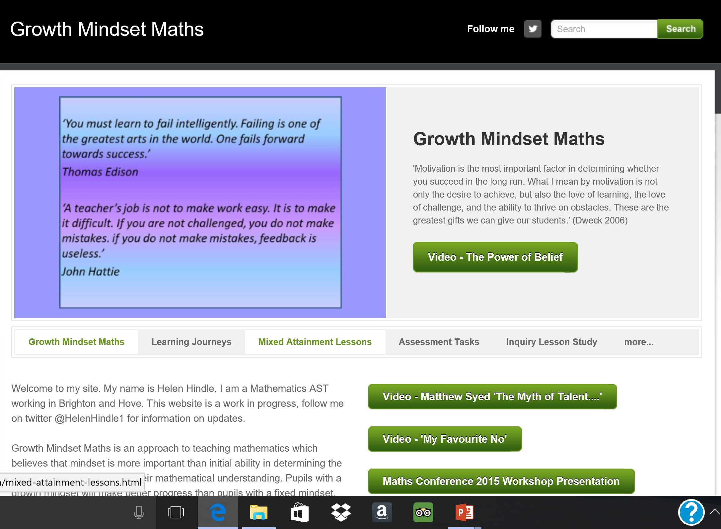

Slide 45


Slide 46
@helenhindle1
mixedattainmentmaths@gmail.com
www.growthmindsetmaths.com
www.mixedattainmentmaths.com
#mixedattainmentmaths

