Slide 1
Transition to Mixed Attainment
Gareth Evans
@MrE_Maths
www.garethevansmaths.wordpress.com

Slide 2
Our Story So Far…
Tarleton Academy @tarletonmaths
Mixed attainment school
‘you can’t teach mixed attainment in maths. It doesn’t work’
Finding Helen Hindle on twitter
Attending the first #mixedattainmentmaths conference
Buying in to it
We visited Cheadle Hulme High School
Notes:
Fully backed by school.
Maths benefitted from all the other subjects being mixed when we were still setted.
We visited Cheadle Hulme High School in Stockport as they have been mixed attainment for 8 years.
Our lesson model is based on what we saw there.

Slide 3
Barriers
If you already teach mixed attainment classes:
What concerns did you have before you made the transition?
How did you get around them?
If you are thinking about making the transition:
What are your concerns about teaching mixed attainment classes?
How could you get around them?
Notes:
*Before task*
We had a faculty day where we started to put together our plans.
We started by deciding what we thought might be our barriers.
Flipchart paper and pens.

Slide 4
Our Fears, and How We Got Around Them
It will involve more planning
We will have to plan many different activities at the same time during the lesson
“High ability” students will be held back
“Low ability” students will be left behind
A more focused approach to planning, making us think more carefully about our teaching
Questioning is key. Minimal resources
We teach to the top through high ceiling, low threshold tasks
We filter down through scaffolding
Notes:
If you feel that SLT wouldn’t back it, feel free to get in contact with us and our SLT can provide support for the transition.
Come and visit us

Slide 5
Our Strategy
Year 7 and Year 8 teams – taken from Bruno Reddy’s advice
Nurture group
Collaborative Planning
Minimal planning
Focus on the basics
Questioning is key
No calculators in Year 7
“interesting”
Numeracy Ninjas
Notes:
Faculty planning day
Differentiation does not mean 3 lessons within one
Nurture group
Teaching for understanding – forces you to think about your delivery of lesson more
Doesn’t put ceiling on for lower ability
Questioning – it is important to have thought through questions first before delivery
Collaborative planning meetings – discuss teaching strategies and questions that could be used in upcoming lessons
Bar modelling
Chromebooks – using google classroom/Hegarty in lessons
18 hours CPD afterschool to discuss as a faculty additional to weekly collaborative planning

Slide 6
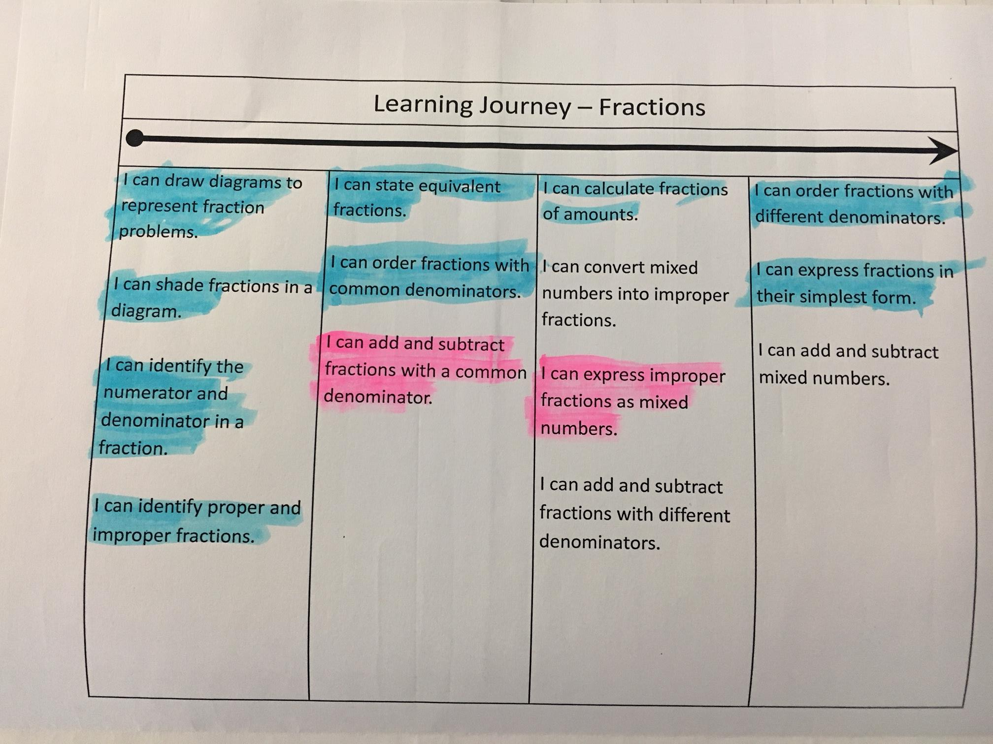
Helen Hindle’s Learning Journeys
Super 9
Highlight as you go along
Chromebooks
Visit www.growthmindsetmaths.com
Notes:
Visit www.growthmindsetmaths.com
I also blogged about them

Slide 7
Assessing
Questions based on Super 9
Notes to Myself
The purpose of assessing is to inform future learning
Feedback – “WWW/EBI” or “Dear Sir”
Hegarty Maths – AMAZING!
GCSE Paper
Notes:
Refer back to super 9
Focus on what they should have got right not what they haven’t

Slide 8
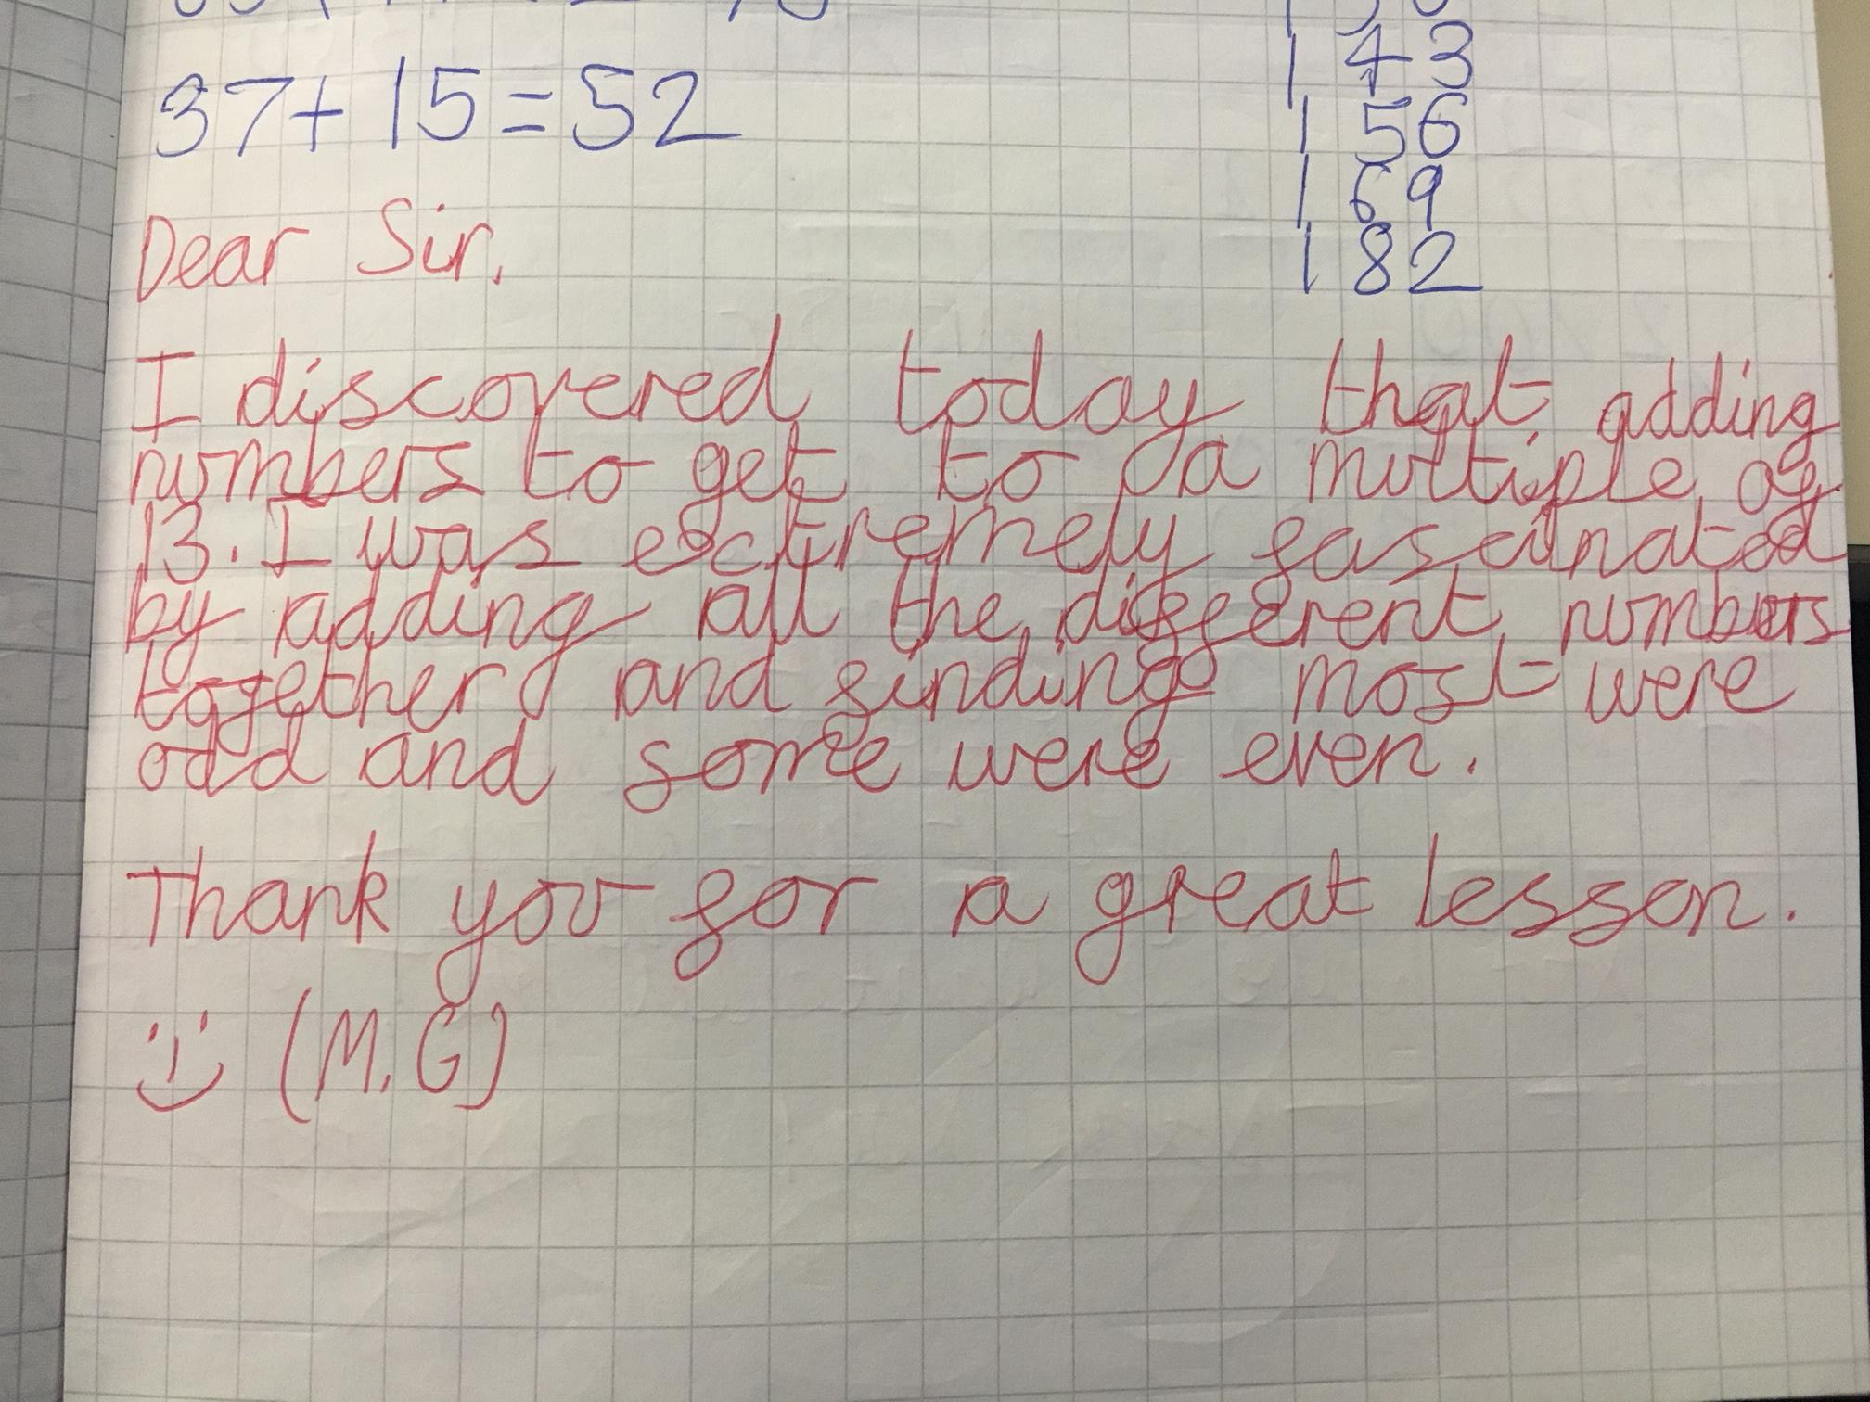
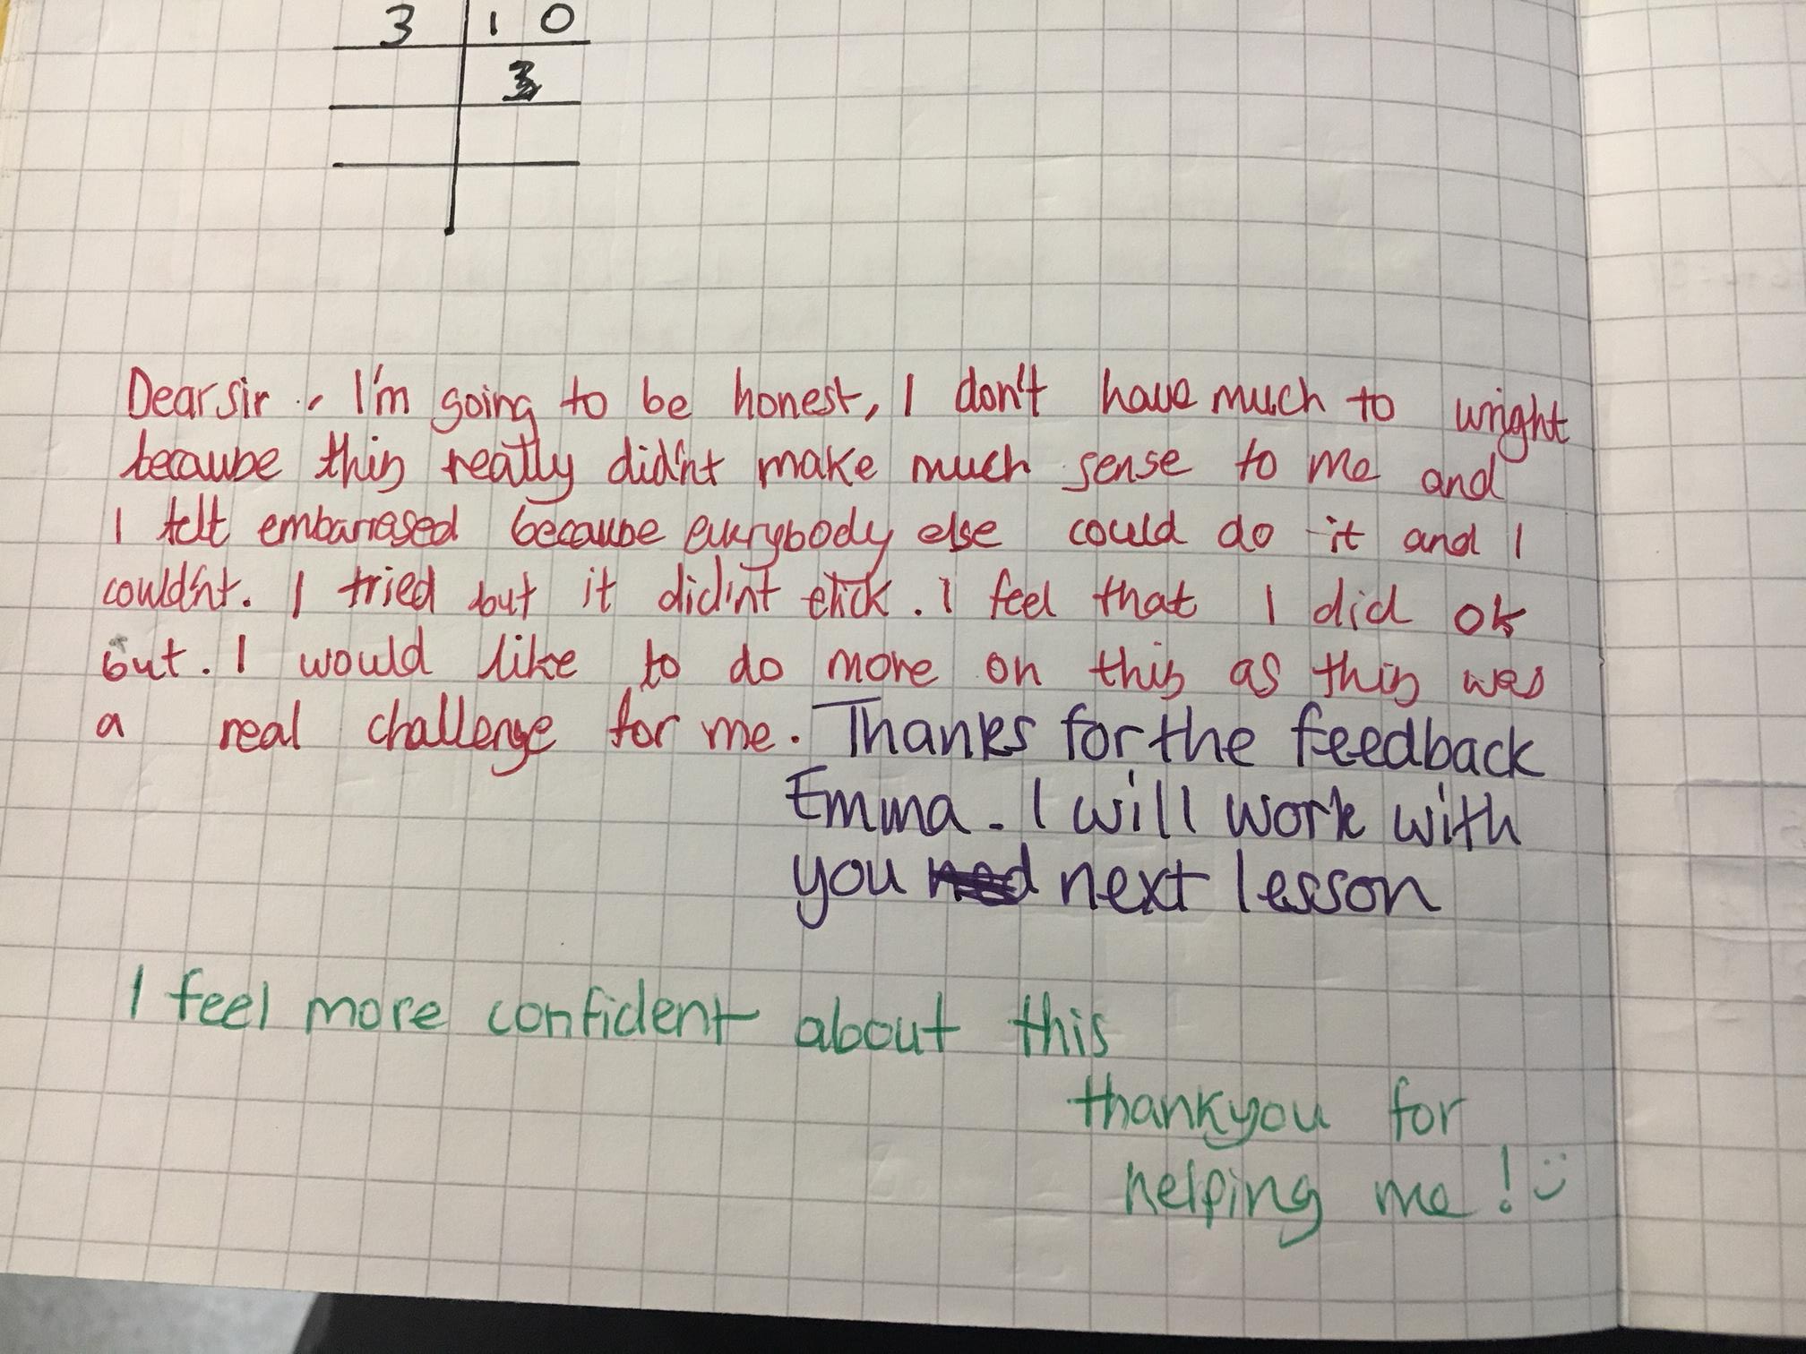
Dear Sir
Used at the end of lessons and assessments as a form of self reflection
Creates a dialogue between teacher and student
All students feel heard – and they are very honest!
Students write a ‘Dear Sir’ to me in red pen. I respond by setting Hegarty Maths tasks
Most important for students to comment on areas for improvement – they had to be trained!

Slide 9
A Typical Tarleton Lesson
Minimal planning and resources
Questioning

Slide 10
How many different ways could you fill the boxes?
What questions might a student ask?
What conditions could you set to make it harder?
The denominators must be common
Notes:
More examples on my blog

Slide 11
Resources
Here are some of our resource ideas. If you think you could make them even better, please let me know ☺
Notes:
Prime factors task – do it as a lesson for 15 minutes

Slide 12
Always, Sometimes, Never

Slide 13
Super 9
@miss_jobacon
Find more on my blog www.mrevansmaths.wordpress.com

Slide 14
How Many Ways…
Notes:
How could this be differentiated to show stretch and challenge?

Slide 15
Increasingly Difficult Questions
@Taylorda01

Slide 16
What Does the Future Hold?
Manipulatives
Develop the use of Chromebooks
Journals

Slide 17
Any questions?
You can contact me via
g.evans@tarletonacademy.org
@MrE_Maths
www.garethevansmaths.wordpress.com
You can contact my school via
My email
@tarletonmaths

