Slide 1
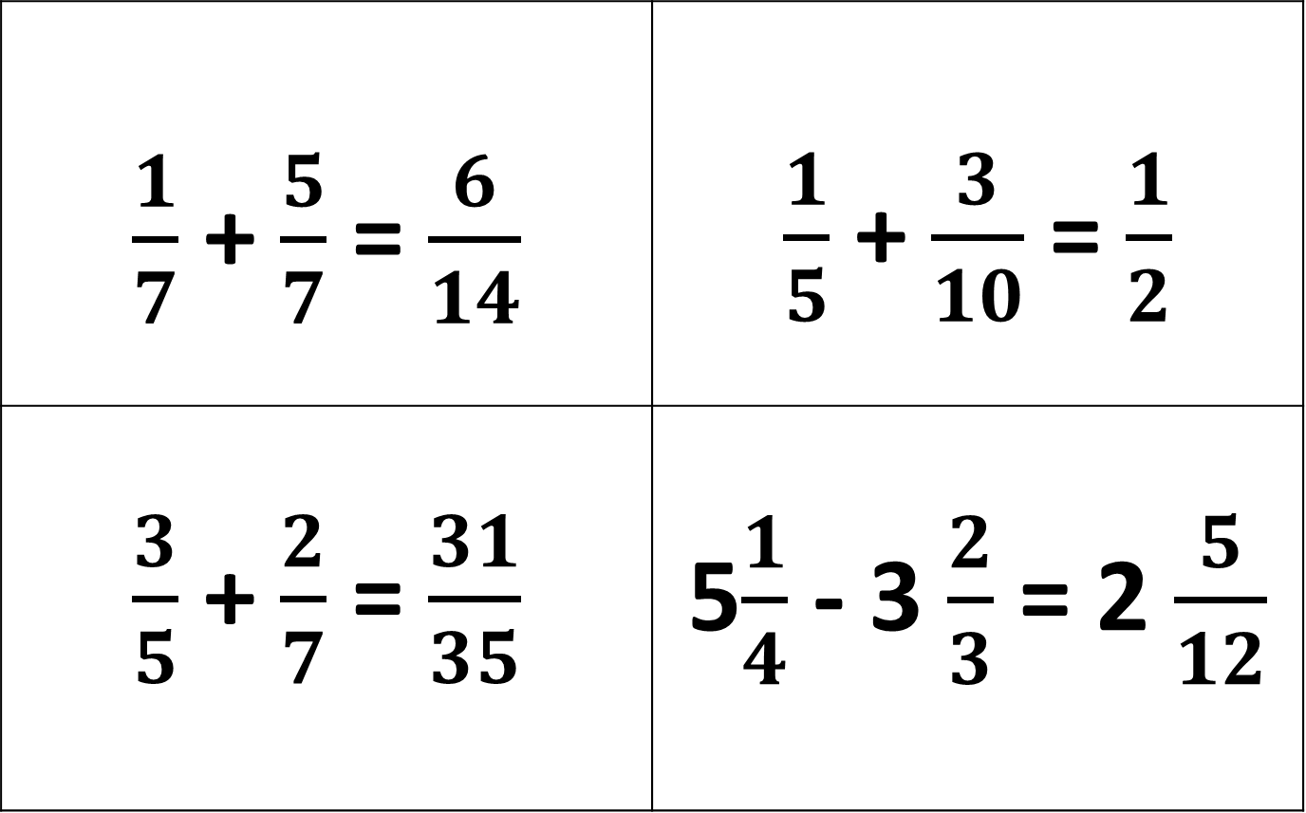
Choose and Example and decide if it is True or False? You must be ready to explain your answer.
$\frac{1}{7}$ + $\frac{5}{7}$ = $\frac{6}{14}$ | $\frac{1}{5}$ + $\frac{3}{10}$ = $\frac{1}{2}$
$\frac{3}{5}$ + $\frac{2}{7}$ = $\frac{31}{35}$ | 5$\frac{1}{4}$ - 3 $\frac{2}{3}$ = 2 $\frac{5}{12}$
Notes:
Example of an open starter activity.

Slide 2
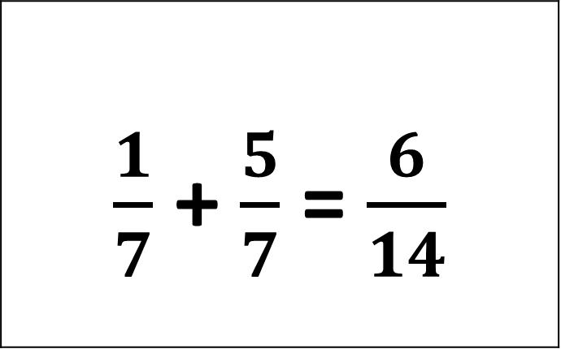
True or False? – Convince Me
$\frac{1}{7}$ + $\frac{5}{7}$ = $\frac{6}{14}$
Notes:
Example of an open starter activity.

Slide 3
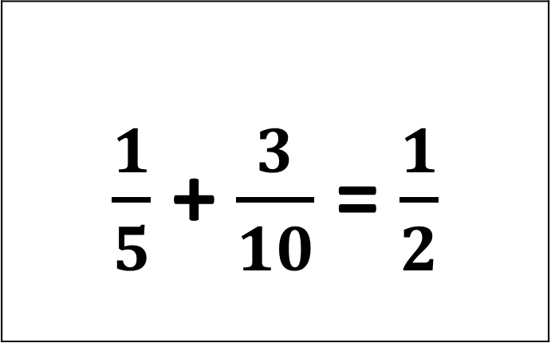
True or False? – Convince Me
$\frac{1}{5}$ + $\frac{3}{10}$ = $\frac{1}{2}$
Notes:
Example of an open starter activity.

Slide 4
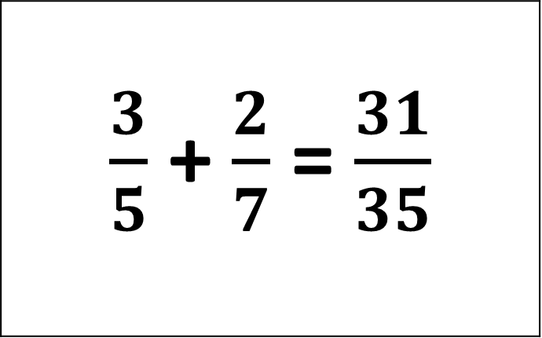
True or False? – Convince Me
$\frac{3}{5}$ + $\frac{2}{7}$ = $\frac{31}{35}$
Notes:
Example of an open starter activity.

Slide 5
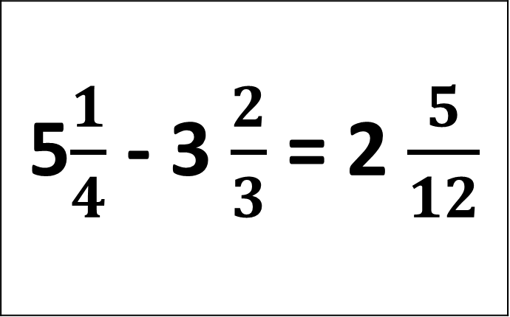
True or False? – Convince Me
5$\frac{1}{4}$ - 3 $\frac{2}{3}$ = 2 $\frac{5}{12}$
Notes:
Example of an open starter activity.

