Slide 1
Fractions
We use this equipment for the fractions activity.
Rainbow Fraction Tiles –
(These can be purchased from www.hopeeducation.co.uk)

Slide 2
Starter Activity - True or False? Convince Me…

Slide 3
Learning Journey
Calculations with Fractions | I can add and subtract fractions with a common denominator. (Task A) |  |  |  | I understand and can use efficient methods to add, subtract, multiply and divide fractions, including mixed numbers and questions that involve more than one operation. (Task E)

Slide 5
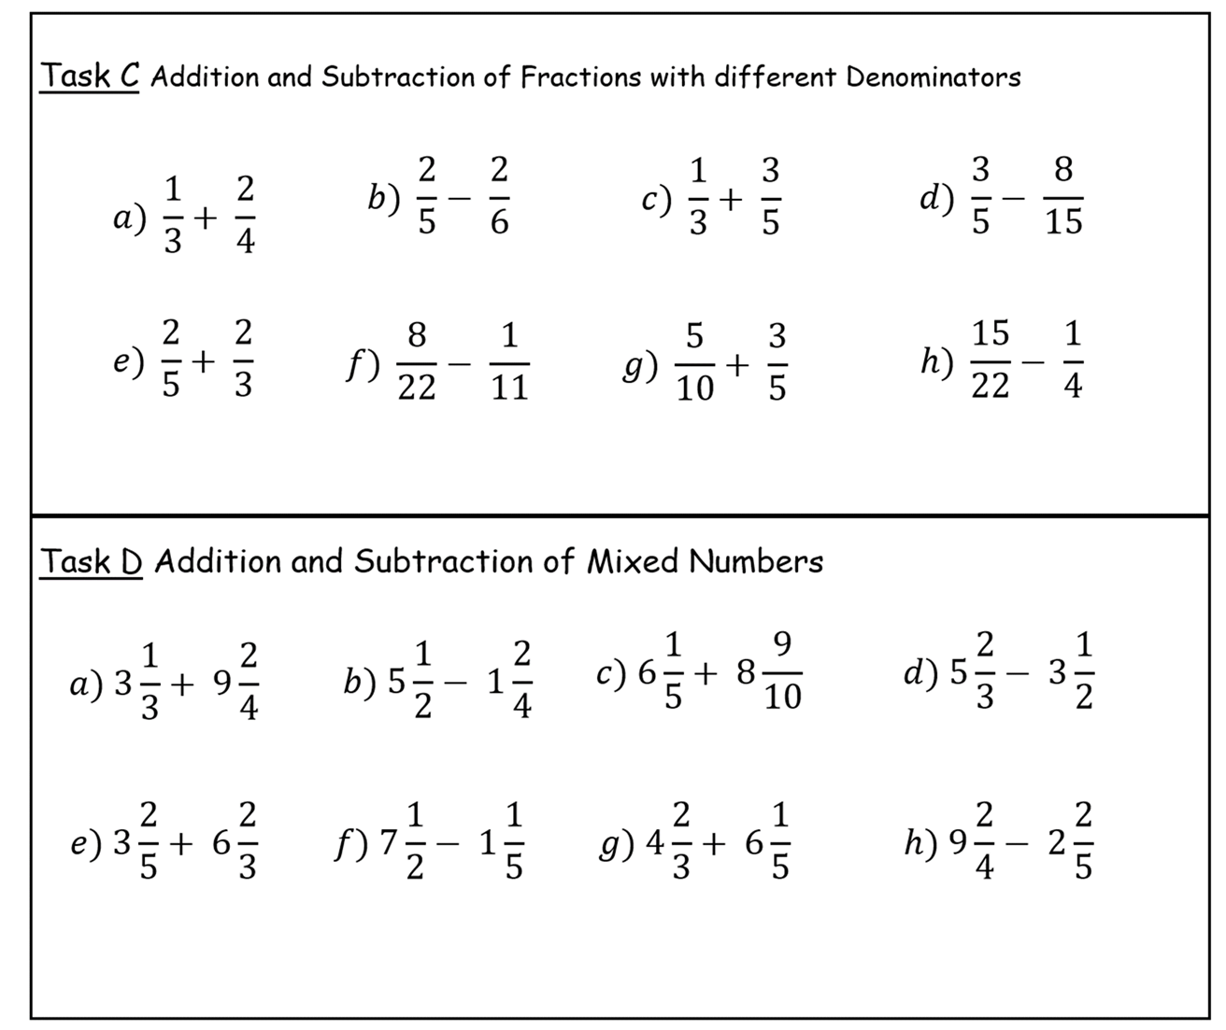
Notes:
Task E starts with an Inquiry Prompt – please see www.inquirymaths.org for a full description of the prompt and how it can be used by a mixed attainment class as an Inquiry lesson.

