Slide 1
TWO YEAR JOURNEY
OF ONE OF MANY MATHEMATICS FACULTIES

Slide 2
2016 - 17

Slide 3
INTRODUCING MIXED ABILITY TEACHING IN YEAR 7
DEVELOPMENT OF SCHEME OF WORK
REASERCH AROUND UNITS OF WORK

Slide 4
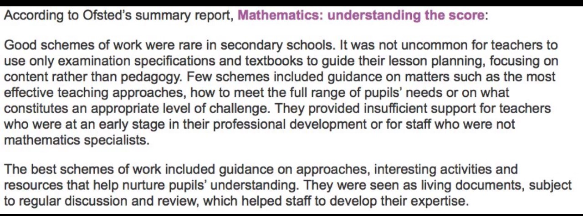

Slide 5
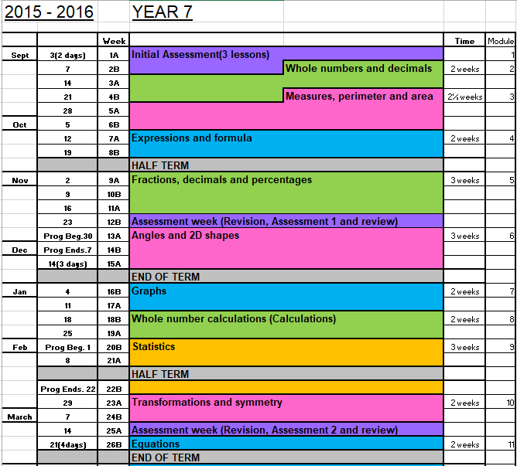
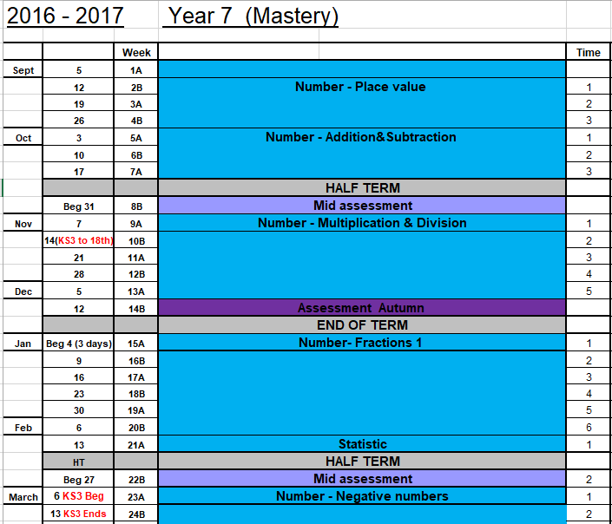

Slide 6
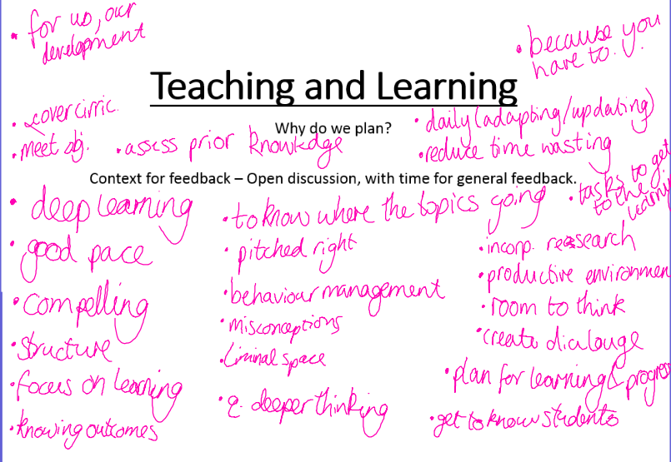

Slide 7
2017 - 18

Slide 8
INTRODUCING MIXED ABILITY TEACHING IN YEAR 7 & 8
DEVELOPMENT OF SCHEME OF WORK
REASERCH AROUND UNITS OF WORK
WORKING TOGETHER

Slide 9
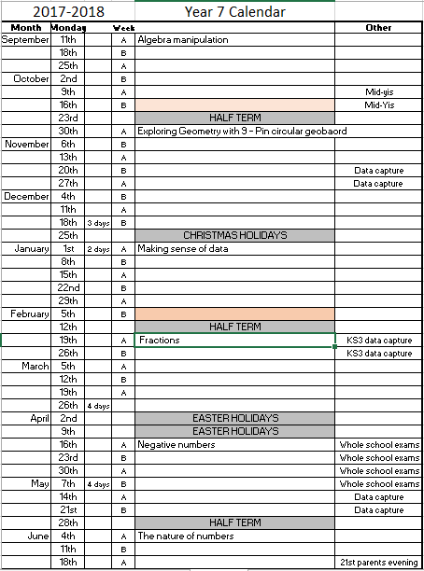

Slide 10
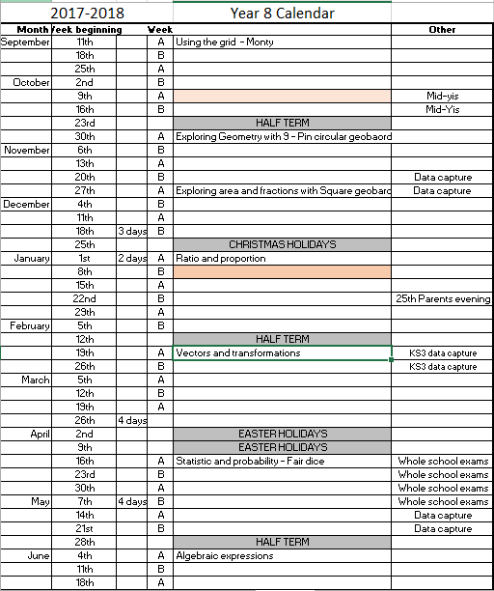

Slide 12
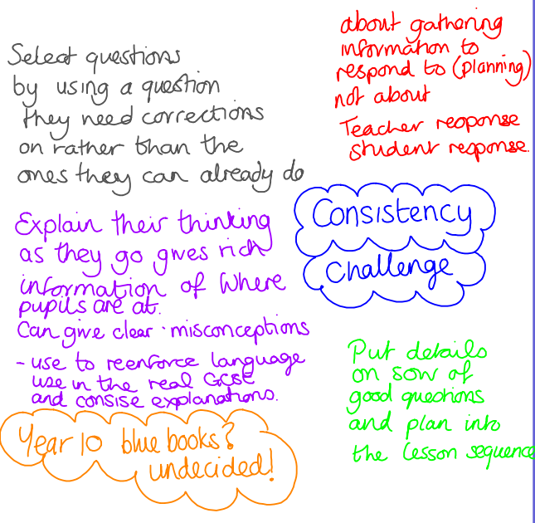

Slide 13
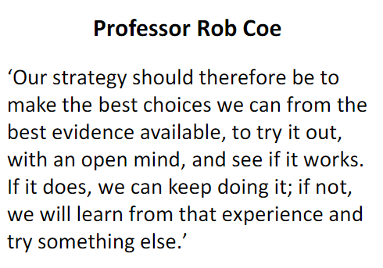

Slide 14
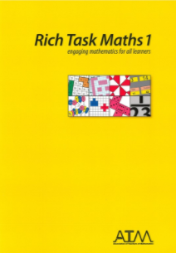
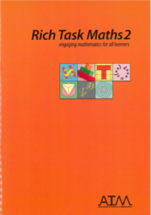
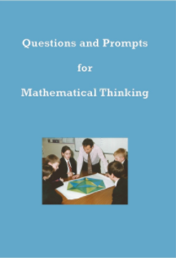
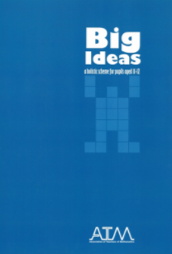
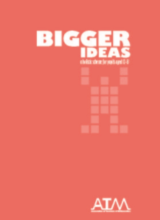
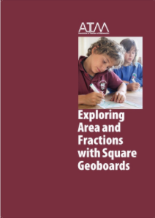
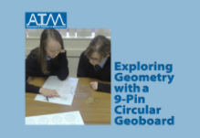
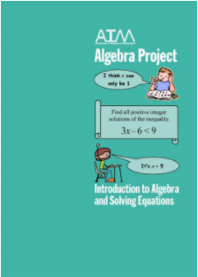
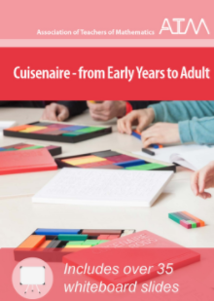

Slide 17
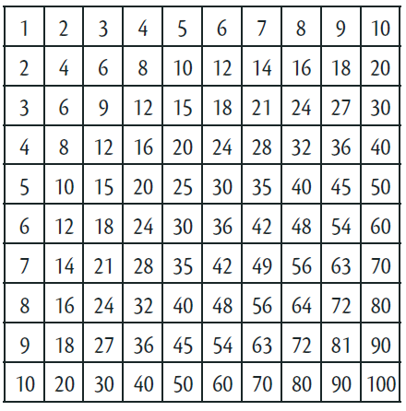

Slide 18
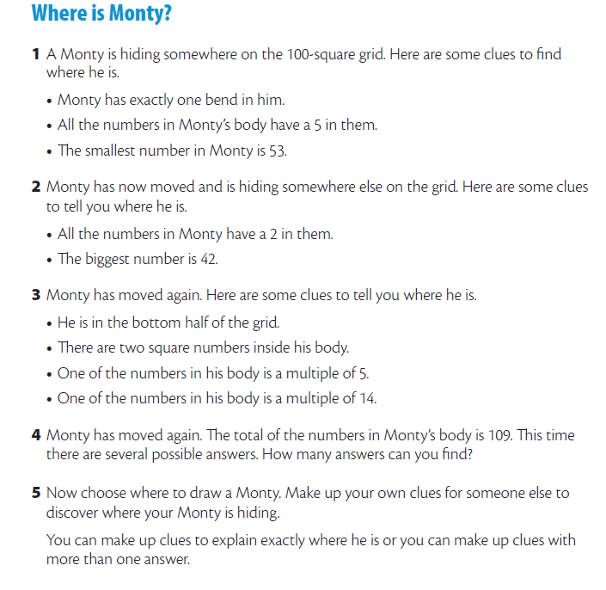
Why is this useful or not useful for mixed ability?
How can this task be developed further?
Is this accessible for all students?
Can it be used to challenge all students?

Slide 20
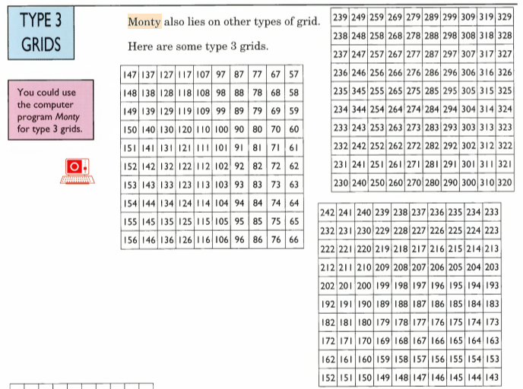

Slide 21
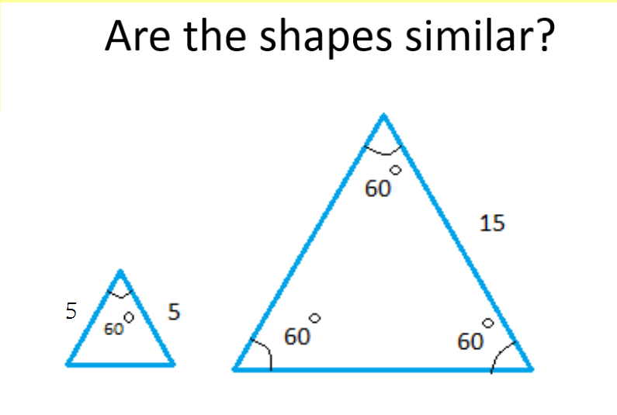
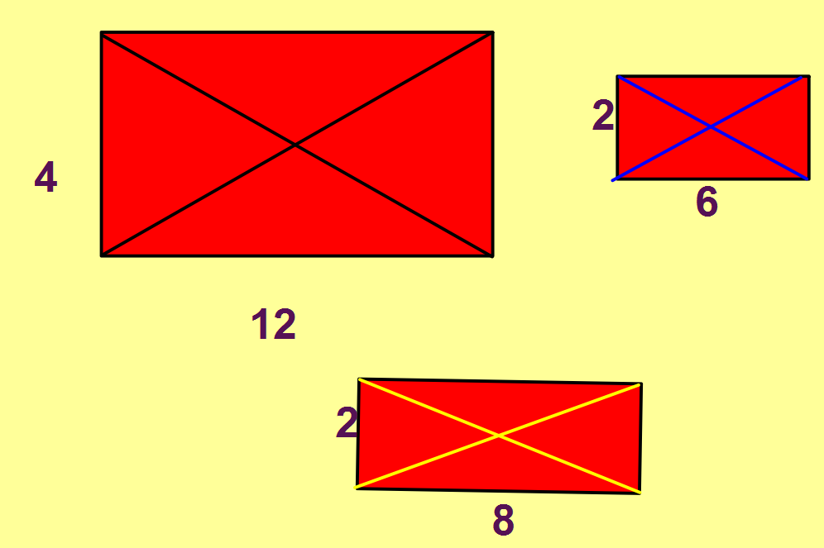

Slide 22
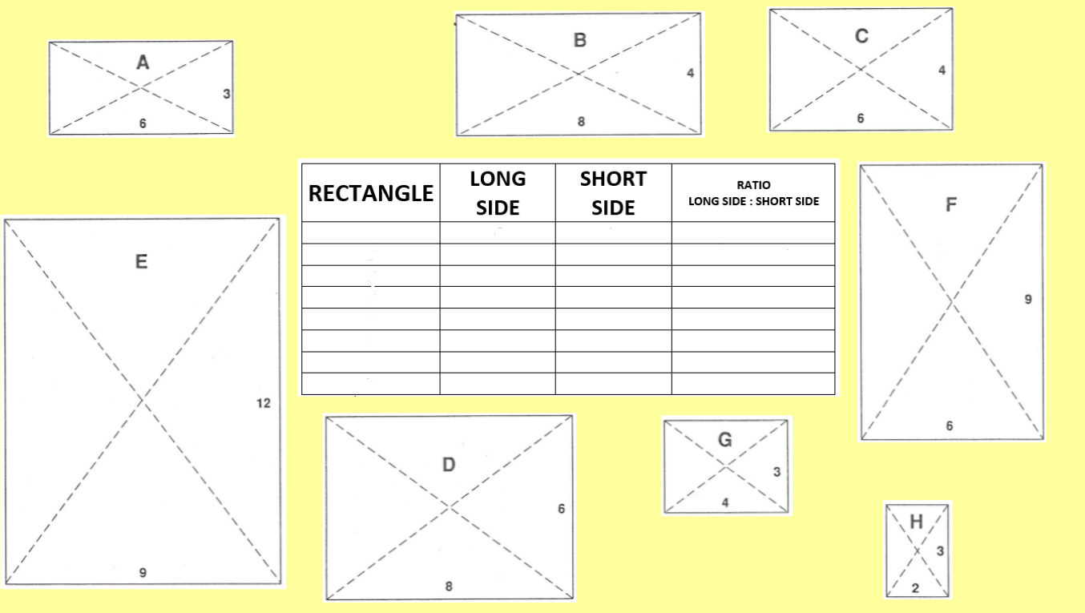
Smile/STEM website

Slide 23
Why is this useful or not useful for mixed ability?
How can this task be developed further?
Is this accessible for all students?
Can it be used to challenge all students?

Slide 24
