Slide 2
cre8ate maths
motivating, memorable mathematical
materials for KS3 & KS4

Slide 3
cre8ate maths took as its starting point
teacher involvement in creating mathematics curriculum materials
using a model of collaborative professional development
providing scope for teacher creativity and the development of teacher subject knowledge

Slide 4
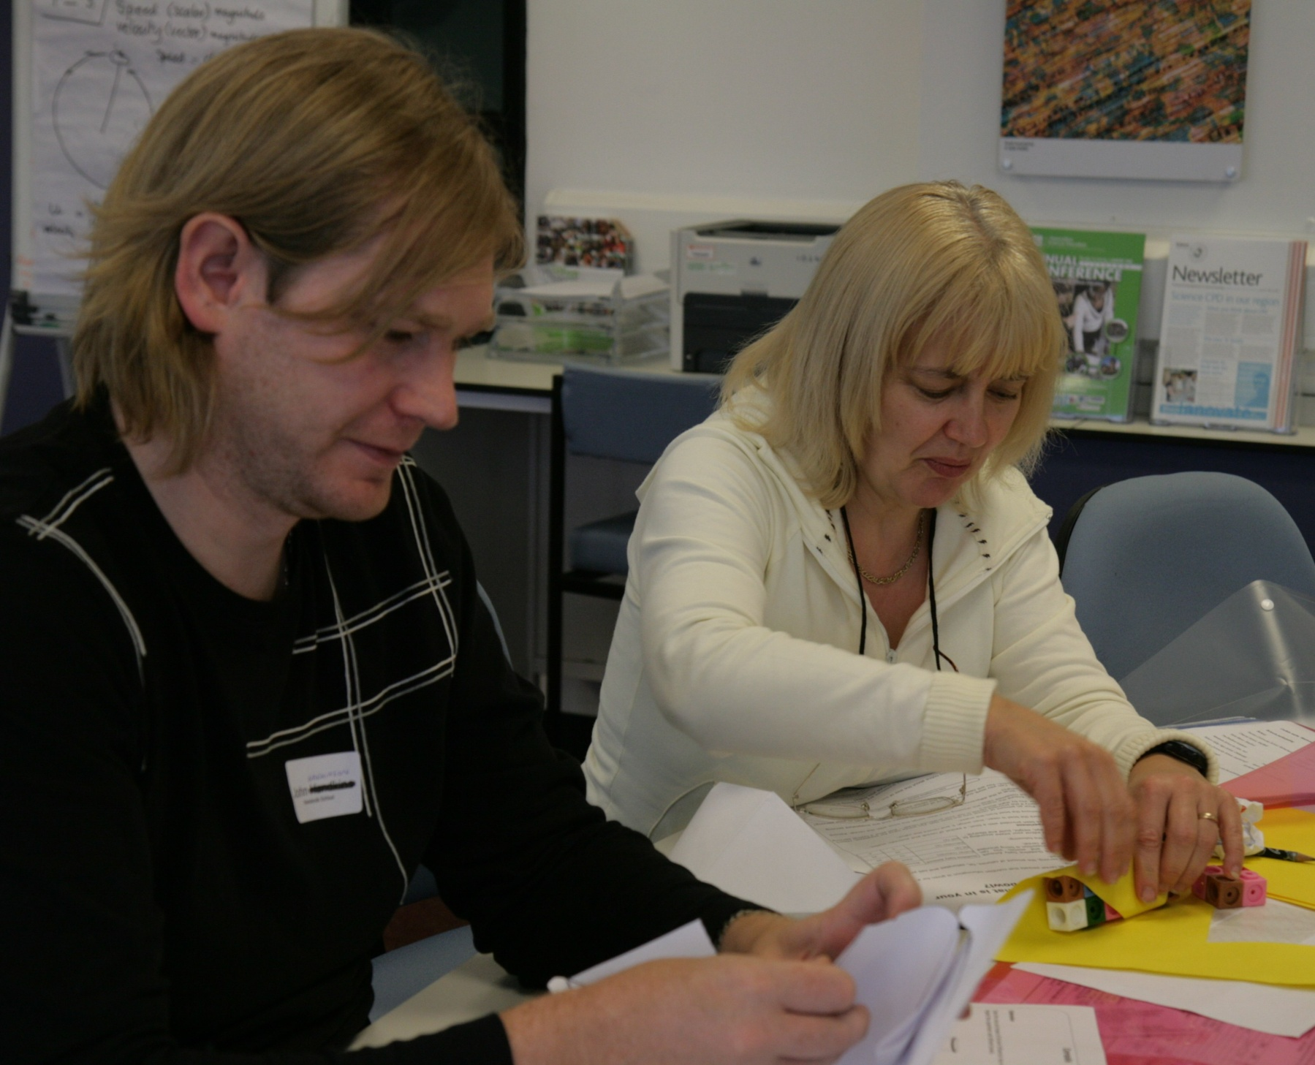

Slide 5
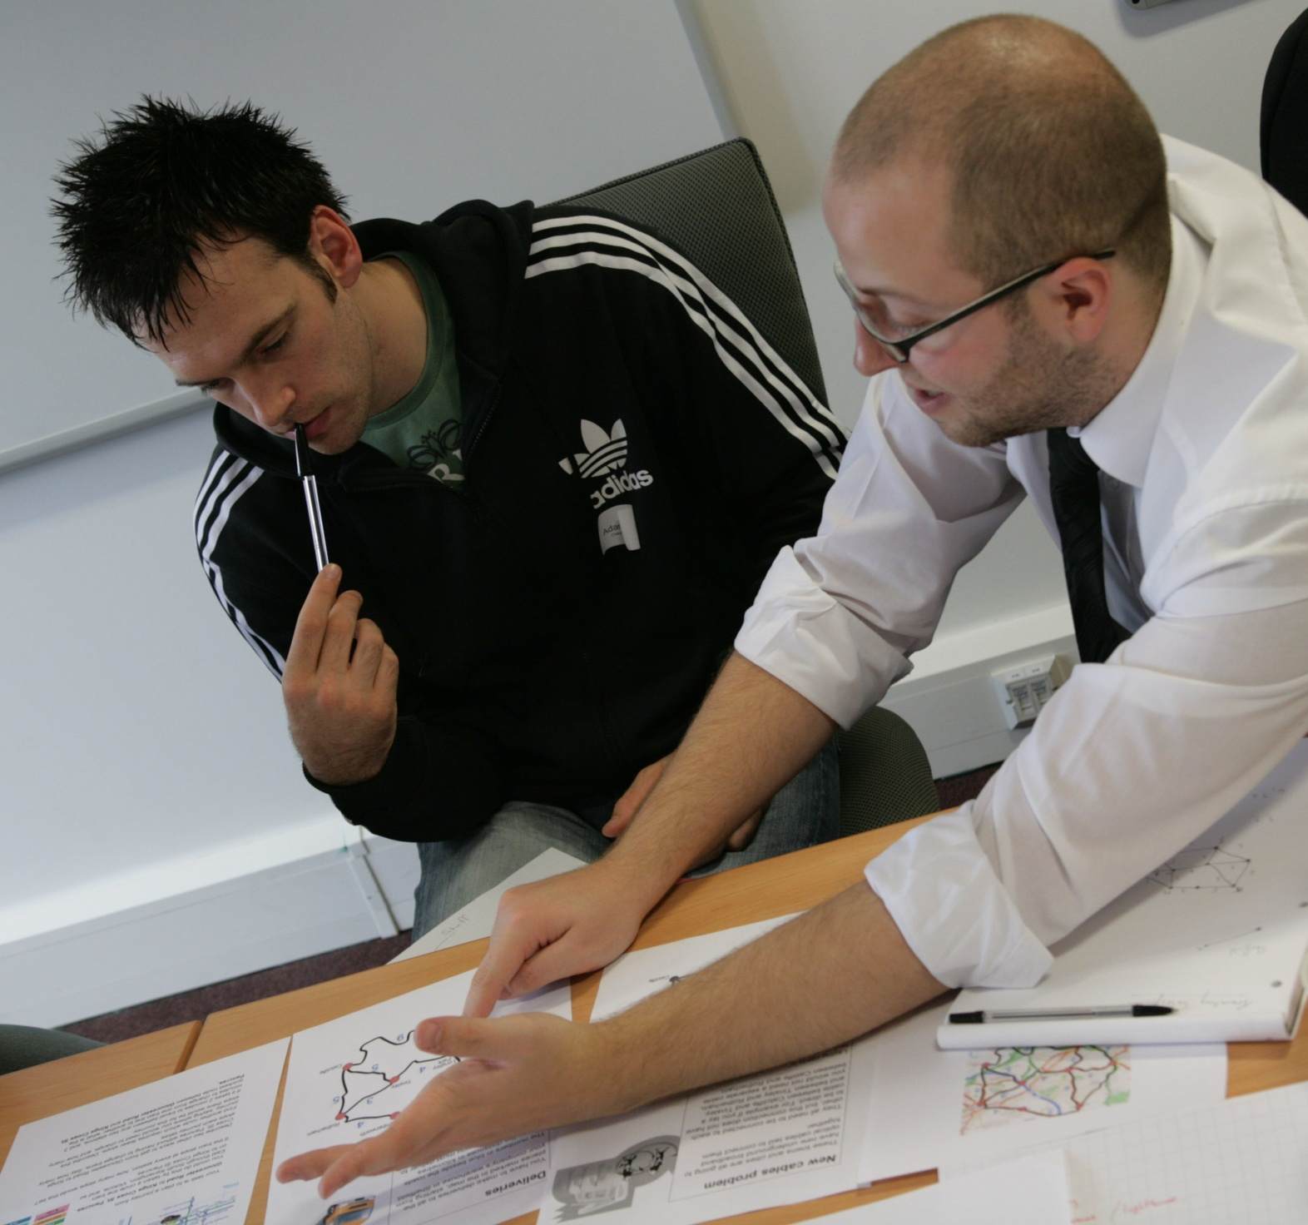

Slide 6
cre8ate maths
the materials
The structure of the resources
1 Agriculture, Horticulture and Land-Based Industries
2 Chemicals and Related Industries
3 Childcare/Early Years
4 Construction and the Built Environment
5 Digital, ICT, Creative and Media
6 Engineering, Manufacturing and Print
7 Food and Drink
8 Health and Social Care
9 Hospitality, Tourism, Sport and Leisure
10 Port, Logistics and Distribution
11 Retail Services
12 Voluntary, Community and Faith

Slide 7
cre8ate maths
the materials
link real and significant mathematical thinking with fully authentic real world applications
suitable for pupils across the attainment range
provide a platform for the development of young peoples’ competence in mathematical procedures, their creativity, and their appreciation and critical understanding of mathematics

Slide 9
Some examples of sectors, topics and activities
Sector | Childcare and early years |  | 3 Childcare/Early years
Topics | Keeping baby warm | Activities | Making a model
 | Healthy childhood |  | Keeping track | True or false? | Who is it?
 | Painting your playground |  | Making a maze | Jumping | Puzzle walks
 | Playground design |  | Designing a playground
 | Nappy changing challenge |  | Survey: Nappy Changing Challenge
Sector | Building for the future |  | 4 Construction and the Built Environment
Topics | Rigid structures | Activities | Finding rigidity | Testing rigidity | Bracing squares
 | Bricks and tiles |  | What makes a wall strong? | Square tiles | Drawing tiles
 | Tiling patterns |  | Patio patterns | Semi-regular tilings | More triangles than squares?
 | Architects' skills |  | Building shapes | Different views | Decoding plans
 | Building a town |  | Designing nets

Slide 10
Sector | Food and drink |  | 7 Food and Drink
Topics | Packaging | Activities | What fits in here? | Four chocolates | It takes the biscuit!
 | Boxes and bottles |  | Boxing stock cubes | Folding cubes | How much does it hold?
 | Minimise or SuperSize |  | Fat, sugar and salt | Calculating energy requirements | Working as a nutritionist
 | Going bananas |  | Guess the weight | Five-a-day | Make a smoothie
 | What's in your bowl? |  | Survey: What's in your bowl?
Sector | Working with others |  | 12 Voluntary, Community and Faith
Topics | Islamic design | Activities | Four by four | Hexagons and stars | Tiles on grids
 | Is it fair? |  | Who gets elected? | Constituency seats | Electoral systems
 | Vedic maths 1 |  | Creating the square | Tiling from the square
 | Vedic maths 2 |  | More about nines | Dividing by nine | Vedic multiplication
 | Running a club |  | Playing the game | It's in the bag! | Organising the league

Slide 11
The slides that follow show some of the cre8ate maths activities

