Slide 1
Curriculum resources from the Mathematics Education Centre at Sheffield Hallam University

Slide 2
the cre8ate maths project
the Maths in Context project (part of the STEM Careers project)
the Mathematics in the Making (MIMA) project
the Project in Citizenship and Mathematics (PiCaM).

Slide 3
Maths in Context part of the STEM Careers project

Slide 4
Maths in Context – an overview
All of the materials are online and free.
To find them type
Maths in context Maths careers
Or follow the link
http://www.mathscareers.org.uk/article/maths-context/
11 main activities
4 sets of activities that can be used as starters.
All of the activities come with a brief section of teacher’s notes with suggestions as to how the activities could be used.

Slide 5
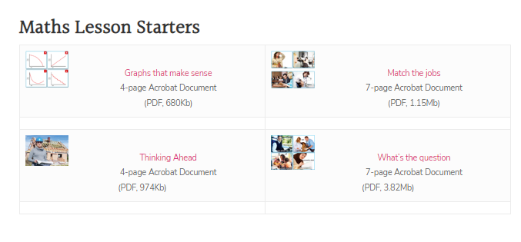

Slide 6
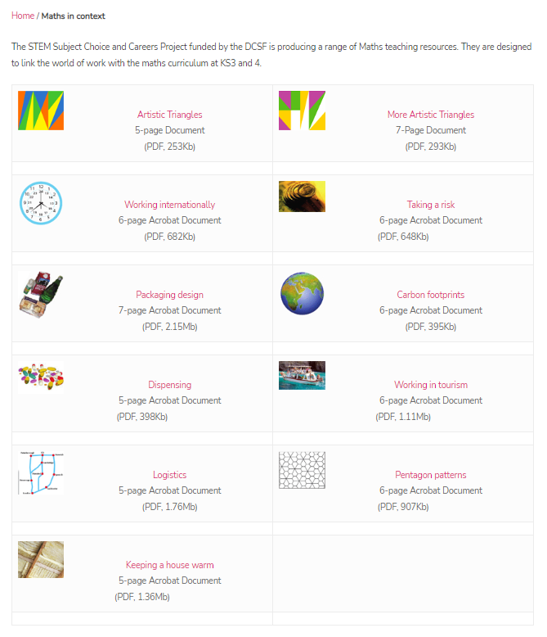

Slide 7
Graphs that make sense

Slide 10
Artistic triangles

Slide 11
More artistic triangles

Slide 12
The end!
Thanks for coming.

