Slide 1
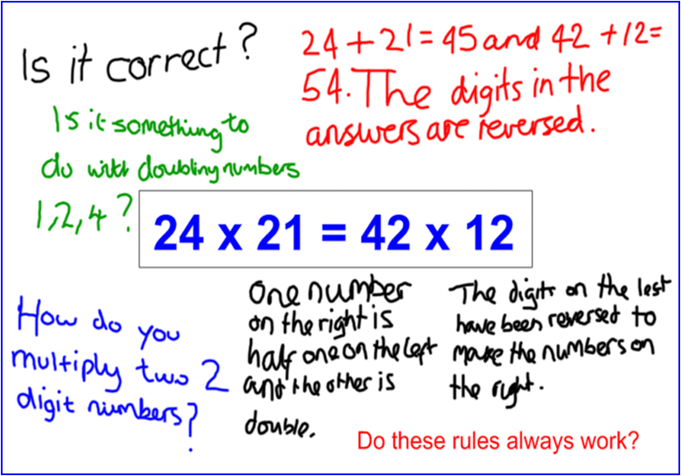
Building an inclusive
community of inquiry
Hollie Walton
Teacher of mathematics, Cambridge
Andrew Blair
Head of mathematics, Ealing, London

Slide 2
Inequalities in mathematics classrooms
1

Slide 3
Inequalities in the maths classroom
PISA (2018) and TIMSS (2019)
Mathematics classrooms privilege some groups above others.
Gender
At year 9, boys performed significantly better than girls. The gender gap was as wide as in previous surveys and greater than the OECD average.
Significantly more girls than boys in years 5 and 9 lacked confidence in mathematics and did not like the subject, finding lessons dull, unenjoyable and off-putting.
Percentage of girls taking A-level Mathematics and Further Mathematics in 2019 was lower than in 2009 – girls 39% and 29% of entrants respectively.

Slide 4
Inequalities in the maths classroom
PISA (2018) and TIMSS (2019)
Socio-economic status
Strongest indicator of achievement in mathematics. Students in years 5 and 9 in England who were eligible for FSM6 achieved scores significantly below the average of their peers and the gap widens as students get older.
Ethnicity
Black students are the lowest achieving group in both years 5 and 9. The results reproduce the pattern of inequitable achievement from previous rounds of the survey.

Slide 5
Inequalities in the maths classroom
British Educational Research Journal (2019) The misallocation of students to academic sets in maths: A study of secondary schools in England
Notes:
The inequality is compounded by the mechanistic teaching of the lower sets, which is often simplified to a sequence of small steps and focuses on the repetition of procedural algorithms. As students are not expected to think through challenging tasks, some potentially powerful mathematical talents go unrecognized and unused (Watson et al., 2003).

Slide 6
Benefits of learning through inquiry
2

Slide 7
Inquiry lessons
 | ‘Path smoothing’ | Inquiry lessons
Learning | Discrete skills; small steps | Conceptual understanding and connections
Activity | Repetitive practice | Exploring, regulating and reflecting
Communicating | Teacher funnelling | Collaborative discussion
Thinking | Routine application | (Re)solving conjectures and questions
Notes:
Ofsted reports; nature of maths teaching not changed in ‘mastery’ classrooms. (Only those who have mastered concept/procedure move onto reasoning/problem-solving.)
Even if you don’t use the whole IM model, any one of these worth having in lessons.

Slide 8
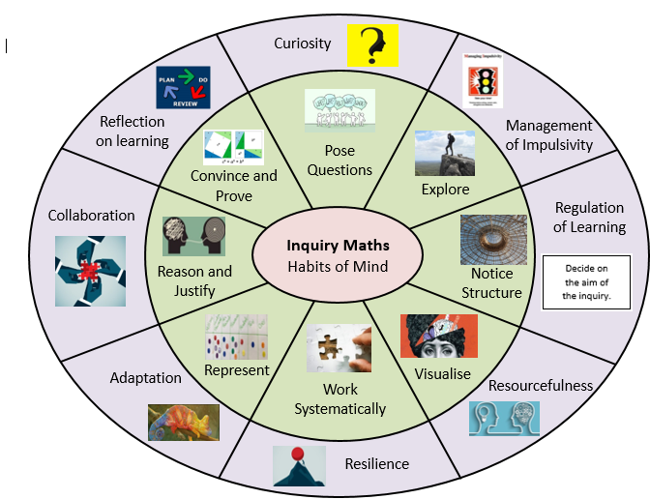
Inquiry Maths Habits of Mind
Poster
(Hamdi Ahmed)
Inquiry Maths
Notes:
Hamdi Ahmed PGCE trainee last year, now working north London
Habits of Mind assignment linked to IM

Slide 9
More inclusive classrooms
Learning mathematics through inquiry is more inclusionary than the traditional classroom setting.
Female students (Borasi, 1992)
Ethnic minority students (Hunter et al., 2020)

Slide 10
Benefits of inquiry-based learning
Behaving like a mathematician.
Transferable skills.
Greater independence of learners.

Slide 11
Starting an inquiry
3
Notes:
HOW SHOULD THE TEA

Slide 12
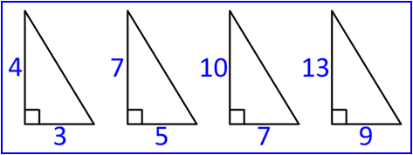
Inquiry Maths prompt
Diagram
Statement
Equation
The sum of two fractions equals their product.
24 x 21 = 42 x 12
Inquiry Maths
Notes:
IM prompt is a diagram, statement or equation. Stripped back to a minimum, piques students’ curiosity (a property that is intriguing) and loaded with the potential for open inquiry. As a HoM said when describing a prompt, “less to it and more in it.”

Slide 13
Inquiry Maths prompt
Stripped back to the minimum, while simultaneously loaded with the potential for exploration.
“Less to it and more in it”
Familiar and unfamiliar
Accessible and inaccessible
Obvious and intriguing
Promotes curiosity and questioning of the sort "Is it true that ...?" or "I've noticed ...". Ripe for speculation or conjecture. Stands just above the understanding of the class. Aimed at students' developing knowledge.
Students must feel confident enough to manipulate and change the prompt; not intimidated by the prompt. Open enough to offer students the opportunity to regulate their own activity.
Fixed and changeable
Closed and open
Inquiry Maths
Notes:
JUST ABOVE

Slide 14
Inquiry Maths prompt
Stands just above the understanding of the class; aimed at students' developing knowledge.
40% of 70 = 70% of 40
50% of 10 = 10% of 50
47% of 74 = 74% of 47
40% of 30% of 20 = 20% of 30% of 40
Alternatives
Inquiry Maths
Notes:
Stands ‘just above’ the level of the class to draw students up to require/demand new knowledge
Choosing a prompt, a teacher cannot just take one ‘off the shelf’ from the website. Should think about setting the prompt JUST ABOVE level of class, so involves a feature that is FAMILIAR (gives students confidence to question and observe) and UNFAMILIAR (intriguing). Example, one department with sets in year 8 changed the percentages prompt on the website to present the right balance of familiarity and intrigue for classes with different levels of attainment.
NOT ‘low threshold, high ceiling’.
Judge level of prompt = skill of inquiry teacher; argument could be made that more difficult in a mixed attainment class.

Slide 15
Starting an inquiry
Activity 1
Ask a question or make an observation about the prompt.
Inquiry Maths

Slide 16
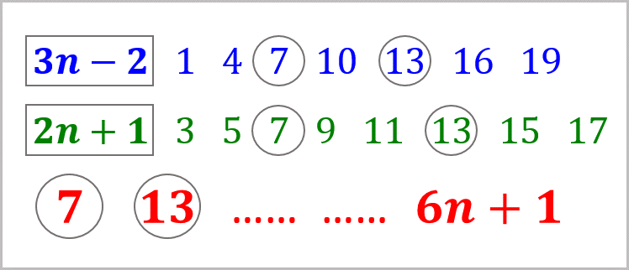
Inquiry Maths prompt
Inquiry Maths

Slide 17
Orientation questioning and noticing
Inquiry Maths

Slide 18
Inquiry Maths model
Zuckerman: slow down
“Now the teacher must ‘slow down’ these sparks of curiosity and imagination so that they are registered and identified by other children, and other students become involved in the process of inquiry. Like thermal neutrons in a nuclear pile, this slowdown must provide for a self-perpetuating chain reaction of interactions in the class, propagating new questions that lead from the initial chaotic question to hypotheses that can be verified.”
Inquiry Maths

Slide 19
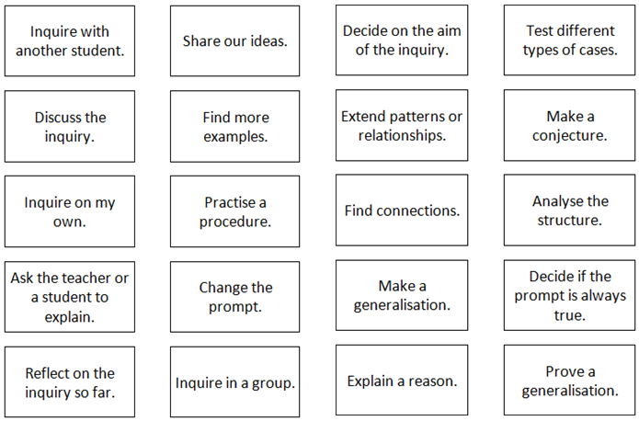
Regulatory cards
Inquiry Maths
Notes:
After posing questions / making observation, students invited to participate in structuring / directing lesson. At same time cards suggest types of activities that are consistent with the discipline of mathematics (induction and deduction). Also includes ‘social’ cards on how to inquire. Change sets of cards depending on experience of class with inquiry (e.g. use the pack of 6 cards for less experienced inquirers).

Slide 20
Regulatory cards
Inquiry Maths
Notes:
After posing questions / making observation, students invited to participate in structuring / directing lesson. At same time cards suggest types of activities that are consistent with the discipline of mathematics (induction and deduction). Also include s ‘social’ cards on how to inquire. Change sets of cards depending on experience of class with inquiry (e.g. use the pack of 6 cards for less experienced inquirers).

Slide 21
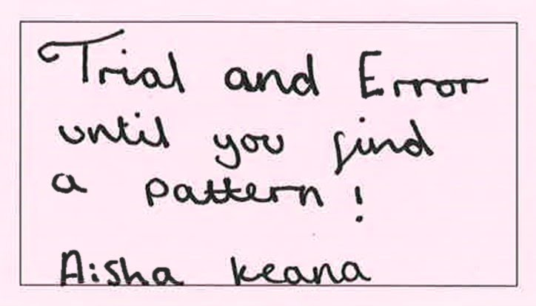
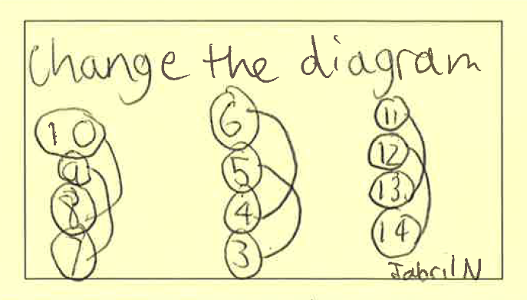
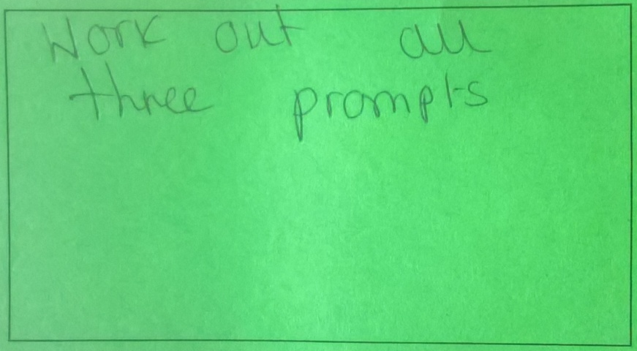
Agency Creating new cards
Inquiry Maths

Slide 22
Including students’ ideas
4

Slide 23
The teacher’s response
To decide
What questions to answer directly (‘arbitrary’ and ‘necessary’ knowledge)
What questions to keep open.
What to explore immediately.
What lines of inquiry to hold back.
Notes:
(Dave Hewitt)

Slide 24
Regulating inquiry
Activity 2
What is the profile of each class?
2. If you were the teacher, how would you respond to the students’ questions, comments and choice of regulatory cards?
Inquiry Maths
Notes:
Hand out sheet with slides 34 and 35 and ask participants to:
Suggest what type of class came up with the responses and card selections; and
Decide how they, as the teacher, would organise the class / structure the inquiry.
Slide 26 year 8 mixed attainment class with some behaviour issues; had carried out inquiries but not experienced; offered set of 12 cards
Slide 27 Year 10 high-attaining class, had carried out inquiries for over a year. [Initial responses not that different, but levels of independence and initiative very different.]

Slide 25
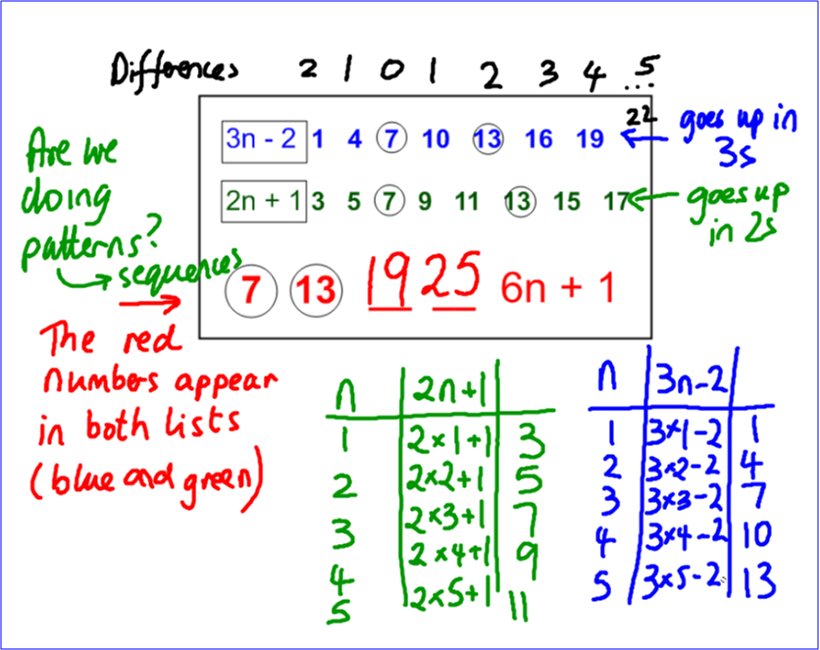
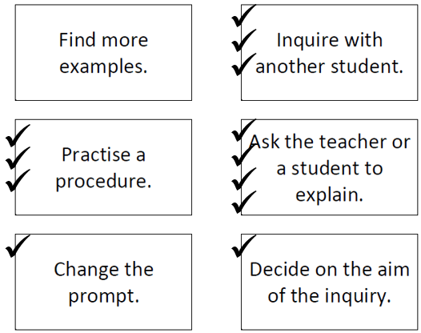
Structured inquiry
Inquiry Maths

Slide 26
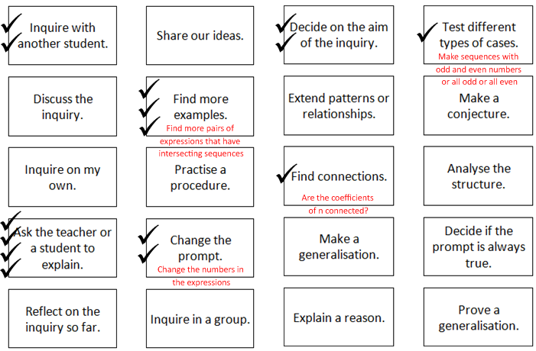
Guided inquiry
✓
Inquiry Maths

Slide 27
The teacher’s response
Inoue and Buczynski (2011) Stumbling blocks to inquiry
Unanticipated student response: Fails to anticipate students’ input and cannot give a pedagogically or mathematically meaningful response.
No student response: Fails to give a meaningful response to students’ silence or lack of input.
Disconnection from prior knowledge: Response severs connections between the lesson and students’ prior knowledge or their attempt to make sense of the concept.

Slide 28
The teacher’s response
Inoue and Buczynski (2011) Stumbling blocks to inquiry
Lack of attention to student input: Ignores the students’ input.
Devaluing of student input: Diminishes student input by rejecting their suggestions and shuts down their attempts at making sense of the problem.
Mishandling of diverse responses: Does not know how to effectively manage or give meaningful ‘traffic controls’ to diverse responses to the prompt.

Slide 29
Levels of inquiry
 | Questions | Regulation | Pathways | Outcomes
Structured | Co-constructed | Restricted by the teacher
Guided | Student-led | Co-constructed
Open | Student-led | Student-led Teacher validation | Student-led Teacher instruction when required | Student-led Teacher assessed
Inquiry Maths
Notes:
Can all be used in a mixed-attainment class – simultaneously different levels of inquiry based on initiative and independence, not prior attainment.

Slide 30
Class profiles
Structured | New to inquiry; not easy to identify students who show curiosity or take initiative in maths lessons. Very few students, if any, are prepared to take risks.
Guided | Either new to inquiry, but contains an identifiable “breakthrough group” whose members generate ideas, offer conjectures and show high levels of curiosity, and have the influence to 'carry' their peers. Or carried out inquiries before and the students are starting to suggest their own pathways.
Open | Experienced in inquiry; can take a prompt and inquire independently in order to create a mathematically-valid outcome (possibly without needing the regulatory cards).
Inquiry Maths
Notes:
Decide on the level of structure / openness based on the independence and initiative of class. Not based on level of attainment: high-attaining classes can become just as anxious and “not know what to do” as students with low prior attainment. Normally inquiry has to be structured or guided; only at the end of perhaps years of developing inquiry skills can the teacher leave the inquiry open.

Slide 31
Differentiation through lines of inquiry
5

Slide 32
Inquiry Maths prompt
Inquiry Maths

Slide 33
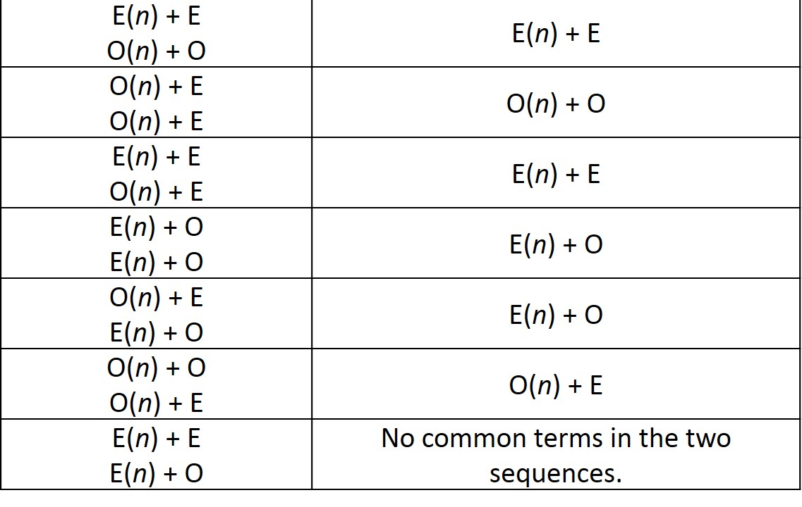
Line of inquiry Odds and evens
First two expressions | Expression for the nth term of the intersecting sequence
Inquiry Maths

Slide 34
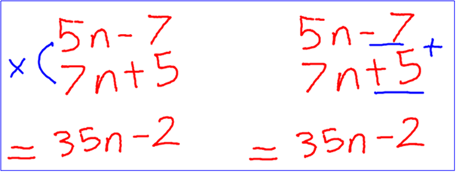
Line of inquiry Two numbers
Esme and Olivia
(Year 9)
Inquiry Maths

Slide 35
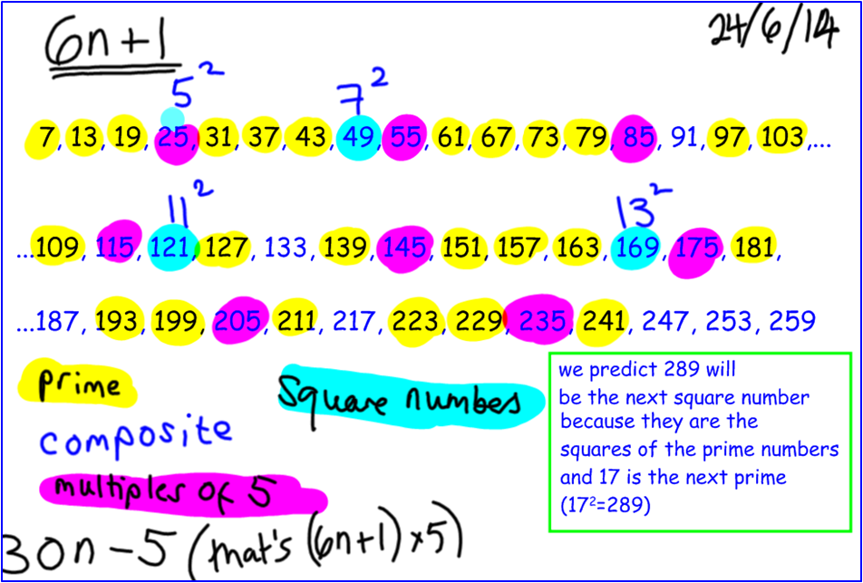
Line of inquiry Other sequences
Inquiry Maths

Slide 36
Line of inquiry Test conjectures
Elijah and Tabassum
(Year 7)
Inquiry Maths

Slide 37
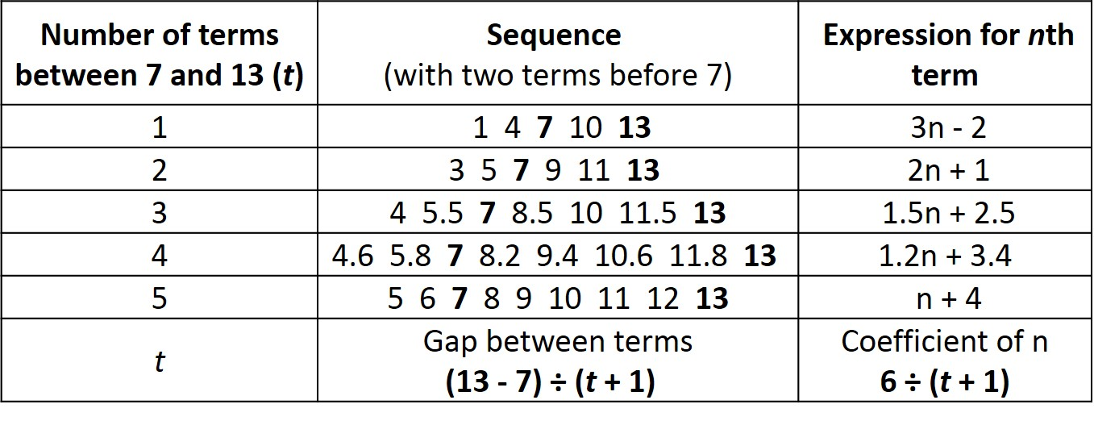
Line of inquiry Number of terms
Inquiry Maths

Slide 38
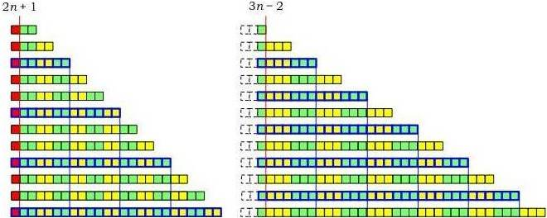
Line of inquiry Diagrams
Inquiry Maths

Slide 39
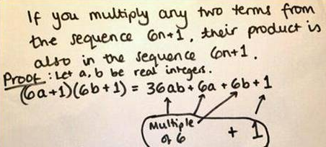
Line of inquiry Proof
Inquiry Maths

Slide 40
Line of inquiry Further inquiry
Chinese
Remainder
Theorem
Inquiry Maths

Slide 41
The teacher’s role in building an inclusive community of inquiry
6

Slide 42
Becoming an inquiry teacher

Slide 43
Developing norms and practices
Time and expertise required
Students’ prior experience of mathematics
Three strands - supporting contributions, establishing common ground and guiding the learning of mathematics.

Slide 44
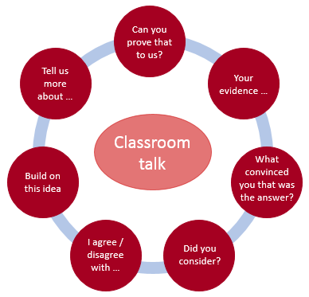
Developing norms and practices
Prompts to scaffold classroom talk
(Makar et al., 2015).

Slide 45
Inquiry Maths and Mixed Attainment Classes
Devised and developed in mixed attainment classrooms.
Prompts promote learning at multiple levels.
Inquiry pathways involve students working on a common aim from different directions and at different levels of reasoning.
Students’ selection of an approach and mathematical level (guided by the teacher when necessary) ensures challenge and progress for all.
Inquiry unites the class in a mathematical process.
The unity of purpose promotes inclusiveness, cohesion and equity as all contributions add to the findings of the inquiry.
Inquiry Maths

