Slide 1
The Montgomery Bus Boycott | 4-Oct-22

Slide 4
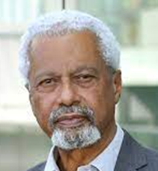
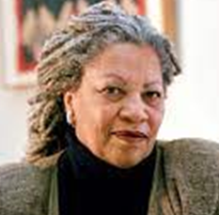
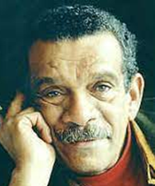
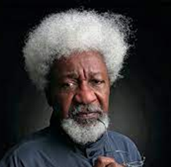
Nobel Prize Winners - Literature
Abdulrazak Gurnah
2021
United Kingdom
Toni Morrison
1993
United States
Derek Walcott
1992
Saint Lucia
Wole Soyinka
1986
Nigeria

Slide 5
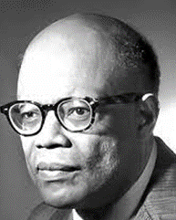
Nobel Prize Winner - Economics
W. Arthur Lewis
1979
St Lucia

Slide 7
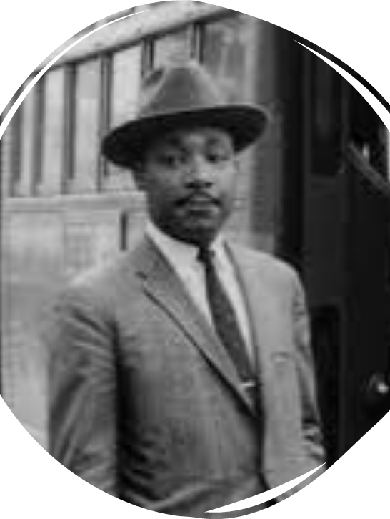
Black History Month
In today’s lesson we are going to be learning about one of these people, Martin Luther King and his role in the Montgomery Bus Boycott.

Slide 8
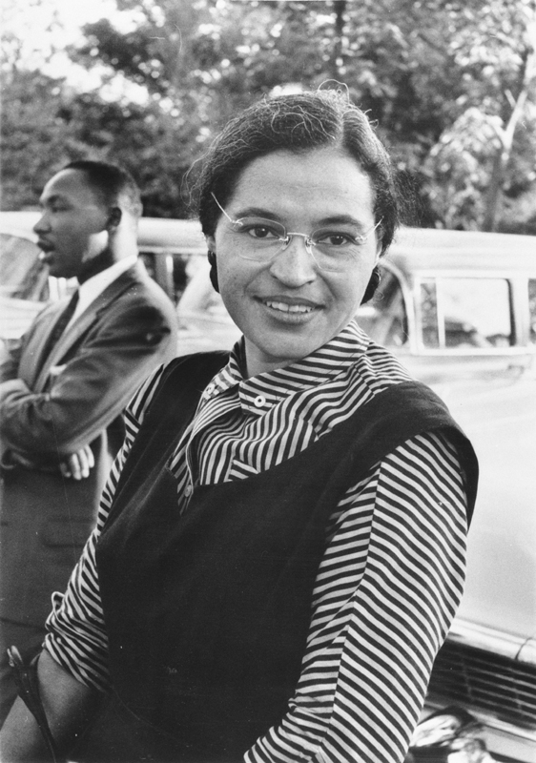
On December 1, 1955, Rosa Parks, a black seamstress, was arrested in Montgomery, Alabama for refusing to give up her bus seat so that white passengers could sit in it.

Slide 9
Rosa Parks’s arrest sparked the Montgomery Bus Boycott, during which the black citizens of Montgomery refused to ride the city’s buses in protest over the bus system’s policy of racial segregation. It was the first mass-action of the modern civil rights era, and served as an inspiration to other civil rights activists across the nation.

Slide 10
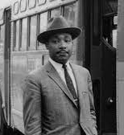
Martin Luther King, Jr., a Baptist minister who endorsed nonviolent civil disobedience, emerged as a leader of the Boycott.

Slide 11
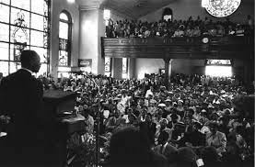
During the boycott Martin Luther King began his rise to national and international prominence in the US Civil Rights Movement. On the boycott’s first day, speaking before a crowd of more than 5,000 people, at the Holt Street Baptist Church, King said:
"There comes a time when people get tired.... tired of being segregated and humiliated.... If you will protest courageously and yet with dignity and Christian love...historians will have to pause and say ‘there lived a great people—a black people—who injected a new meaning and dignity into the veins of civilization.’ This is our challenge and our overwhelming responsibility.”

Slide 12
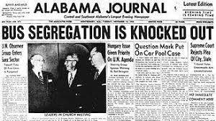
Following a November 1956 ruling by the Supreme Court that segregation on public buses was unconstitutional, the bus boycott ended successfully. It had lasted 381 days.

Slide 13
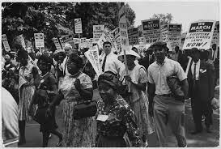
Many of the elements in the Montgomery Bus Boycott—organization, community solidarity, nonviolence, and the intervention of the federal government—proved to be the groundwork on which the Civil Rights Movement of the 1960s would be based.

Slide 14
Create a Time-Line of these events in Martin Luther King Jr’s life.
Martin met Coretta Scott King in January 1952, and they married on 18th June 1953 | He was the father of four children; Yolanda (b. 1955), Martin (b. 1957), Dexter (b. 1961) and Bernice (b. 1963). | Martin Luther King Jr was born in the USA to African American parents on January 15th 1929.
In 1963, Martin gave his famous “I Have a Dream” speech, at a famous rally named ‘March on Washington.’ Over 250,000 people gathered in the country’s capital to hear Martin and other activists speak about the importance of civil rights. | The boycott of the buses ended in Dec 1956, when after the 381 days of protest, a court finally ruled that such segregation laws should no longer be recognised. | In October 1964, Martin won the Nobel Peace Prize! He was told over the phone whilst he was in bed suffering from exhaustion – it had been a long, hard fight for civil rights!
In 1964 – 99 years after the abolition of slavery – the Civil Rights Act was passed, outlawing racial segregation and discrimination in the USA. | Martin Luther King was assassinated on April 4th 1968. | His first major role in the Civil Rights Movement came in 1955. He helped to organise the boycott of the city’s buses, after an African American lady – Rosa Parks – was arrested for refusing to give up her seat to a white man on a bus. The protest started in Dec 1955.

Slide 15
Task One - Calculation Questions
Q1) How old was Martin Luther King Junior when he died? | Q2) How old was Martin Luther King when he got married? | Q3) His wife was born in April 1927. How old was she when she got married?
Q4) How many years ago did the boycott start? | Q5) During the boycott, the average person had to walk 3.5 miles a day. How many miles would they cover during a week (assuming they walked 5 days a week)? | Q6) The boycott led to a loss of $3000 a day and lasted 381 days. What was the total loss.

Slide 16
Task Two – Percentages, Fractions and Ratio Questions
Q1) In 1930, the year after Martin was born, the black population in the US was approximately 11 million, and the total US population was 121 million. What was the ratio? Give your answer in its simplest form. | Q2) It is estimated around 40 000 people participated in the boycott, if 40% of them were over the age of 35, how many under 35’s participated? | Q3) Lyndon B Johnson was the president at the time the Civil Rights Act was passed. If he won 486 of the 538 electoral college votes available, what fraction of them did he win? Give your answer in its simplest form.
Q4) Lyndon B Johnson was the president at the time the Civil Rights Act was passed. He won 43,127,041 votes in the popular vote, which equated to 61.1%. How many people voted altogether? | Q5) There have been 17 black Nobel prize winners. 4 for literature, 12 for peace and 1 for economics. What percentage of the prizes were for: Literature Peace Economics | Q6) $3000 dollars in 1956 is equivalent to $32,665.92 today. What is the percentage increase.

Slide 17
Task Three – Compound Measures and Conversions
Q1) During the boycott, the average person had to walk 3.5 miles a day. If they walked at a speed of 20 minutes per mile, how much time would they spend walking per day? | Q2) The boycott led to a loss of $3000 a day and lasted 381 days. In 1956 the exchange rate was £1 = $ 2.8 What was the total loss in dollars and in pounds? | Q3) During the boycott, the average person had to walk 3.5 miles a day. Assuming they walked 5 days a week, how far did they walk in km each week? 1 mile = 1.6km
Q4) The bus boycott lasted for 381 days. How many hours was this? | Q5) $3000 dollars in 1956 is equivalent to $32,665.92 today. The current exchange rate is £1 = $1.13. How much is $32,665,92 in £s. | Q6) The Montgomery Bus Boycott inspired the bus Boycott in Bristol in 1963. Bristol is 4250 miles. Convert this into Km.

Slide 18
Task 4 – Presenting Data
Martin Luther King Jr won a Nobel Prize for Peace. There have been 17 black Nobel Prize Winners. Create a bar graph or pie chart to show the categories for which they won their prizes.
Name | Year | Country | Category
Ralph Bunche | 1950 | United States | Peace
Albert John Luthuli | 1960 | South Africa | Peace
Martin Luther King Jr | 1964 | United States | Peace
W. Arthur Lewis | 1979 | Saint Lucia | Economics
Desmond Tutu | 1984 | South Africa | Peace
Wole Soyinka | 1986 | Nigeria | Literature
Derek Walcott | 1992 | Saint Lucia | Literature
Toni Morrison | 1993 | United States | Literature
Nelson Mandela | 1993 | South Africa | Peace
Kofi Annan | 2001 | Ghana | Peace
Wangari Maathai | 2004 | Kenya | Peace
Barack Obama | 2009 | United States | Peace
Ellen Johnson Sirleaf | 2011 | Liberia | Peace
Leymah Gbowee | 2011 | Liberia | Peace
Denis Mukwege | 2018 | Democratic Republic of the Congo | Peace
Abiy Ahmed | 2019 | Ethiopia | Peace
Abdulrazak Gurnah | 2021 | United Kingdom | Literature

Slide 19
Get ready for the answers

Slide 20
Task One - Numeracy
Q1) How old was Martin Luther King Junior when he died? 39 years old | Q2) How old was Martin Luther King when he got married? 24 years old | Q3) His wife was born in April 1927. How old was she when she got married? 26 years old
Q4) How many years ago did the boycott start? 67 years | Q5) During the boycott, the average person had to walk 3.5 miles a day. How many miles would they cover during a week (assuming they walked 5 days a week)? 17.5 miles | Q6) The boycott led to a loss of $3000 a day and lasted 381 days. What was the total loss. $ 1143000

Slide 21
Task Two – Percentages, Fractions and Ratios
Q1) In 1930, the year after Martin was born, the black population in the US was approximately 11 million, and the total US population was 121 million. What was the ratio? 1:11 | Q2) It is estimated around 40 000 people participated in the boycott, if 40% of them were over the age of 35, how many under 35’s participated? 24 000 | Q3) Lyndon B Johnson was the president at the time the Civil Rights Act was passed. If he won 486 of the 538 electoral college votes available, what fraction of them did he win? Give your answer in its simplest form. $$\frac{243}{269}$$
Q4) Lyndon B Johnson won 43,127,041 votes in the popular vote, which equated to 61.1%. How many people voted altogether? 70,584,355 | Q5) There have been 17 black Nobel prize winners. 4 for literature, 12 for peace and 1 for economics. What percentage of the prizes were for: Literature 23.5% Peace 70.6% Economics 5.9% | Q6) $3000 dollars in 1956 is equivalent to $32,665.92 today. What is the percentage increase. 32665.92 – 3000 = 29665.92 $\frac{29665.92}{3000}$ x 100 = 988.864 %

Slide 22
Task Three – Compound Measures and Conversions
Q1) During the boycott, the average person had to walk 3.5 miles a day. If they walked at a speed of 20 minutes per mile, how much time would they spend walking per day? 1 hour and 10 minutes | Q2) The boycott led to a loss of $3000 a day and lasted 381 days. In 1956 the exchange rate was £1 = $ 2.8 What was the total loss in dollars and in pounds? 3000 x 381 = $1 143 000 1 143 000 ÷ 2.8 = £408 214.29 | Q3) During the boycott, the average person had to walk 3.5 miles a day. Assuming they walked 5 days a week, how far did they walk in km each week? 1 mile = 1.6km 3.5 x 5 = 17.5 miles 17.5 x 1.6 = 28km
Q4) The bus boycott lasted for 381 days. How many seconds was this? 32918400 | Q5) $3000 dollars in 1956 is equivalent to $32,665.92 today. The current exchange rate is £1 = $1.13. How much is $32,665,92 in £s. £28 907.89 | Q6) The Montgomery Bus Boycott inspired the bus Boycott in Bristol in 1963. Bristol is 4250 miles from Montgomery. Convert this into Km. 6800 km

Slide 23
Task 4 – Presenting Data
Martin Luther King Jr won a Nobel Prize for Peace. There have been 17 black Nobel Prize Winners. Create a pie chart to show the categories for which they won their prizes
360 ÷ 17 = 21.2
Category | Frequency | Calculation
Peace | 12 | 12 x 21.2 = 254°
Literature | 4 | 4 x 21.2 = 85°
Economics | 1 | 1 x 21.2 = 21°
 | Total | 360°

Slide 24
I am really pleased with...
Today I have tried to...
To progress I need to...
Today I have learned that...
In these questions I have learnt that…
I have been able to…
But I got stuck on...
Self Reflection
Before this lesson I could already...
Now I can also...
One thing I need to remember from today’s lesson is...
I was successful when I…
I did not know how to…
But now I can…
The most important thing I learned today is...
I can see the link between...
Notes:
Example of a strategy for student reflection.

Slide 25
Colour in the arrow, up to the statement which best describes your current understanding.
 | I’m so confident - I could explain this to someone else!
 | I can get to the right answer but I don’t understand well enough to explain it yet.
 | I understand some of this but I don’t understand all of it yet.
 | I tried hard and I listened but I am finding this challenging. I will make sure that I get help with this next lesson.
 | I do not understand any of this yet. There are things I could do to be a better learner next lesson.
Notes:
Example of a strategy for student reflection.

Slide 26
Tips I would give a friend to solve this problem are ......... | I have made a link between this topic and … | To help me move forward, when I got stuck today, I ….
Today I interacted with the teacher by …… | Today I am still unsure about ……………… To fill in this gap I intend to ………… | A barrier to my learning today was……….. I will try to overcome this by …..
Today I explained to ………. how to ………….. | Something I have learnt today about the way I learn is ……… | At home, I need to look at ………………
Notes:
Example of a strategy for student reflection.

