Slide 1
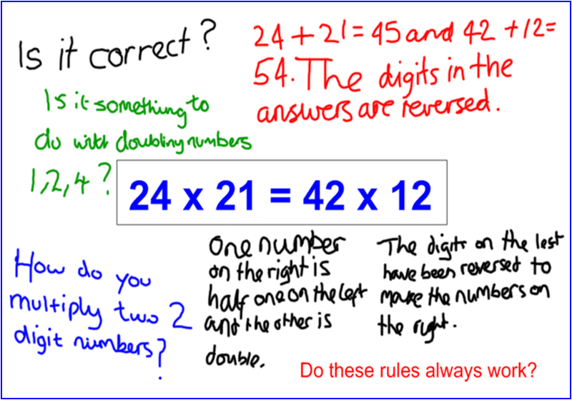
Developing
self-regulation
in Inquiry Maths
classrooms
Andrew Blair, PhD
Head of Mathematics, Haverstock School (Camden, London)
www.inquirymaths.org
@inquirymaths
Inquiry Maths

Slide 2
Regulation and agency
1
Inquiry Maths
Notes:
Perhaps a better title: ‘Developing agency in IM classrooms’,
but self-regulation a buzz word of the moment with the EEF ‘Metacognition and self-regulated learning’ Guidance Report (April 2018)
Session: how to plan in order an inquiry to develop agency (and within that self-regulation)

Slide 3
Inquiry Maths website
Inquiry Maths

Slide 4
Other regulation
Vygotsky
Other regulation to self-regulation
Like other cultural functions, verbal planning emerges as a function created by others. Then, without changing externally, it is directed towards one’s own behaviour (in the form of egocentric speech); and, finally, it is transformed by ceasing to appear externally and is abbreviated to form an internal device. (Levina, 1981)
Inquiry Maths
Notes:
Not about independent ability to carry out or apply a procedure in a existing or new context: wider concept linked to social action.
Social process in which individuals think flexibly and reflexively in social situations.
Original version: Students learn to regulate their own thinking when their behaviour is regulated by collaborators in social activity and when they regulate the thinking of others. (Thinking and Speech, 1934/1987)
Levina, R. E. (1981). L. S. Vygotsky’s Ideas about the Planning Function of Speech in Children. In Wertsch, J. V. (Ed.) The Concept of Activity in Soviet Psychology. Armonk, New York: M. E. Sharpe, pp. 279-299.

Slide 5
Self-regulation in maths
Vygotsky
Thinking in concepts
Adolescents think in a different way; their ‘everyday’ thinking is restructured from above by mathematical concepts; the student constructs a psychological system of concepts; new concepts are related to others both latitudinally (same level of generalisation) and longitudinally (in a hierarchy of generalisation).
Inquiry Maths
Notes:
Vs cognitive psychologists – knowledge => self-regulation
Social cognition: process of developing SRL remains static throughout schooling.
One method for Zimmermann and Schunk – observation/modelling, imitation/emulation, self-control, self-regulation. No concept of change and development.

Slide 6
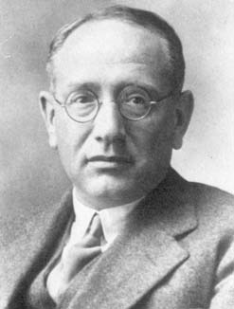
Inquiry Maths model
Mathematics presented with rigour is a systematic deductive science but mathematics in the making is an experimental inductive science. (How to Solve It, 1945)
The result of the mathematician’s creative work is demonstrative reasoning, a proof, but the proof is discovered by plausible reasoning, by guessing. (Mathematics and Plausible Reasoning, 1954)
Polya: deduction completes induction
Inquiry Maths
Notes:
What does it mean to think mathemtically?
IM aims to combine two forms of mathematical reasoning identified by Polya: “deduction completes induction.”
“We have discovered an interesting result but the reasoning that led to it was merely plausible, experimental, provisional, heuristic; let us try to establish it definitively by a rigorous proof.” (1945)
Induction: exploration and generalising (identifying/spotting patterns)
Deduction: reasoning (structural), formal (algebraic), proof
Questioning, noticing and conjecturing (can imply inductive or deductive reasoning)
Decisions on the validity and level of reasoning can only be taken with “knowledge about the process of production” (Balacheff, 1988, p. 228).

Slide 7
Self-regulation and agency
Authentic learners have “the ability and incentive to seek and find knowledge independently, to transcend the limits of their own erudition and of established, stereotyped beliefs” (Zuckerman, 2003).
Active subjects who “create their own development (changes) via their own activity” (Giest, 2010).
“Agency refers to the actual ways situated persons wilfully master their own life” (Van Oers, 2015).
Inquiry Maths
Notes:
Students’ self-regulation develops as an expression of their agency.
Independence, initiative, creativity, purpose (volition / will)
SR is a broader concept than being able to copy a teacher’s model independently.
References:
Zuckerman, G. A. (2003a). The Learning Activity in the First Years of Schooling: The Developmental Path Toward Reflection. In Kozulin, A., Gindis, B., Ageyev, V. and Miller, S. (Eds.)Vygotsky’s Educational Theory in Cultural Context. Cambridge: Cambridge University Press, pp. 177-199.
Giest, H. (2010). The Formation Experiment in the Age of Hypermedia and Distance Learning. In Van Oers, B., Wardekker, W., Elbers, E. and Van der Veer, R. (Eds.) The Transformation of Learning: Advances in Cultural-Historical Activity Theory. Cambridge: Cambridge University Press, pp. 100-126.
Van Oers, B. (2015). Implementing a Play-Based Curriculum: Fostering Teacher Agency in Primary School. Learning, Culture and Social Interaction, 4, 19-27.

Slide 8
Inquiry Maths agency
Students learn to
Make conjectures
Explore ideas in collaboration
Identify when they need new knowledge
Ask the teacher for instruction
Explain their reasoning
Prove their results
Ask questions and notice properties
Plan, monitor and reflect on their activity
Inquiry Maths
Notes:
Session: how to plan in order an inquiry to develop agency (and within that self-regulation)

Slide 9
Planning for inquiry
2
Inquiry Maths

Slide 10
Levels of inquiry
 | Questions | Regulation | Pathways | Outcomes
Structured | Co-constructed | Restricted by the teacher
Guided | Student-led | Co-constructed
Open | Student-led | Student-led Teacher validation | Student-led Teacher instruction when required | Student-led Teacher assessed
Inquiry Maths

Slide 11
Class profiles
Structured | New to inquiry; not easy to identify students who show curiosity or take initiative in maths lessons. Very few students, if any, are prepared to take risks.
Guided | Either new to inquiry, but contains an identifiable “breakthrough group” whose members generate ideas, offer conjectures and show high levels of curiosity, and have the influence to 'carry' their peers. Or carried out inquiries before and the students are starting to suggest their own pathways.
Open | Experienced in inquiry; can take a prompt and inquire independently in order to create a mathematically-valid outcome (possibly without needing the regulatory cards).
Inquiry Maths
Notes:
Decide on the level of structure / openness based on the independence and initiative of class.
Not based on level of attainment: high-attaining classes can become just as anxious and “not know what to do” as students with low prior attainment.
Normally inquiry has to be structured or guided; only at the end of perhaps years of developing inquiry skills can the teacher leave the inquiry open.
ACTIVITY 1 (resource PLANNING DOCUMENT x 2)
Choose a class – mixed attainment class in a type of school of your choosing.

Slide 12
Inquiry Maths model
3
Inquiry Maths

Slide 13
Double stimulation
Stimulus-means
Regulatory cards
Student
Stimulus-object
Inquiry prompt
The method of double stimulation allows the teacher to “study the development and activity of the higher mental functions with the aid of two sets of stimuli. These two sets of stimuli fulfil different roles vis-à-vis the subject’s behaviour. One set of stimuli fulfils the function of the object on which the subject’s activity is directed. The second functions as signs that facilitate the organisation of this activity.” (Vygotsky, Thinking and Speech)
Inquiry Maths
Notes:
“Psychologically speaking, the overall process of [mental] labour inevitably presupposes a contradiction, i.e., a unification in each individual act of two elements, a preliminary element and an executive element.... We are only concerned with organizing the child’s life, and teaching, so that the child confront the two necessary elements for the development of thinking, as the highest forms of behaviour. Those two elements are, first, the difficulty or, put differently, the problem which is to be solved, and, second, those elements and tools by means of which this problem may be solved.” (Vygotsky, 1997d, p. 175) Educational Psychology
Vygotsky’s proposal that method is “simultaneously a prerequisite and product, a tool and result of the research” (Vygotsky, 1997c, p. 27) in order to discuss the stimulus-means. While the stimulus-means are a prerequisite for research in objectifying mental functions and making them accessible to study (Vygotsky, 1999, p. 59), they are not a neutral or inert tool applied to the observation of psychological processes. Rather, as Engeström contends, they are transformed by the agency of the participants in the research. In this sense, I suggest that method is a product of research in two ways. Firstly, the researcher’s development of the stimulus-means leads to a greater illumination of the object of study. Secondly, the stimulus-means are the product in the way they change the behaviour of the participants.

Slide 14
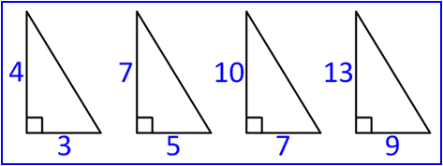
Stimulus-object Prompt
Diagram
Statement The sum of two fractions
equals their product.
Equation 24 x 21 = 42 x 12
“Less to it and more in it.”
Inquiry Maths

Slide 15
Stimulus-object Prompt
Stripped back to the minimum, while simultaneously loaded with the potential for exploration.
“Less to it and more in it”
Promotes curiosity and questioning of the sort "Is it true that ...?" or "I've noticed ...". Ripe for speculation or conjecture. Stands just above the understanding of the class. Aimed at students' developing knowledge.
Familiar and unfamiliar
Accessible and inaccessible
Obvious and intriguing
Not designed to intimidate a class; students must feel confident enough to manipulate and change the prompt. Open enough to offer students the opportunity to regulate their own activity.
Fixed and changeable
Closed and open
Inquiry Maths

Slide 16
Inquiry Maths model
Zuckerman: slow down
“Now the teacher must ‘slow down’ these sparks of curiosity and imagination so that they are registered and identified by other children, and other students become involved in the process of inquiry. Like thermal neutrons in a nuclear pile, this slowdown must provide for a self-perpetuating chain reaction of interactions in the class, propagating new questions that lead from the initial chaotic question to hypotheses that can be verified.”
Inquiry Maths
Notes:
Zuckerman, G. A., Chudinova, E. V. and Khavkin, E. E. (1998). Inquiry as a Pivotal Element of Knowledge Acquisition within the Vygotskian Paradigm: Building a Science Curriculum for the Elementary School. Cognition and Instruction, 16(2), 201-233.

Slide 17
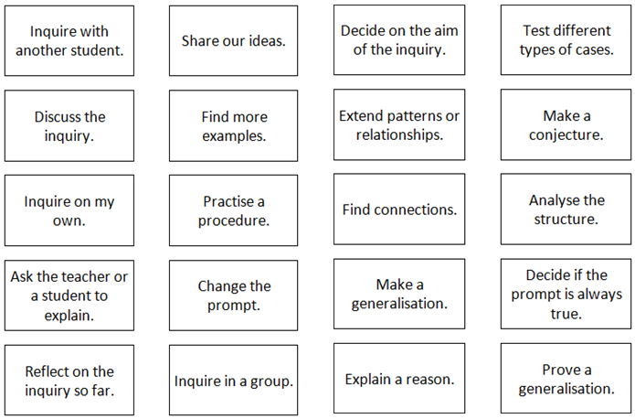
Stimulus-means Regulatory cards
Inquiry Maths
Notes:
ACTIVITY 2: choose a prompt – how could each regulatory card apply to the prompt?
Feedback from each pair: explain how three cards relate to prompt.

Slide 18
Regulatory cards
4
Inquiry Maths
Notes:
ACTIVITY choose prompt – how could it develop? Inquiry pathways.

Slide 19
Problem of regulation
Waiting for knowledge
Goos mentions “a small number of students” who resisted the teacher’s attempts to encourage them to learn more independently by “waiting for the teacher to hand over the required knowledge or by avoiding constructive interaction with peers.”
Refusal to participate
Alrø and Skovsmose A group of students refused to advocate – that is, put forward ideas to be examined – and instead zoomed out . By disrupting the class with “perverted” forms of dialogue, the students exhibited “underground intentions” to change, or even halt, the course of the inquiry.
Inquiry Maths
Notes:
Problem of regulation in forms of inquiry that emphasise negotiation of knowledge (Borasi’s ‘humanistic’ inquiry)
Alrø, H. & Skovsmose, O. (2002). Dialogue and Learning in Mathematics Education: Intention, Reflection and Critique.
Inquiry title ………………………………………………………………………………………

Slide 20
Problem of regulation
Teacher dilemma
Tension between the students’ expectation to know and be led and the teacher’s desire to avoid simply telling them how to proceed.
Goodchild Teachers were reluctant “to give the game away by telling too much”; instead, they wanted students to discover the alternative form of representation (graphing) for themselves.
Upholding the notion of discovery can lead to artifice. Classroom observations have shown teachers falsely claim that they are “not at liberty to say”, that they “don’t know”, that it is not in the interest of the students to be told, and that finding the concept independently will “help them learn more”.
Inquiry Maths
Notes:
If no mechanism exists to overcome the “missing perspective problem”, a tension arises between the students’ expectation to know and be led and the teacher’s desire to avoid simply telling them how to proceed. This is precisely the experience of three teachers from a Norwegian secondary school in our second example. They were involved in research into “aligning inquiry-based practice” in mathematics classrooms (Goodchild et al., 2013). As it was their first taste of inquiry (based on the prompt x + y = 7), the teachers were cautious and designed four differentiated cards of questions to act as prompts to guide students. One question (or rather instruction) on the first card – “Draw these number pairs [values for x and y] on millimetre paper” – caused the teachers most problems. In not wanting “to give the game away by telling too much” (Goodchild et al., 2013, p. 405), the teachers found it difficult to decide how to respond when students could not interpret the instruction to “draw” (rather than “plot”) number pairs. Throughout this episode, the teachers were reluctant to lead students into graphing functions in favour of letting them discover the alternative form of representation for themselves.

Slide 21
Problem of regulation
Absence of a mechanism for a meta-communication
Alrø and Skovsmose: “If the proper terms and tools for speaking about aims and intentions are not present, the result will be an amputated discussion of purpose” in which students resort to guessing a mathematical frame of reference. When students’ suggestions do not correspond to the hidden expectations of the teacher, they do not get in contact; the meaning of the landscape is “not negotiated and no mutual understanding is established.”
O’Connor: the absence of terms and tools is the “missing perspective problem”. The teacher cannot assume that students, who operate in “a twilight of shifting and unclear purposes”, share a disciplinary perspective on the inquiry or a meta-knowledge of its pedagogical purpose.
Inquiry Maths
Notes:
“How much do newspapers fill?” (Alrø and Skovsmose, 1998)
Can all fractions be turned into decimals? Position-driven discussion; exploratory talk and summative talk.
Through exploratory speech, ideas are generated, conjectures tentatively proposed, and partially developed ideas discussed. In this inductive phase, the teacher might overlook imprecise speculations and might pass over errors in calculations or meet them, not with direct corrections, but with counter-examples that provoke fresh thinking: “When we are in the heavy lifting and framing stages of developing new ideas, stopping to correct every flaw is disruptive to the real work” (O’Connor, p. 177). However, the teacher asserts the deductive side of mathematics when reviewing and summarising the exploratory discussion or when fully formulating an idea that has emerged in the discussion. In summative speech, when the focus of the discussion is clearly defined and stable, the teacher “tightens the criterion levels for precision and correctness” (p. 178). She attends to students’ mistakes and re-casts their ideas using formal mathematical language.

Slide 22
Problem of regulation
Examples of the “missing perspective problem”
(Pilot 4) With a table of x and y values displayed on the board, a student suggests that we “add it all up” and “put it in a sum or like make it into a sum.” She thinks about the values empirically. The conceptual knowledge necessary to be able to ‘see’ the possibility of converting from an algebraic representation to a graphical one did not exist and, more importantly, nor did a mechanism that would allow the students to ask for guidance.
Inquiry Maths
Notes:
Inquiry: y = 2x + 1

Slide 23
Problem of regulation
Examples of the “missing perspective problem”
(Pilot 3) Student declares after an initial discussion of the prompt: “We understand. There’s no point in doing anything else. We all understand.”
This could seem like zooming out and forces the teacher into directing the inquiry to overcome the impasse.
Inquiry Maths
Notes:
Prompt: List leading to … + negative

Slide 24
Stimulus-means Regulatory cards
Stimulus
The cards encourage students’ agency by stimulating inductive and deductive reasoning. Students begin to regulate their activity consciously and become more aware of mathematical reasoning when they learn the meaning of the regulatory statements.
Means
The cards are a means by which the teacher can become aware of the forms of students’ reasoning that develop in the course of inquiry.
Inquiry Maths

Slide 25
Regulatory cards advantages
Provide tools and terms of a meta-communication.
Support a process in which students participate in deciding upon the knowledge required and how to use that knowledge. Overcomes “missing perspective problem” and teacher dilemma.
Self-differentiation Gives individual students a means of directing (or, at least, negotiating) their own activity.
Leads to a harmonisation of learning and concepts.
Contribute to an alternative conception of mathematical inquiry to one that emphasises discovery.
Inquiry Maths
Notes:
Students select cards that reflect how they think the inquiry should proceed.
For example, they can use the cards to signal confusion or indicate that they require more structure or an explanation of a procedure or concept.

Slide 26
Regulating inquiry
“The most challenging part of an Inquiry Maths lesson for the
teacher comes after students have asked the questions and
selected the cards.”
“I think many of my lessons are, at least in some ways, not
dissimilar from the first level of Inquiry Maths. I often present
students with a problem or a technique and then ask them for
their observations and questions. What will be new to me is the
aspect of negotiating the way the lesson progresses from there.”
Inquiry Maths

Slide 27
Regulating inquiry
What is the profile of each class?
If you were the teacher, how would you suggest each inquiry proceeds?
Inquiry Maths
Notes:
ACTIVITY 3 Hand out sheet with slides 29 to 32 and ask participants to:
Suggest what type of class came up with the responses and card selections; and
Decide how they, as the teacher, would organise the class / structure the inquiry.
Year 8 mixed attainment class with some behaviour issues; had carried out inquiries but not experienced; offered set of 18 cards with more ‘social’ cards than in the mixed set of 20.
Year 10 high-attaining class, had carried out inquiries for over a year. [Initial responses not that different, but levels of independence and initiative very different.]
Emphasise fluid nature of inquiry based on interactions with individual or groups of students; levels of inquiry not fixed (change and evolve at different points of the inquiry and with different students).
Year 7 mixed attainment – new to inquiry (one term) – ask if it could ‘work’ with other sets of numbers (more tentative) – structured and guided
Year 8 mixed attainment – notable: generated other examples (taken initiative), use of algebra – guided and open

Slide 28
Levels of inquiry
 | Questions | Regulation | Pathways | Outcomes
Structured | Co-constructed | Restricted by the teacher
Guided | Student-led | Co-constructed
Open | Student-led | Student-led Teacher validation | Student-led Teacher instruction when required | Student-led Teacher assessed
Inquiry Maths

Slide 29
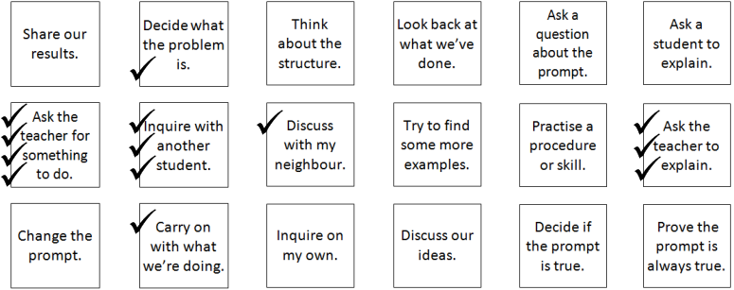
Structured inquiry
Inquiry Maths

Slide 30
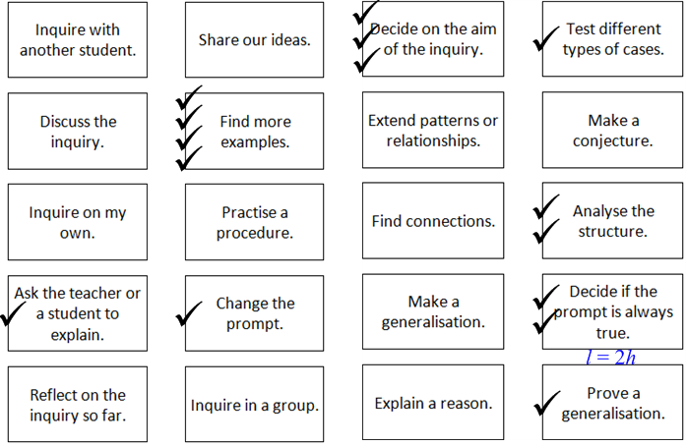
Guided inquiry
Inquiry Maths

Slide 31
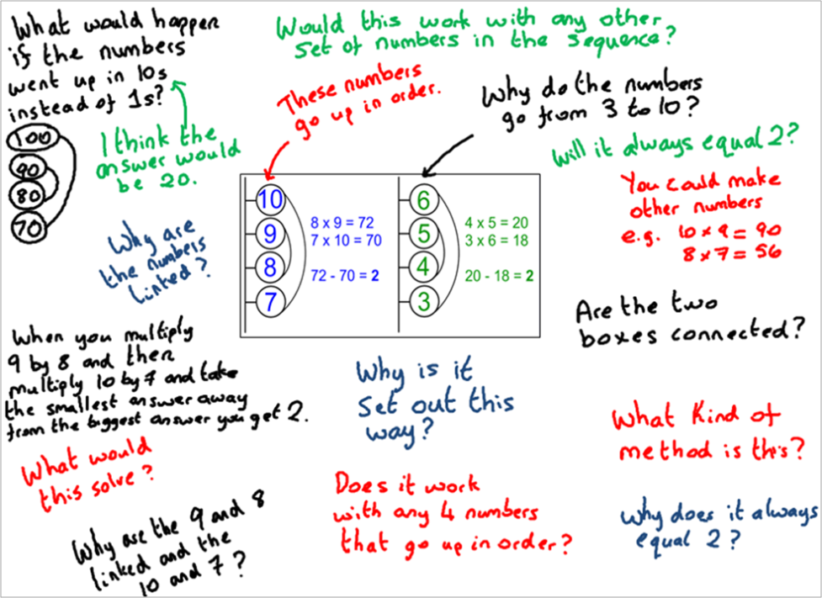
Structured and guided
Inquiry Maths
Notes:
ACTIVITY 3 How could inquiry proceed in relation to cards?
20 cards

Slide 32
Guided and open
Inquiry Maths

Slide 33
Research: agency
5
Inquiry Maths
Notes:
Most important: Increases constructive and critical agency
Engeström: As well as giving rise to forms of creativity, agency can also lead to disruption in the research site as participants contest or even resist the inquiry model

Slide 34
Agency
Agency gives rise to forms of creativity and independence, but it can also lead to disruption in the classroom when participants dispute, subvert or even resist inquiry.
Inquiry Maths
Notes:
Most important aspect of cards: increases constructive and critical agency (positive: creativity, initiative and independence).
As well as giving rise to forms of creativity, agency can also lead to disruption in the research site as participants contest or even resist the inquiry model. (Engeström)

Slide 35
Agency Regulatory cards
Original set of cards
Inquiry Maths

Slide 36
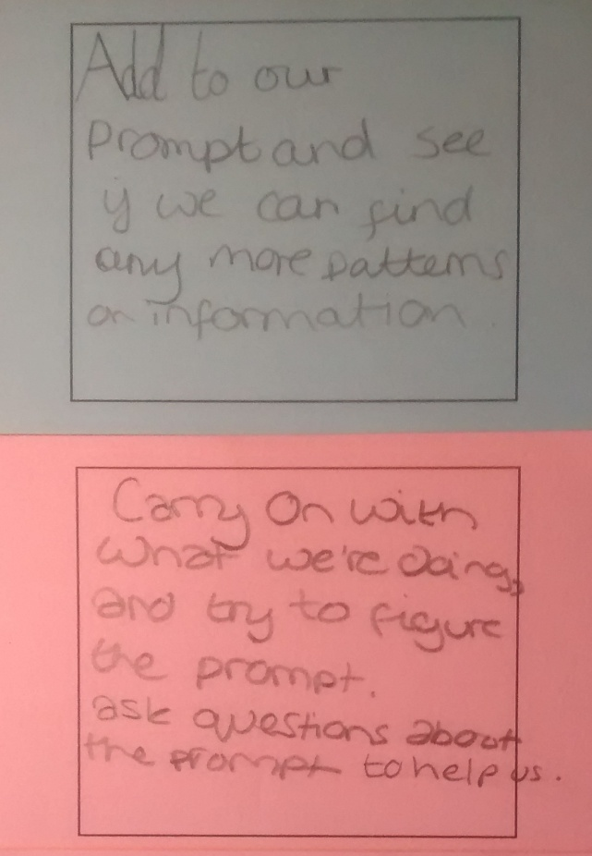
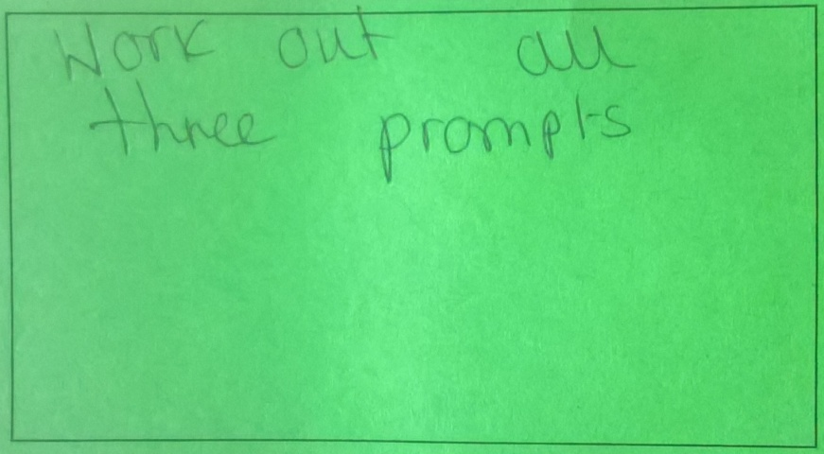
Agency Creating new cards
Mechanisms for the creation of new cards:
Blank cards
Expanding ideas in response to the teacher’s probing questions.
Inquiry Maths

Slide 37
Agency Creating new cards
Inquiry Maths

Slide 38
Agency Independence in card selection
Complementary
Cards are selected to indicate what students want to do and how they propose to do it.
Combination
Two or three cards are combined (for example, Find more examples by testing different types of cases.)
Sequence
The sequence is similar, but it contains the explicit notion of steps from one card to the next.
Inquiry Maths

Slide 39
Agency Disputation
The teacher, as representative of the mathematical culture, evaluates and sanctions the choices made. Disputation occurs when a student disagrees with the teacher’s suggested course of action at the end of the regulatory phase.
St 1: “Don’t spend too much time on talking. It gets boring and confusing.”
St 2: “I want to use laptops now.”
St 3: “I’d find out when you discuss as a class, you learn more and everybody contributes and we discover more.”
Rare incidences compared to subversion and resistance.
Inquiry Maths
Notes:
Principal research
Inquiries
X
X
X

Slide 40
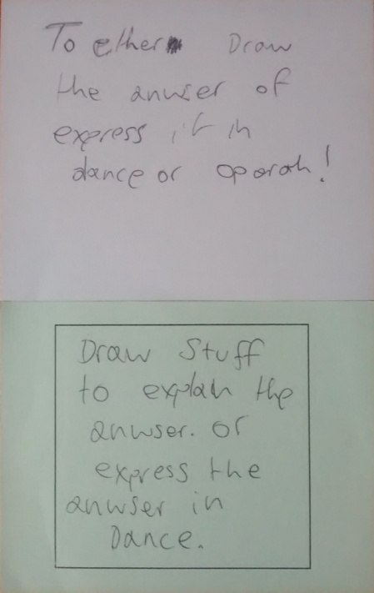
Agency Subversion
Select the same ‘default’ card each time regardless of the specific position reached in the inquiry. One card became the de facto choice for students who aimed to zoom out (Use laptops to help us).
Students made up what appeared, on the surface, to be ‘nonsense’ cards, but, on a deeper level, they offered a critique of the intentions behind the regulatory cards.
To either draw the answer or express it in
dance or opera. (Lewis and Shakura, 12b)
Express our ideas using a crowbar and a
bouncy castle. (Lewis and Shakura, 16)
Inquiry Maths
Notes:
=> Teacher WITHDRAWS CARD
The off-beat humour was easy to deal with in class because many of the students (aged 12 and 13) would not have understood its implications. Nevertheless, the almost mocking tone of the bizarre statements suggests that at least one student had not been convinced that the intentions behind the regulatory cards offered any difference to normal secondary school classrooms.

Slide 41
Agency Resistance
Pilot inquiries 2-4 Students zoom out - “do no work”,
“have a day off” and "go home” led to direct refusal from
the teacher. In pilot 5 the students do accept the
teacher’s invitation to select a card. A discussion now
focussed on the meaning of the card.
Principal research Only one case of resistance.
St: Carry on with what we’re doing
T: What are you doing?
St: Chatting
T: About maths?
St: No.
Inquiry Maths
Notes:
Principal research 12 St: “Relax.” (after withdrawal of the default card) Work with another student “so don’t have to do anything.”

Slide 42
Teacher’s agency
Restricted agency
Withdrawal of card(s)
More directive when restricted or only one inquiry pathway; however, bypassing the regulatory cards and, along with them, the slowdown of the inquiry that the cards entail left students without a clear aim.
Arbiter of legitimate cards
Accepted or rejected students’ suggestion of new cards for the class set.
The legacy of inquiry based on inductive processes can be an obstacle to the teacher expressing her own agency.
Inquiry Maths
Notes:
The grounds for not converting a new statement into a regulatory card were as follows:
Statement judged to be appropriate only to the specific circumstances in which it arose (for example, ‘work it out as a sum’);
(2) Statement did not promote activities and processes I associate with Inquiry Maths classrooms (for example, ‘play some games’ and ‘relax’); or
(3) The statement was similar to a card already in the set (for example, ‘Work on the prompt in pairs’)

Slide 43
Teacher’s agency
Role of teacher: design, adapt and change the cards
Cards as means
The regulatory cards have the potential to promote the teacher’s agency if they are used as a means of becoming aware of the forms of students’ reasoning.
Cards as stimulus
By assessing the students’ levels of inductive and deductive reasoning, how they navigate between the two forms during inquiry and the relationship they establish between them, the teacher can prepare or adapt the content of the cards to stimulate the development towards ‘ideal and final’ forms of mathematical reasoning.
Inquiry Maths

Slide 44
Regulatory cards
Inquiry Maths
Notes:
ACTIVITY 4 What cards could you use / design with the class and prompt you have chosen?

Slide 45
Regulatory cards
Inquiry Maths

Slide 46
Composition of the cards
Profile of class
Experience of class with inquiry
Stimulus-object (prompt)
Aims of teacher (forms of reasoning and agency to be ‘stimulated’)
Potential forms of disputation, subversion and resistance
Inquiry Maths

Slide 47
Questions
inquiry maths

Slide 48
Additional slides
Inquiry Maths

Slide 49
What do students say?
“I ask lots more questions in maths after doing inquiry lessons. Last week I made up my own inquiry on enlargements.” (year 8)
“What’s different is that I feel I have a say in what we do. That makes me work harder.” (year 10)
“I benefited from an inquiry lesson as I could show how I proved my answer was correct using algebra.” (year 8)
“When I ask a question, I want to answer it more.” (year 9)
Inquiry Maths

Slide 50
What do teachers say?
“I really liked the way the inquiry allowed the students to ‘roam free’ with ideas and concepts. Allowing the students to explore and express their thoughts was a real eye opener and was very rewarding to see as a teacher.”
“I ran my first inquiry lesson with year 7 today. It was professionally invigorating.”
“Using Inquiry Maths over this year for my year 7 class has made my students into active learners who are fearless and methodical when attacking a problem.”
“The process gave the students the experience of being real mathematicians, something which is far too rarely the case in schools. They loved it and I felt that I learned much more about their strengths than I had in the preceding lessons.”
“The students’ responses were inspiring, amazing, and truly beyond any of my expectations.”
“I was pleased with the students’ enthusiasm and very proud of their first attempt at Inquiry Maths.”
Inquiry Maths

Slide 51
Questions
How do you plan a lesson for Ofsted or an observation?
How do you decide what the success criteria or lesson objectives are going to be?
How do you manage the regulatory cards?
How do you decide if the prompt is appropriate for a class?
How does inquiry work with a mixed attainment class?
Can you expect students in bottom sets to take part in inquiry lessons?
Are students mature enough to be given this level of responsibility?
Can you expect students to inquire into topics without being given 'content' knowledge beforehand?
Inquiry Maths

Slide 52
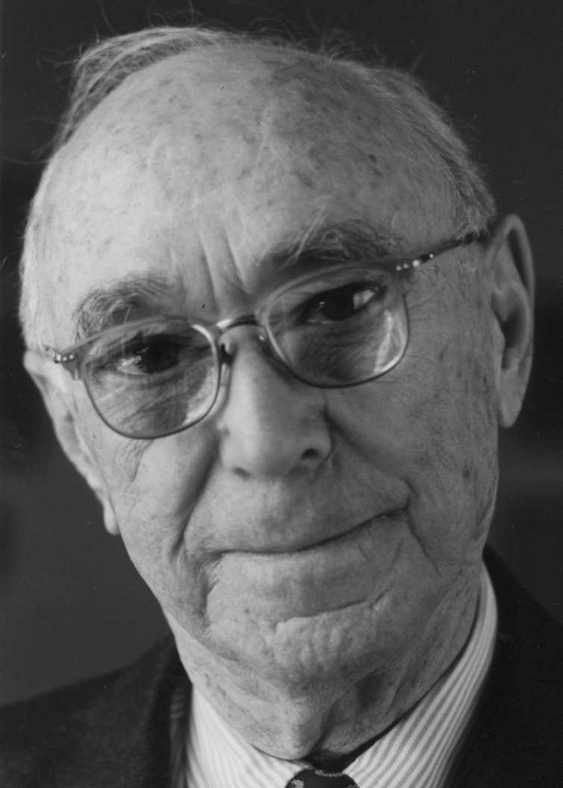
Inquiry Maths model
Bruner: plodding and leaping
Give the child practice at both plodding and leaping. Let him go by small steps. Then let him take great leaps, huge guesses.
Without guessing, he is deprived of his rights as a mind. (Needed: A Theory of Instruction, 1963)
Inquiry Maths

Slide 53
Regulatory cards metacognition
Retrospective verbalisation requires retrieval from long-term memory
and the construction of a response. It can lead to incomplete
descriptions of prior thinking and is subject to bias.
Students may:
not remember
‘misremember’
‘invent’ memories (even without knowing they are doing so).
The report of a global strategy (as opposed to the details of thinking at a
particular instant) might be more accurate. However, even then students
might describe a strategy that just occurred to them when they are
asked.
Hacker et al. (1998). Metacognition in Educational Theory and Practice. Lawrence Erlbaum.
Inquiry Maths

Slide 54
Regulatory cards metacognition
Declarative
knowledge
Knowing:
yourself as a thinker
academic tasks
strategies to perform a task.
Procedural
knowledge
monitoring strategic decisions (checking on progress)
regulating thinking and activity (planning)
evaluating what one knows to accomplish a task (selecting).
Inquiry Maths

Slide 55
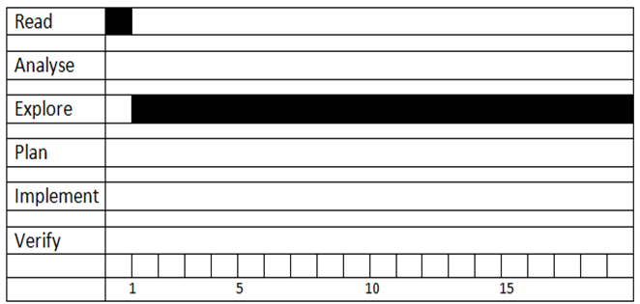
Regulatory cards Schoenfeld
Student
Inquiry Maths
Notes:
(slides 15 and 16 optional) Explaining origin of regulatory cards:
http://www.inquirymaths.com/home/Regulatory-cards/why-do-maths-students-need-self-regulation – link to explanation of diagrams on website.

Slide 56
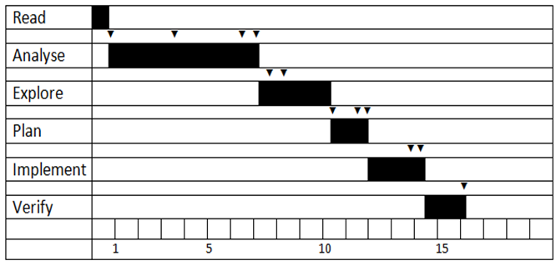
Regulatory cards Schoenfeld
Mathematician
“It’s not only what you know, but how you use it (if at all) that matters.”
Inquiry Maths

Slide 57
Regulatory cards
Students who have the capacity to monitor, plan, evaluate, control and change their thinking:
Become more independent;
Assume greater responsibility for themselves as learners;
Perform better on academic tasks.
Inquiry Maths

