Slide 1
GCSE Questions WJEC
Transformations
2011 to 2013

Slide 2
Teacher notes
You can get pupils to sort the cards in various ways:
RAG
Can do and can’t do
Question types
Line from easy to hard
Think about which questions you would like pupils to try after they have sorted them
Would you like them to help each other?
You might want to link this to the learning journey:
Get pupils to decide which grade each question is
Pupils to self assess themselves after doing some questions and looking at the Learning journey

Slide 3
 | F/G | E | D | C | B | A/A*
Transformations | Find the order of rotational symmetry for basic 2-D shapes (F) Draw lines of symmetry on basic 2-D shapes (G) | Draw lines of symmetry on more complex 2-D shapes Reflect a 2-D shape in the x-axis or the y-axis | I can enlarge a shape by a positive scale factor I can reflect a shape in a horizontal or vertical mirror line. Rotate a 2-D shape about the origin | Enlarge a 2-D shape about any point I can translate a shape by a positive vector. Rotate a 2-D shape about any point Enlarge a 2-D shape by a fractional scale factor Reflect a 2-D shape in the line y = x or y = -x | I can enlarge a shape by any scale factors. I can combine transformations. I can reflect a shape in a line when the equation of the line is given to me. | I can solve problems using addition & subtraction of vectors I can solve more complex geometrical problems using vectors
I am starting the lesson on grade _______I can …………..
By the end of the lesson I want to be able to ……………………….
Notes:
You might use this LJ from a previous lesson already glued into their books. If this is the case try to get pupils to annotate their LJ with dates and using a different coloured pen.

Slide 4
Cut the questions up and put into envelopes
Instructions for pupils
Sort your questions into similar types
Now into 'can do' and 'can't do' piles
Try as many as possible
Make a note of the questions you want explained

Slide 5
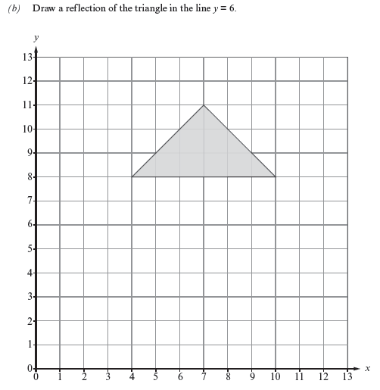
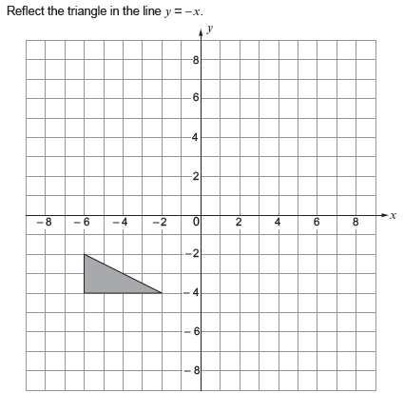
Notes:
Non Calculator Questions - Higher

Slide 6
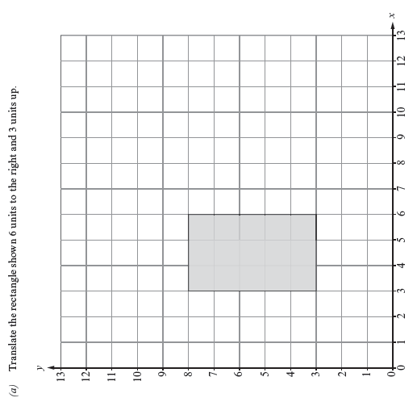
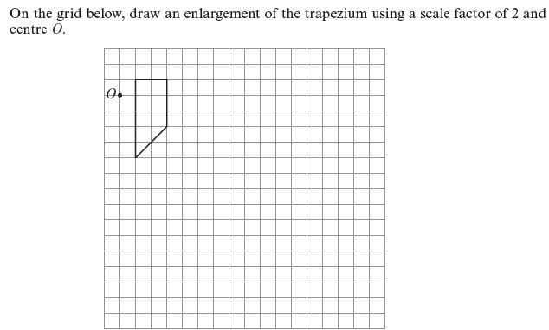
Notes:
Non Calculator Questions - Higher

Slide 7
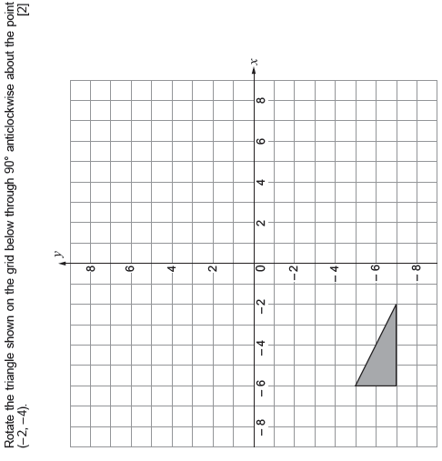
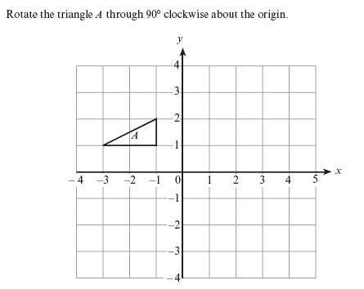
Notes:
Non Calculator Questions - Higher

Slide 8
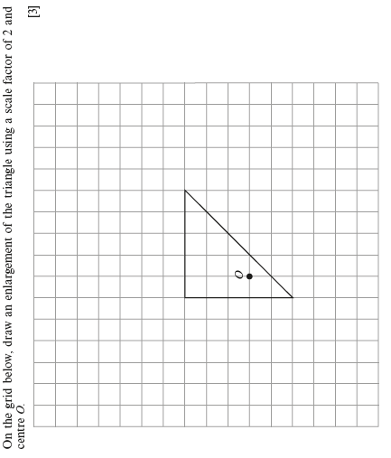
Notes:
Non Calculator Questions - Higher

Slide 9
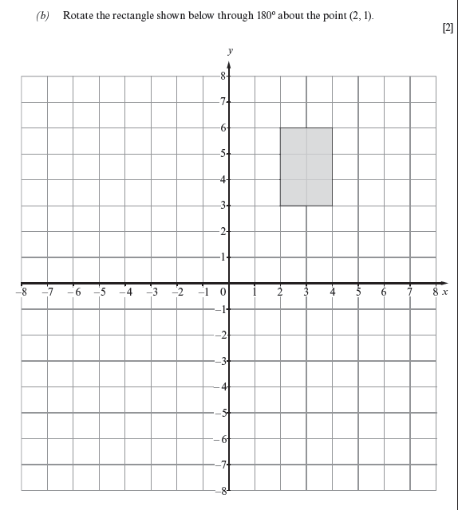
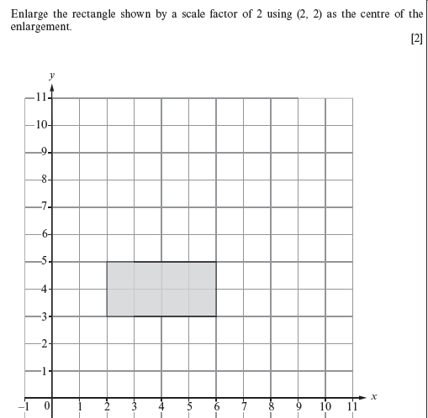
Notes:
Calculator Questions - higher

Slide 10
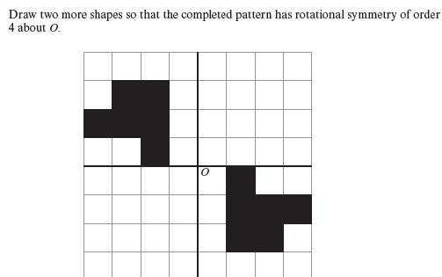
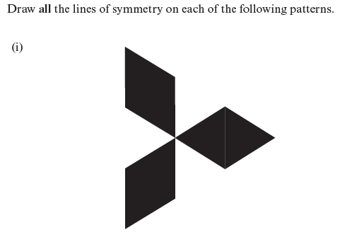
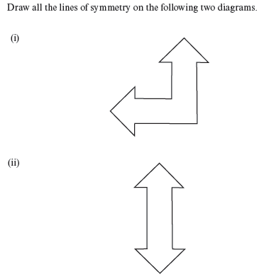
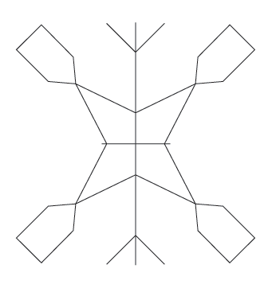
Notes:
Non Calculator - foundation

Slide 11
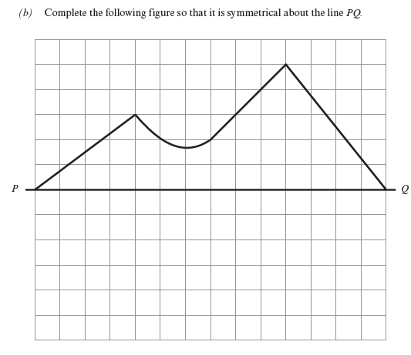
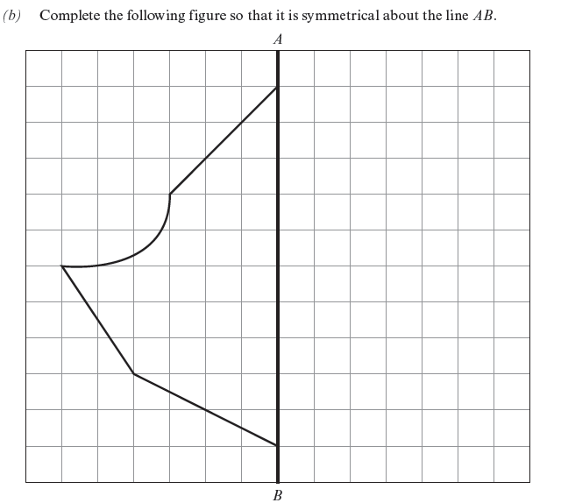
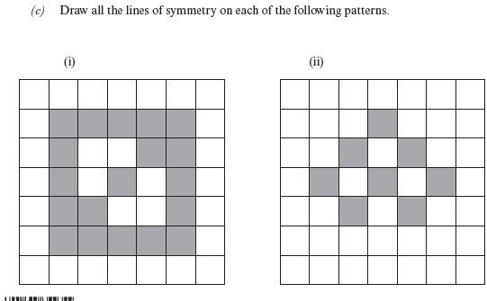
Notes:
Calculator Questions – Foundation

