Slide 1
GCSE Questions WJEC
Pythagoras
2011 to 2013

Slide 2
Teacher notes
The notes for each slide will say which exam papers the questions come from
You can get pupils to sort the cards in various ways:
RAG
Can do and can’t do
Question types
Line from easy to hard
Think about which questions you would like pupils to try after they have sorted them
Would you like them to help each other?
You might want to link this to the learning journey:
Get pupils to decide which grade each question is
Pupils to self assess themselves after doing some questions and looking at the Learning journey

Slide 3
Grade | F | E | D | C | B
Pythagoras’ Theorem | I can recognise square numbers and cube numbers. | I can solve problems involving squares, cubes and square roots. | I can find the length of the longest side (the hypotenuse) in a right angled triangle using Pythagoras’ Theorem | I can find the length of a shorter side in a right angled triangle using Pythagoras’ Theorem. | I can find missing lengths and distances in shapes other than right angled triangles using Pythagoras Theorem.
I am starting the lesson on grade _______I can …………..
By the end of the lesson I want to be able to ……………………….
Notes:
You might use this LJ from a previous lesson already glued into their books. If this is the case try to get pupils to annotate their LJ with dates and using a different coloured pen.

Slide 4
Cut the questions up and put into envelopes
Instructions for pupils
Sort your questions into similar types
Now into 'can do' and 'can't do' piles
Try as many as possible
Make a note of the questions you want explained

Slide 5
Notes:
Non Calculator Questions - Higher

Slide 6
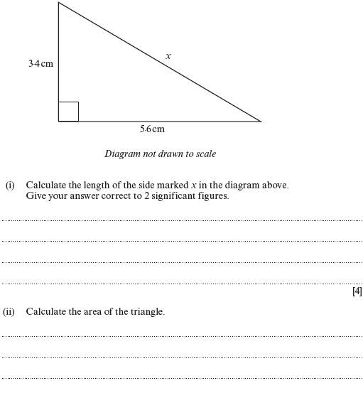
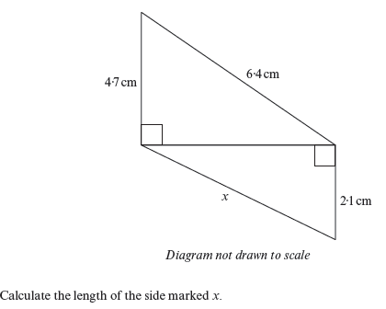
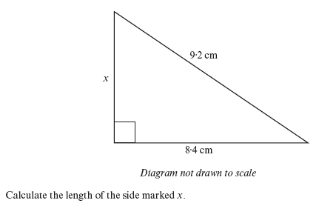
Notes:
Calculator Questions - higher

Slide 7
No Non-calculator Foundation questions recently
Notes:
Non Calculator - foundation

Slide 8
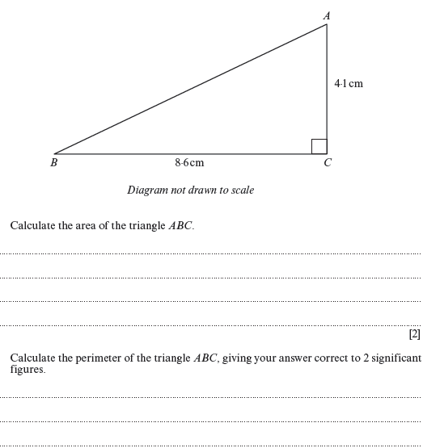
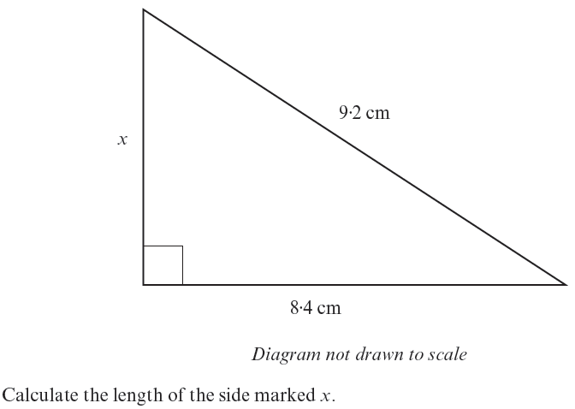
Notes:
Calculator Questions – Foundation

