Slide 1
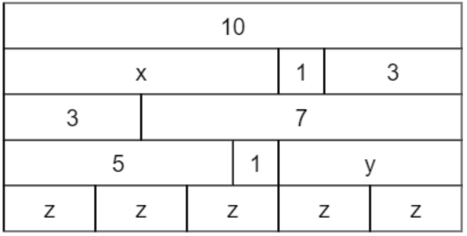
Representing Equivalence
What equations can you write down now?
Can you spot the equations…
$$10=x+1+3$$
$$x=5+1$$
$$3z+y=10$$
$$5z−y=x$$
How many possibilities are there?
@McGuirea499

Slide 2
Representing Equivalence
What equations can you write down?
Equations with decimals?
Can you see…
$$1−0.25=6×0.125$$
$$x+0.67=0.887$$
$$x−0.4=2×0.32$$
@McGuirea499

