Slide 1
Sequences
We use multi-link for the sequences activity.

Slide 2
Starter Activity Think / Pair / Share
Which is the odd one out?
You must give a reason for your answer.
4, 6, 8, 10, 12, …., ….,
2, 4, 8, 16, 32, …..,
8, 6, 4, 2, 0, -2, ……,
6, 9, 12, 15, ….., ……,

Slide 3
Sequences | I can draw the next two patterns in a simple sequence (Task A) I can work out the next two terms (numbers) in a sequence | I can find a term to term rule for a linear sequence. I can describe a sequence in words. (Task B) | I can find the position to term rule for a linear sequence and explain how I worked it out. (Task C) I can generate a sequence from a position to term rule. | I can use a position to term rule to find any term in a sequence and also to decide whether a number is part of a sequence. (Task D) | I understand the difference between a linear sequence and a quadratic sequence. (Task E)

Slide 4
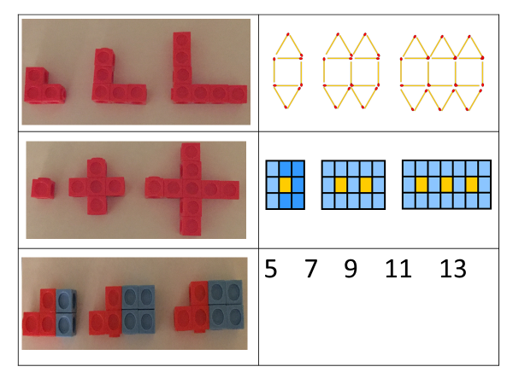
Notes:
Pupil hand-out. Print this slide and the next slide 2 to a page.

Slide 5
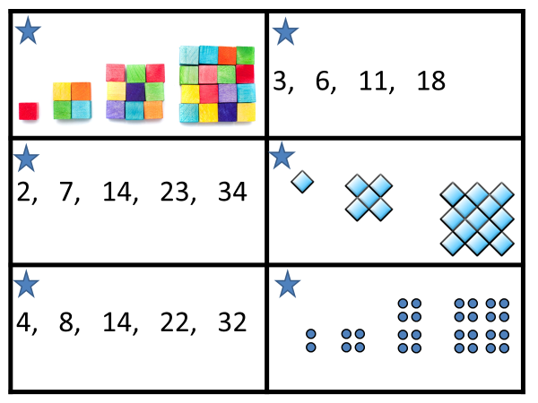
Notes:
Pupil hand-out. Print the previous slide and the next slide 2 to a page.

Slide 6
Don’t do the starred sequences unless you are completing Task E.
Task A | Draw or build the next two patterns in the sequence. What do you notice about each sequence?
Task B | Describe the sequence in words. Find the term to term rule for the sequence. What is the same and what is different about each sequence?
Task C | Find the position to term rule for each sequence and explain how you worked it out. What is the same and what is different about each sequence?
Task D | Find the 20th 50th and 100th term in each sequence.
Task E | What is different about the starred sequences? Can you find the next two terms in these sequences? Can you find a nth term rule for these sequences and explain how you did it?

