Slide 1
Mixed-attainment Mathematics conference #3 Park View School, London Saturday 27th January 2018 Mike Ollerton
Angle at KS3 and KS4

Slide 2
Angle
A
D
B
C

Slide 3
A
E
D
B
F
C

Slide 4
A
E
D
G
H
B
F
C

Slide 5
A
E
J
D
I
G
H
B
F
C

Slide 6
A
E
J
D
N
I
M
L
G
H
K
B
F
C

Slide 9
70⁰
55⁰

Slide 10
D
A
70⁰
90⁰
C
55⁰
B

Slide 11
θ⁰
θ⁰
α⁰

Slide 12
θ⁰
α⁰

Slide 14
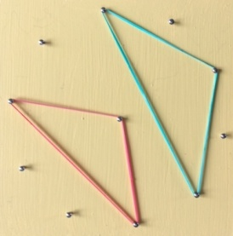
Triangles on a 10-pin (+1) circular Geoboard

