Slide 1
In this class…… We all have different starting points. We can all learn from one another. We can all make progress. We will value our mistakes because we can learn from them. We will choose tasks that challenge us because this is how we develop our skills and understanding. We will keep trying even when we are finding a task difficult because this is how we make progress.
Notes:
Use this slide to have a class discussion about what it means to be a good learner in Maths. Explain that in Maths we celebrate and reward good learning not attainment.

Slide 2
You all have the same Learning Journey but you may have different start points
A Learning Journey cannot tell you how good you are at Maths.
A Learning Journey shows you the different skills / Knowledge within a topic.
It helps you to identify what you can already do and what you need to do next to move your learning on.
It helps you to choose your Learning Objective for each lesson.

Slide 3
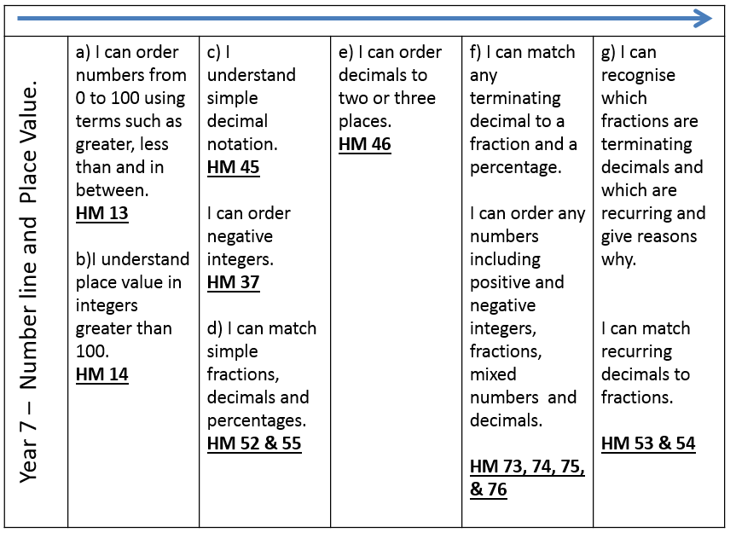
The Learning Journey shows you the skills / knowledge that you will be developing over each unit of work.

Slide 4
Each lesson you will refer to your Learning Journey and decide what you can already do. It is your responsibility to make sure that each lesson you choose a task which will challenge you.

Slide 5
You are going to have a few minutes to have a go at answering some questions.
Do not worry if you can’t answer any questions yet.
This is not a test, it is a quick to check to find out what you already know and what you still need to learn. This will help guide you when you are selecting tasks.
Each unit of work we will compare your Learning Journey at the end of the unit with your Learning Journey at the start of the unit to see which new things you have learnt.

Slide 6
Year 7 – Number line and Place Value. | a) I can order numbers from 0 to 100 using terms such as greater, less than and in between. HM 13 b)I understand place value in integers greater than 100. HM 14 | c) I understand simple decimal notation. HM 45 I can order negative integers. HM 37 d) I can match simple fractions, decimals and percentages. HM 52 & 55 | e) I can order decimals to two or three places. HM 46 | f) I can match any terminating decimal to a fraction and a percentage. I can order any numbers including positive and negative integers, fractions, mixed numbers and decimals. HM 73, 74, 75, & 76 | g) I can recognise which fractions are terminating decimals and which are recurring and give reasons why. I can match recurring decimals to fractions. HM 53 & 54
Notes:
Print this slide and the next slide two to a page and give to pupils to glue into their books. These should be printed to colour paper so that pupils can easily find them in their books. Pupils will refer to these in most lessons.

Slide 7
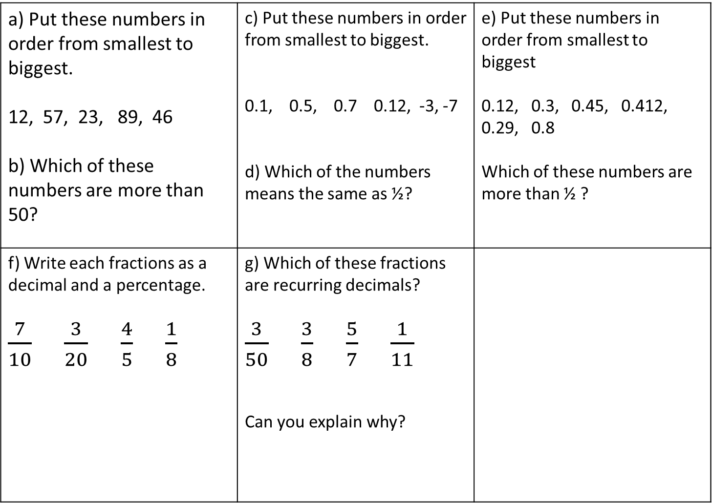
a) Put these numbers in order from smallest to biggest. 12, 57, 23, 89, 46 b) Which of these numbers are more than 50? | c) Put these numbers in order from smallest to biggest. 0.1, 0.5, 0.7 0.12, -3, -7 d) Which of the numbers means the same as ½? | e) Put these numbers in order from smallest to biggest 0.12, 0.3, 0.45, 0.412, 0.29, 0.8 Which of these numbers are more than ½ ?
f) Write each fractions as a decimal and a percentage. $\frac{7}{10}$ $\frac{3}{20}$ $\frac{4}{5}$ $\frac{1}{8}$ | g) Which of these fractions are recurring decimals? $\frac{3}{50}$ $\frac{3}{8}$ $\frac{5}{7}$ $\frac{1}{11}$ Can you explain why?
Notes:
Print this slide and the previous slide two to a page and give to pupils to glue into their books. These should be printed to colour paper so that pupils can easily find them in their books. Pupils will refer to these in most lessons.

Slide 8
Get ready for the answers….
Highlight any parts of the Learning Journey you answered completely correctly.
If you didn’t get an answer correct, don’t highlight anything.
It’s ok not to get anything correct yet, you will learn how to answer questions like these things over the next few lessons.

Slide 9
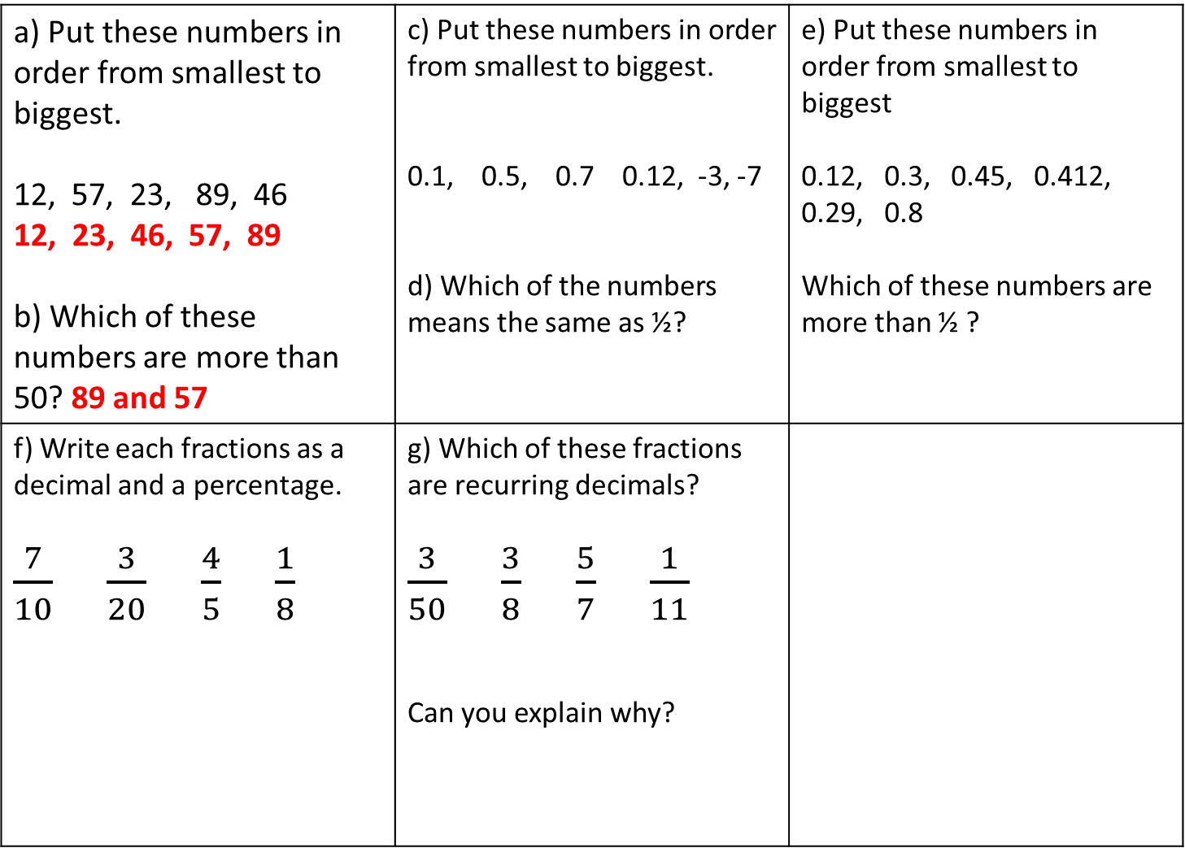
a) Put these numbers in order from smallest to biggest. 12, 57, 23, 89, 46 12, 23, 46, 57, 89 b) Which of these numbers are more than 50? 89 and 57 | c) Put these numbers in order from smallest to biggest. 0.1, 0.5, 0.7 0.12, -3, -7 d) Which of the numbers means the same as ½? | e) Put these numbers in order from smallest to biggest 0.12, 0.3, 0.45, 0.412, 0.29, 0.8 Which of these numbers are more than ½ ?
f) Write each fractions as a decimal and a percentage. $\frac{7}{10}$ $\frac{3}{20}$ $\frac{4}{5}$ $\frac{1}{8}$ | g) Which of these fractions are recurring decimals? $\frac{3}{50}$ $\frac{3}{8}$ $\frac{5}{7}$ $\frac{1}{11}$ Can you explain why?

Slide 10
Year 7 – Number line and Place Value. | a) I can order numbers from 0 to 100 using terms such as greater, less than and in between. HM 13 b)I understand place value in integers greater than 100. HM 14 | c) I understand simple decimal notation. HM 45 I can order negative integers. HM 37 d) I can match simple fractions, decimals and percentages. HM 52 & 55 | e) I can order decimals to two or three places. HM 46 | f) I can match any terminating decimal to a fraction and a percentage. I can order any numbers including positive and negative integers, fractions, mixed numbers and decimals. HM 73, 74, 75, & 76 | g) I can recognise which fractions are terminating decimals and which are recurring and give reasons why. I can match recurring decimals to fractions. HM 53 & 54

Slide 11
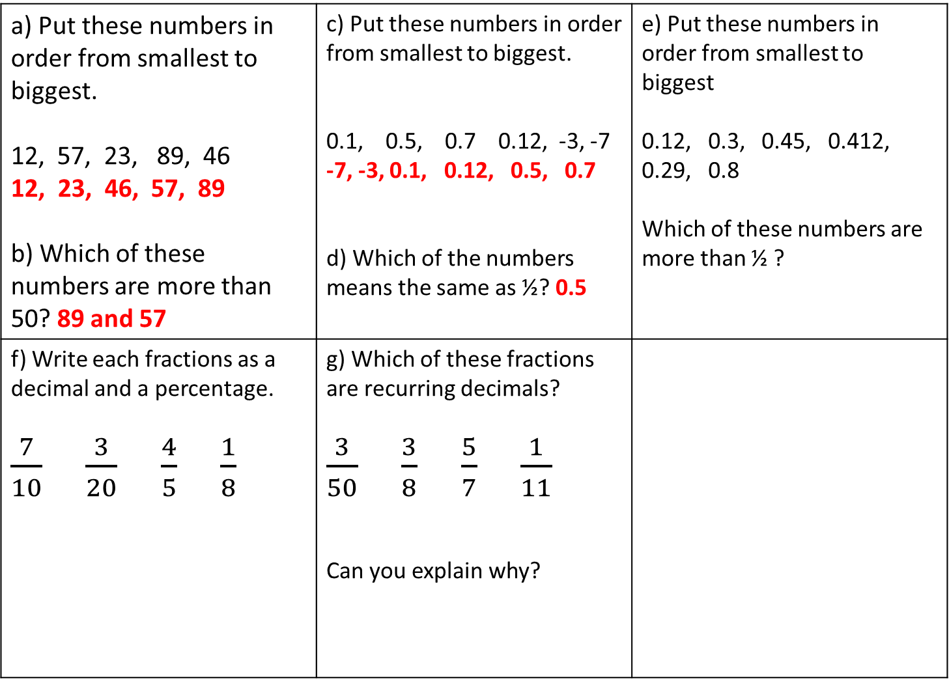
a) Put these numbers in order from smallest to biggest. 12, 57, 23, 89, 46 12, 23, 46, 57, 89 b) Which of these numbers are more than 50? 89 and 57 | c) Put these numbers in order from smallest to biggest. 0.1, 0.5, 0.7 0.12, -3, -7 -7, -3, 0.1, 0.12, 0.5, 0.7 d) Which of the numbers means the same as ½? 0.5 | e) Put these numbers in order from smallest to biggest 0.12, 0.3, 0.45, 0.412, 0.29, 0.8 Which of these numbers are more than ½ ?
f) Write each fractions as a decimal and a percentage. $\frac{7}{10}$ $\frac{3}{20}$ $\frac{4}{5}$ $\frac{1}{8}$ | g) Which of these fractions are recurring decimals? $\frac{3}{50}$ $\frac{3}{8}$ $\frac{5}{7}$ $\frac{1}{11}$ Can you explain why?

Slide 12
Year 7 – Number line and Place Value. | a) I can order numbers from 0 to 100 using terms such as greater, less than and in between. HM 13 b)I understand place value in integers greater than 100. HM 14 | c) I understand simple decimal notation. HM 45 I can order negative integers. HM 37 d) I can match simple fractions, decimals and percentages. HM 52 & 55 | e) I can order decimals to two or three places. HM 46 | f) I can match any terminating decimal to a fraction and a percentage. I can order any numbers including positive and negative integers, fractions, mixed numbers and decimals. HM 73, 74, 75, & 76 | g) I can recognise which fractions are terminating decimals and which are recurring and give reasons why. I can match recurring decimals to fractions. HM 53 & 54

Slide 13
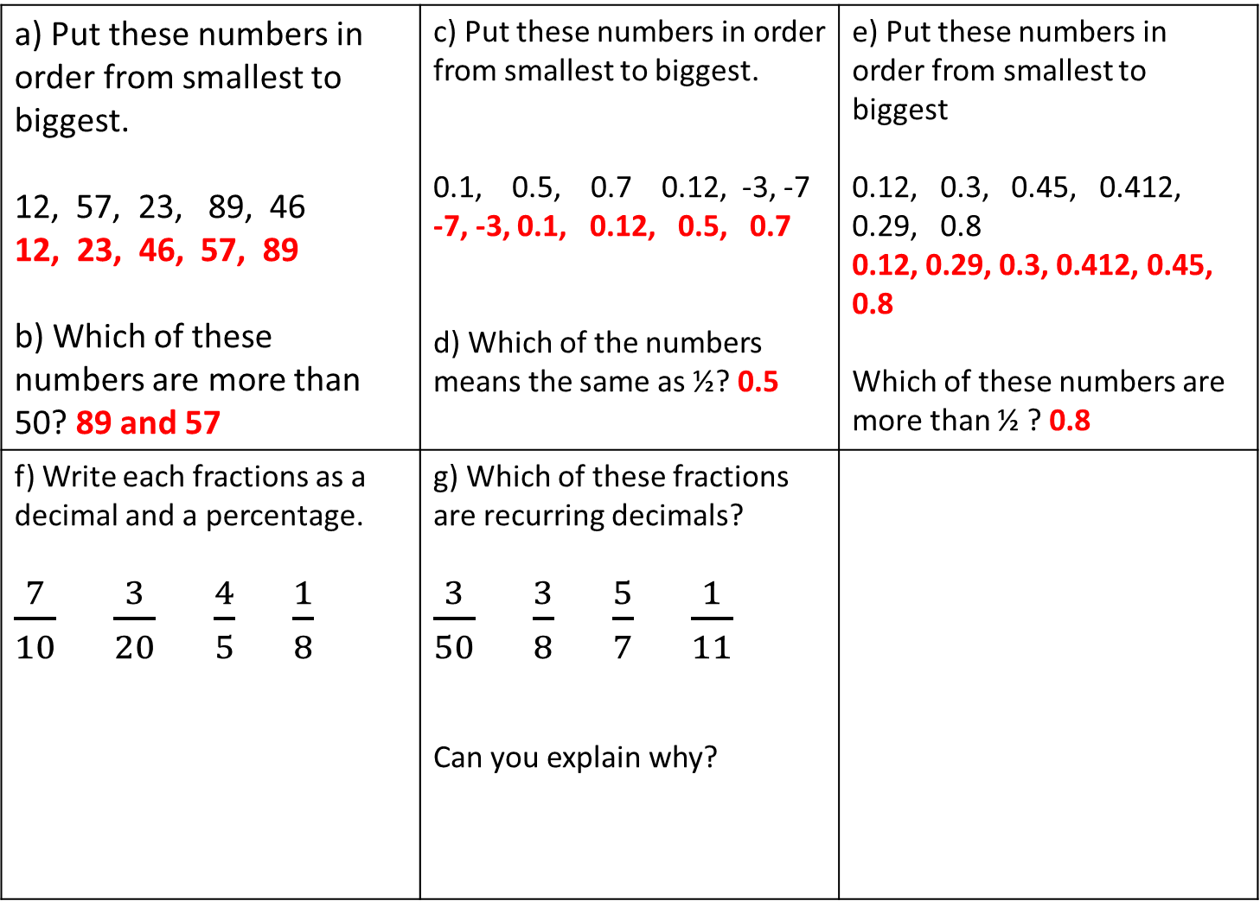
a) Put these numbers in order from smallest to biggest. 12, 57, 23, 89, 46 12, 23, 46, 57, 89 b) Which of these numbers are more than 50? 89 and 57 | c) Put these numbers in order from smallest to biggest. 0.1, 0.5, 0.7 0.12, -3, -7 -7, -3, 0.1, 0.12, 0.5, 0.7 d) Which of the numbers means the same as ½? 0.5 | e) Put these numbers in order from smallest to biggest 0.12, 0.3, 0.45, 0.412, 0.29, 0.8 0.12, 0.29, 0.3, 0.412, 0.45, 0.8 Which of these numbers are more than ½ ? 0.8
f) Write each fractions as a decimal and a percentage. $\frac{7}{10}$ $\frac{3}{20}$ $\frac{4}{5}$ $\frac{1}{8}$ | g) Which of these fractions are recurring decimals? $\frac{3}{50}$ $\frac{3}{8}$ $\frac{5}{7}$ $\frac{1}{11}$ Can you explain why?

Slide 14
Year 7 – Number line and Place Value. | a) I can order numbers from 0 to 100 using terms such as greater, less than and in between. HM 13 b)I understand place value in integers greater than 100. HM 14 | c) I understand simple decimal notation. HM 45 I can order negative integers. HM 37 d) I can match simple fractions, decimals and percentages. HM 52 & 55 | e) I can order decimals to two or three places. HM 46 | f) I can match any terminating decimal to a fraction and a percentage. I can order any numbers including positive and negative integers, fractions, mixed numbers and decimals. HM 73, 74, 75, & 76 | g) I can recognise which fractions are terminating decimals and which are recurring and give reasons why. I can match recurring decimals to fractions. HM 53 & 54

Slide 15
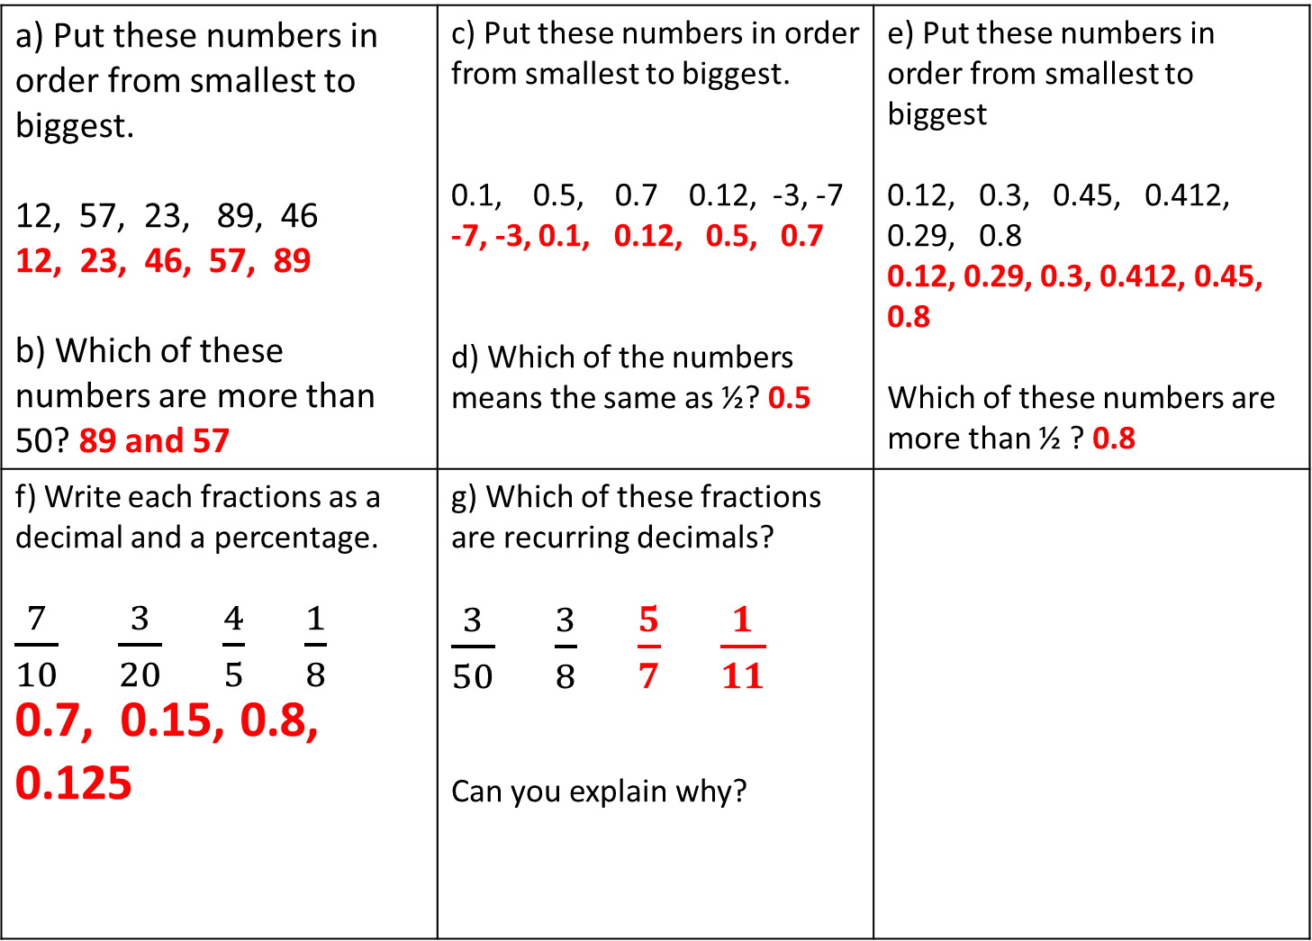
a) Put these numbers in order from smallest to biggest. 12, 57, 23, 89, 46 12, 23, 46, 57, 89 b) Which of these numbers are more than 50? 89 and 57 | c) Put these numbers in order from smallest to biggest. 0.1, 0.5, 0.7 0.12, -3, -7 -7, -3, 0.1, 0.12, 0.5, 0.7 d) Which of the numbers means the same as ½? 0.5 | e) Put these numbers in order from smallest to biggest 0.12, 0.3, 0.45, 0.412, 0.29, 0.8 0.12, 0.29, 0.3, 0.412, 0.45, 0.8 Which of these numbers are more than ½ ? 0.8
f) Write each fractions as a decimal and a percentage. $\frac{7}{10}$ $\frac{3}{20}$ $\frac{4}{5}$ $\frac{1}{8}$ 0.7, 0.15, 0.8, 0.125 | g) Which of these fractions are recurring decimals? $\frac{3}{50}$ $\frac{3}{8}$ $\frac{5}{7}$ $\frac{1}{11}$ Can you explain why?

Slide 16
Year 7 – Number line and Place Value. | a) I can order numbers from 0 to 100 using terms such as greater, less than and in between. HM 13 b)I understand place value in integers greater than 100. HM 14 | c) I understand simple decimal notation. HM 45 I can order negative integers. HM 37 d) I can match simple fractions, decimals and percentages. HM 52 & 55 | e) I can order decimals to two or three places. HM 46 | f) I can match any terminating decimal to a fraction and a percentage. I can order any numbers including positive and negative integers, fractions, mixed numbers and decimals. HM 73, 74, 75, & 76 | g) I can recognise which fractions are terminating decimals and which are recurring and give reasons why. I can match recurring decimals to fractions. HM 53 & 54
(You must tell the teacher if this is your starting point.)

Slide 17
What happens next…
The highlighted statements show what you could already do before we had any lessons on this topic.
For all future lessons you will tick and date the new things that you learn so that you can see the progress that you are making.

Slide 18
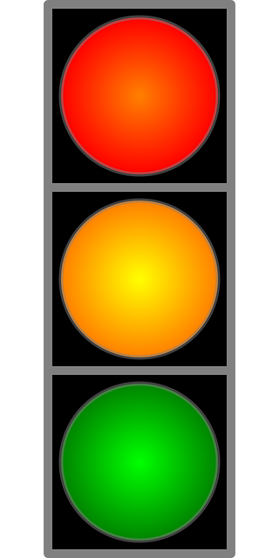
This means you are stuck.
You need to choose a strategy to un-stick yourself.
This means you are learning.
This is where you should find yourself most of the time
This means you understand so well that you could explain to someone else. You are ready for a new challenge.
Notes:
Use this slide to have a class discussion about what strategies pupils can use when they are in the red zone.

Slide 19
What strategies could I use?
Notes:
Collect suggestions from the class. Make sure that pupils are aware that they can ask for a clue card, ask for help from another pupil, the teacher or a support teacher, or they may need to change tasks.

Slide 20
How do I know when I’ve moved to green?
Notes:
Collect suggestions from the class. Make sure that pupils are aware that ‘being green’ isn’t simply about getting the right answers, its about understanding deeply enough to be able to explain to someone else.

Slide 21
What should I do next?
Notes:
Collect suggestions from the class. Make sure that pupils are aware that they shouldn’t spend too long in the green zone. They should choose a different task or ask the teacher for an extension task.

