Slide 1
GCSE Questions WJEC
Angles
2011 to 2013

Slide 2
Teacher notes
The notes for each slide will say which exam papers the questions come from
You can get pupils to sort the cards in various ways:
RAG
Can do and can’t do
Question types
Line from easy to hard
Think about which questions you would like pupils to try after they have sorted them
Would you like them to help each other?
You might want to link this to the learning journey:
Get pupils to decide which grade each question is
Pupils to self assess themselves after doing some questions and looking at the Learning journey

Slide 3
 | G | F | E | D | C | B
Angles | I can distinguish between acute, obtuse, reflex and right angles. | I can work out the size of missing angles at a point I can work out the size of missing angles on a straight line I can draw and measure angles | I know the sum of the interior angles of a triangle and a quadrilateral. I can calculate missing angles in triangles and quadrilaterals I can use bearings | I can find alternate/corresponding angles, given two parallel lines. I can calculate the sum of the interior angles of polygons. I can calculate the size of an interior angle of a regular polygon. Given the exterior angle of a regular polygon I can calculate the number of sides. I can draw bearings | I can solve multi-step problems involving interior / exterior angles of regular polygons. I can do calculations that use bearings | Find angles in circles using circle theorems
Notes:
You might use this LJ from a previous lesson already glued into their books. If this is the case try to get pupils to annotate their LJ with dates and using a different coloured pen.

Slide 4
Cut the questions up and put into envelopes
Instructions for pupils
Sort your questions into similar types
Now into 'can do' and 'can't do' piles
Try as many as possible
Make a note of the questions you want explained

Slide 5
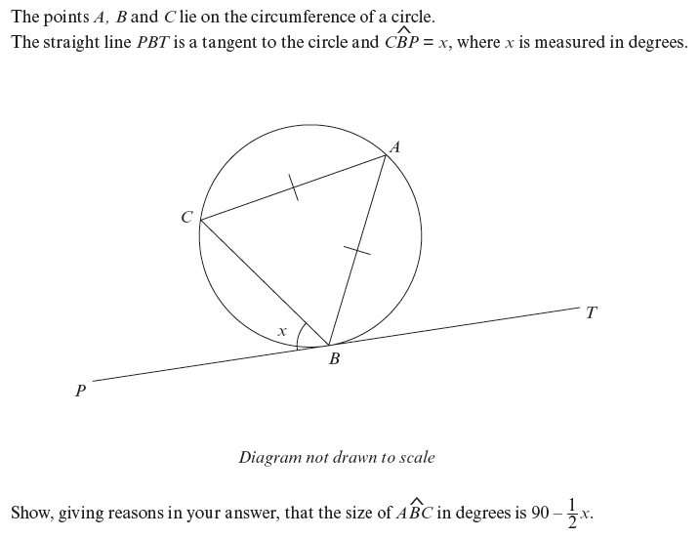
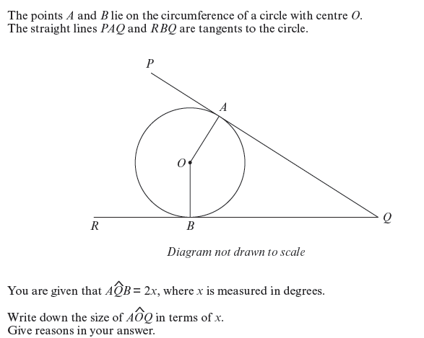
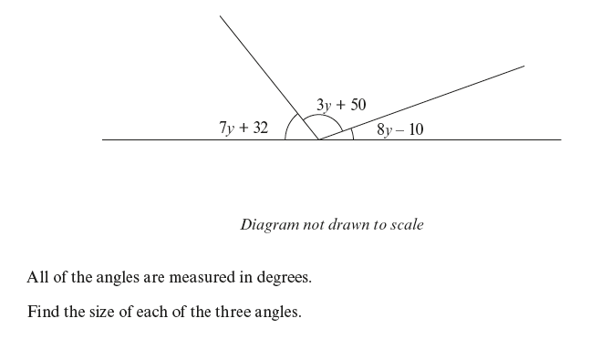
Notes:
Non Calculator Questions - Higher

Slide 6
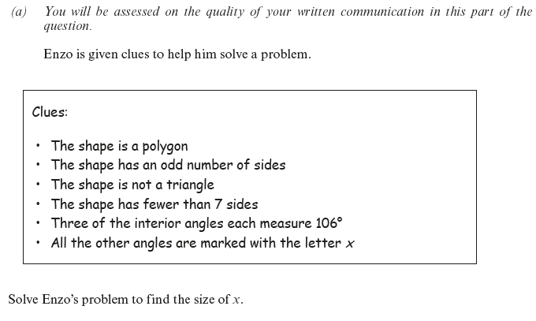
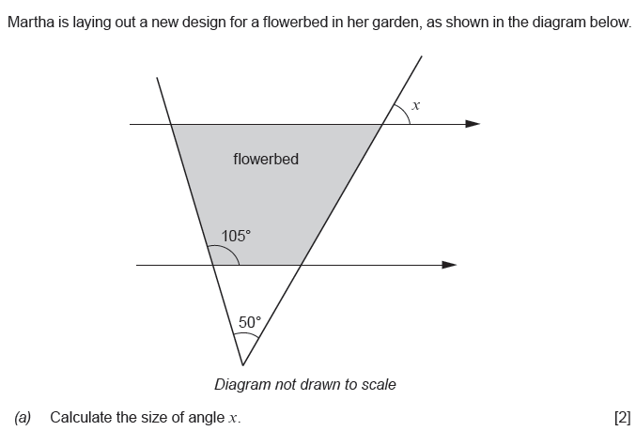
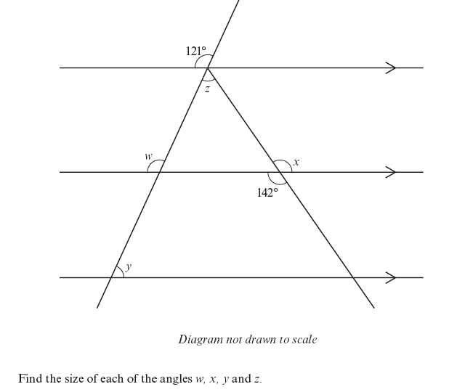
Notes:
Non Calculator Questions - Higher

Slide 7
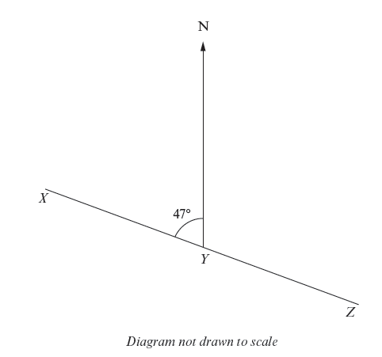
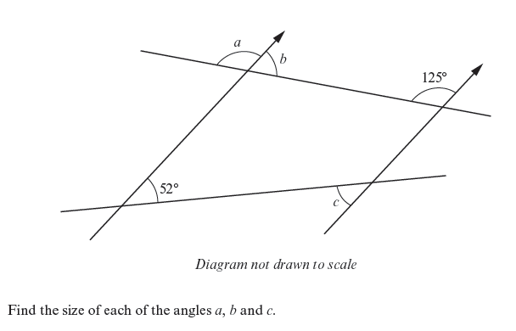
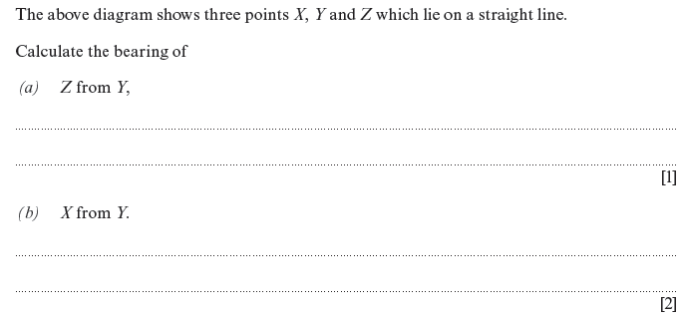
Notes:
Non Calculator Questions - Higher

Slide 8
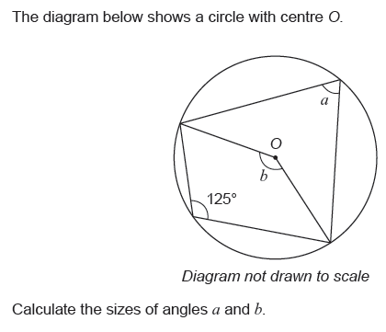
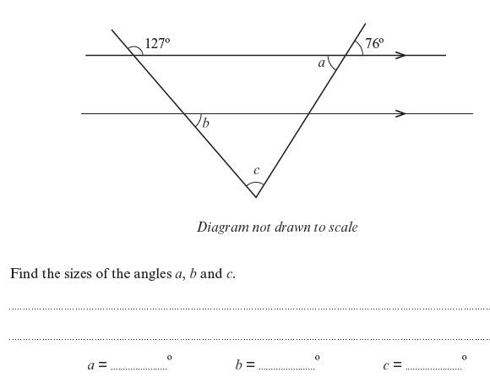
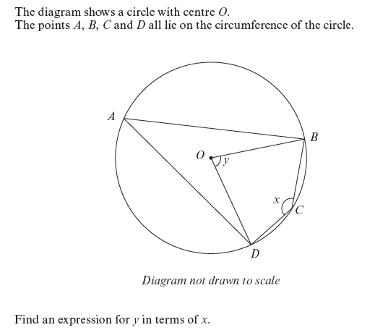
Notes:
Calculator Questions - higher

Slide 9
Notes:
Calculator Questions - higher

Slide 10
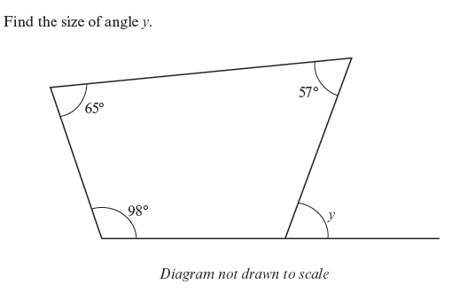
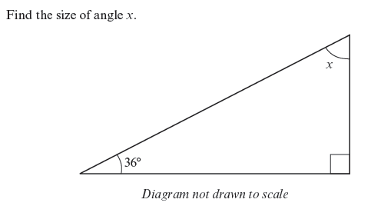
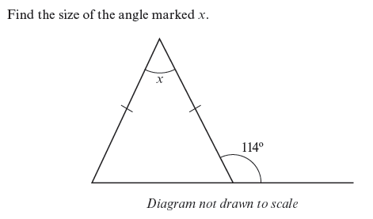
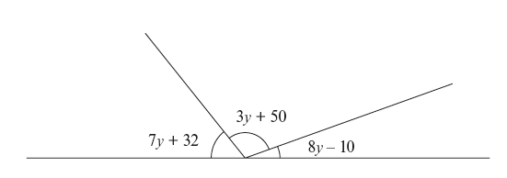
Notes:
Non Calculator - foundation

Slide 11
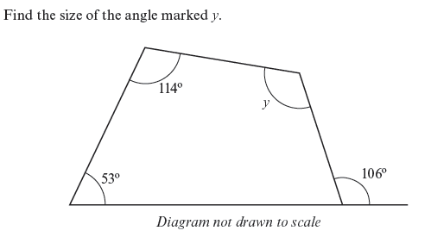
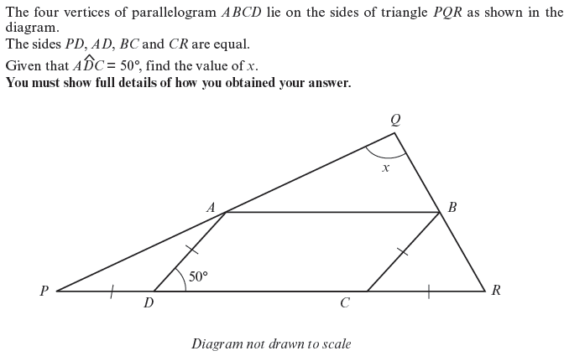
Notes:
Non Calculator - foundation

Slide 12
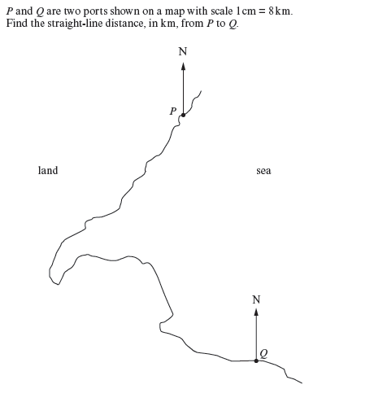
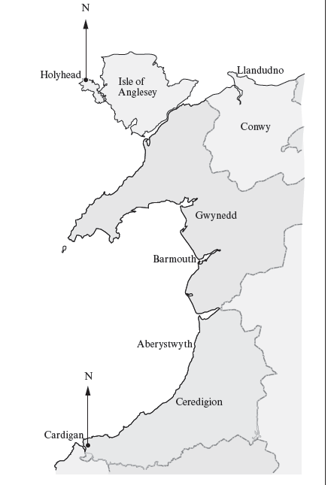
Notes:
Calculator Questions – Foundation

Slide 13
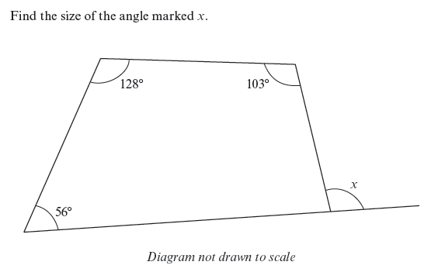
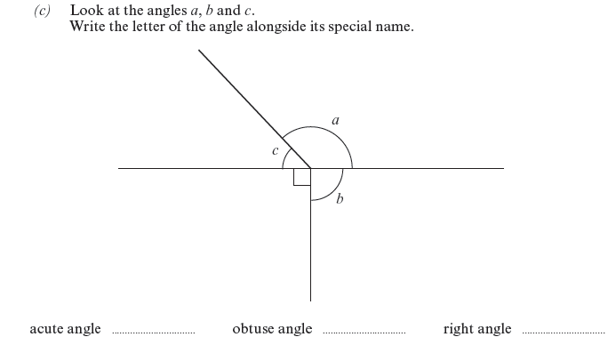
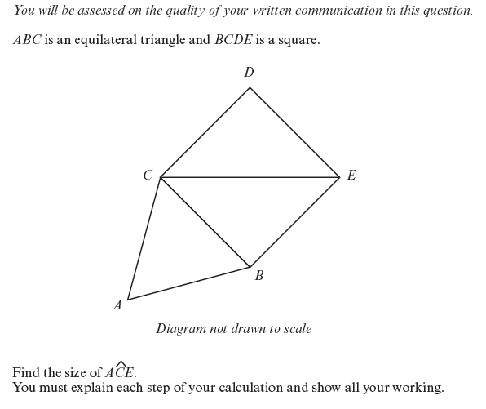
Notes:
Calculator Questions – Foundation

